Slide 1
Catching the SE
Notes:
Good afternoon, welcome to
A Proven Methodology for Open-Source Intelligence Gathering and Social Engineering. We are excited to present here at the first ever SE-RI/Layer8!

Slide 2
whoami - Robert Stewart
Security Consultant for Rapid7
7+ years in the infosec community
Soft spot for SE, OSINT, and Physical Security
Twitter: @RizzyRong
Notes:
Security Consultant @ R7,
I have over 12 years of experience in IT, with the last 7ish year being focused on Security in some form or another.
I’ve conducted countless Phishing engagements for many different sizes of companies all with different goals and accomplishments.
My primary focus these days is in all forms of Social Engineering, but my favorite is Physical SE.

Slide 3
Overview
What is SE?
Phishing
Physical SE
Solutions
Notes:
Here’s an overview of what to expect for today’s talk:
OSINT Methodology for ESE
Results: What Works, What Doesn’t Work
Tips and Tricks
Finally, we will be releasing some Free Templates!
Fun fact, I calculated earlier that 32% of our slides contain Steve Buscemi

Slide 4
Storytime!
Catching Phish
Notes:
I want to start with a story.
A few months ago, I was conducting a phishing pentest for a large healthcare client. It went really well, my colleague and I were able to show some ways to bypass their security appliances, etc.
At the end of the engagement, my client asked for certain statistics such as # of emails opened and who opened them. Realized client wanted data to integrate results with their internal phishing awareness program campaigns.
On one side, we had the client assuming that this data was part of phishing because that’s how they do it.
On the other side, I’m doing a pentest, so although I do get some data, my main focus is to really show the different steps I took towards compromise.
This is why we need to get the right goals discussed before we start our engagement and collecting our data, in this situation, we could’ve easily met halfway and looked at ways to obtain that data.

Slide 5
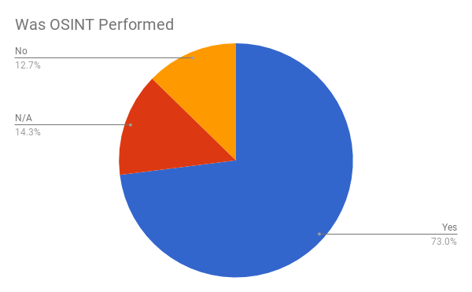
ESE Research Results
A Sampling of 60 Reports from 2015 - 2018
Data points?
Was OSINT Performed
Number of Emails Discovered
Number of Customer Provided
Type of Pretext
Logo/Signature in Pretext E-mail?
Creds Compromised

Slide 6
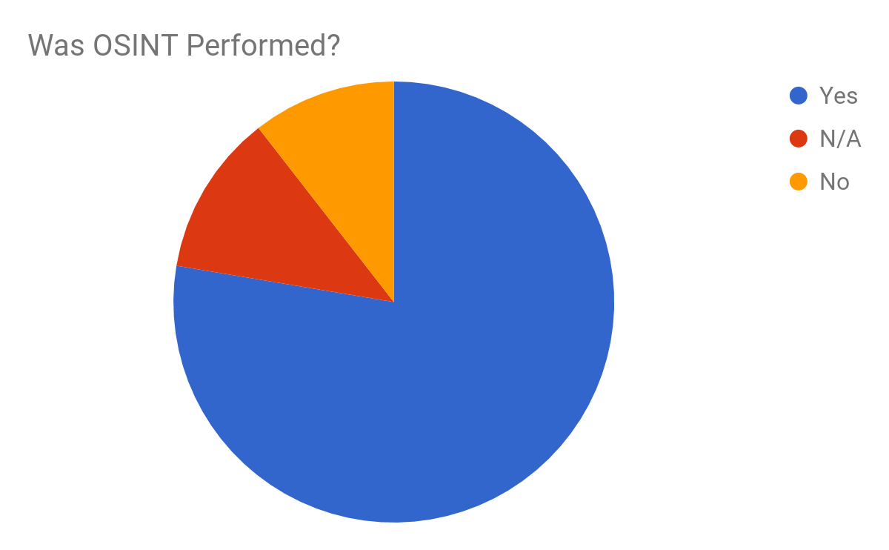
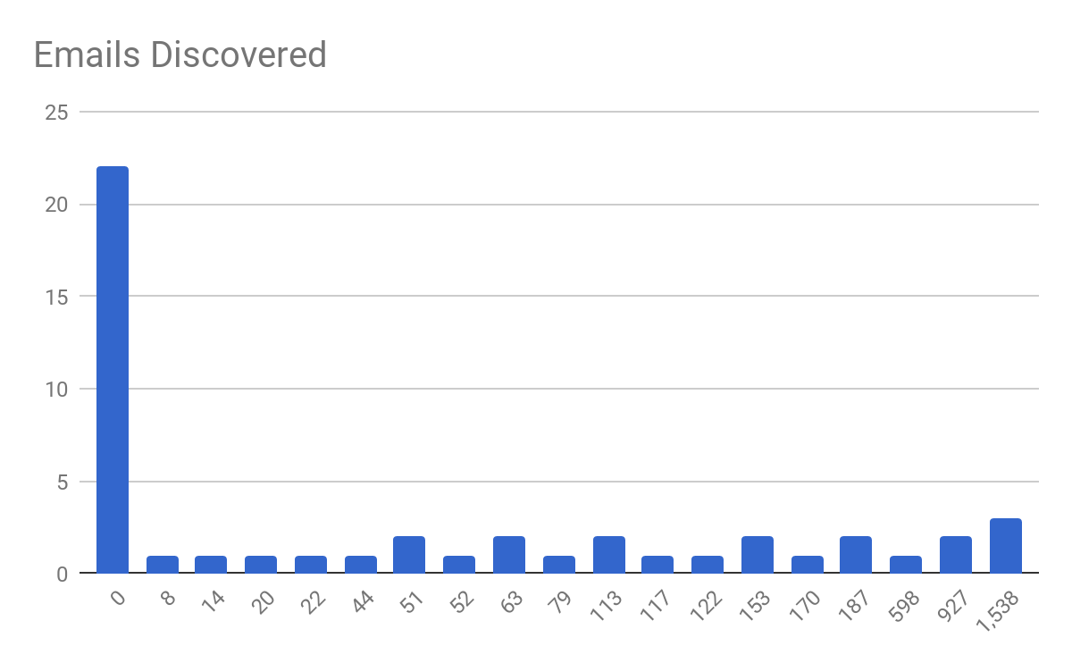
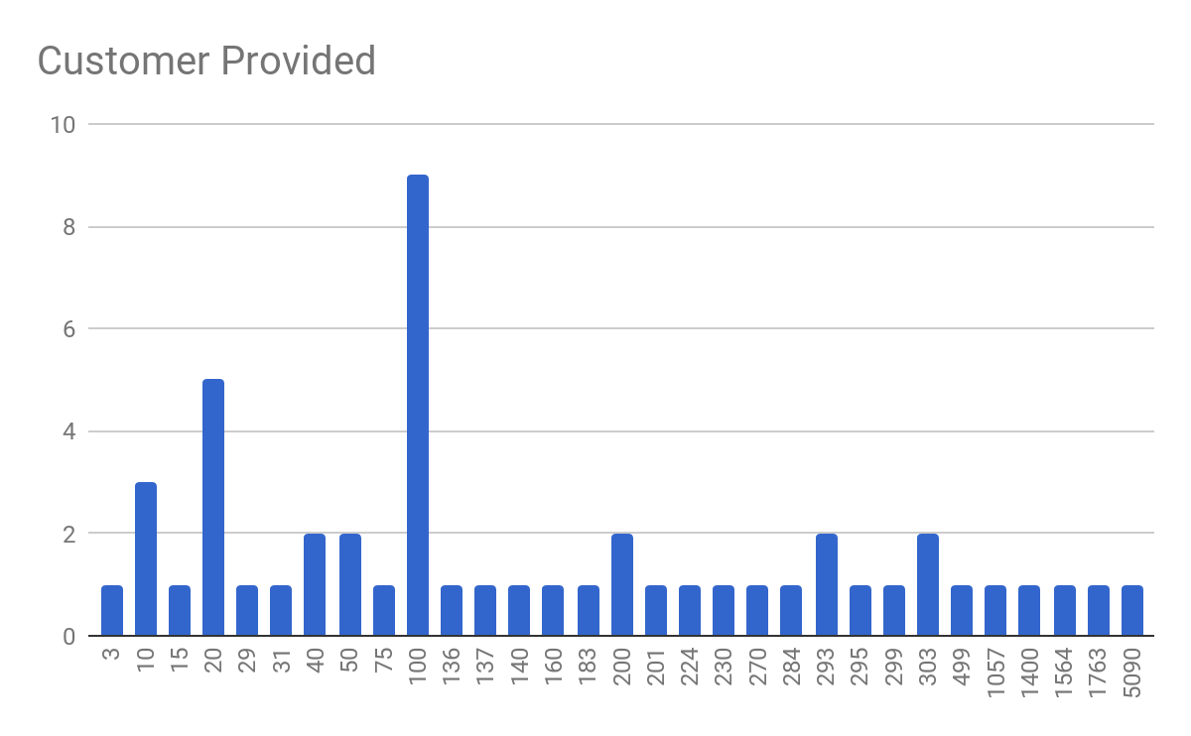
OSINT

Slide 7
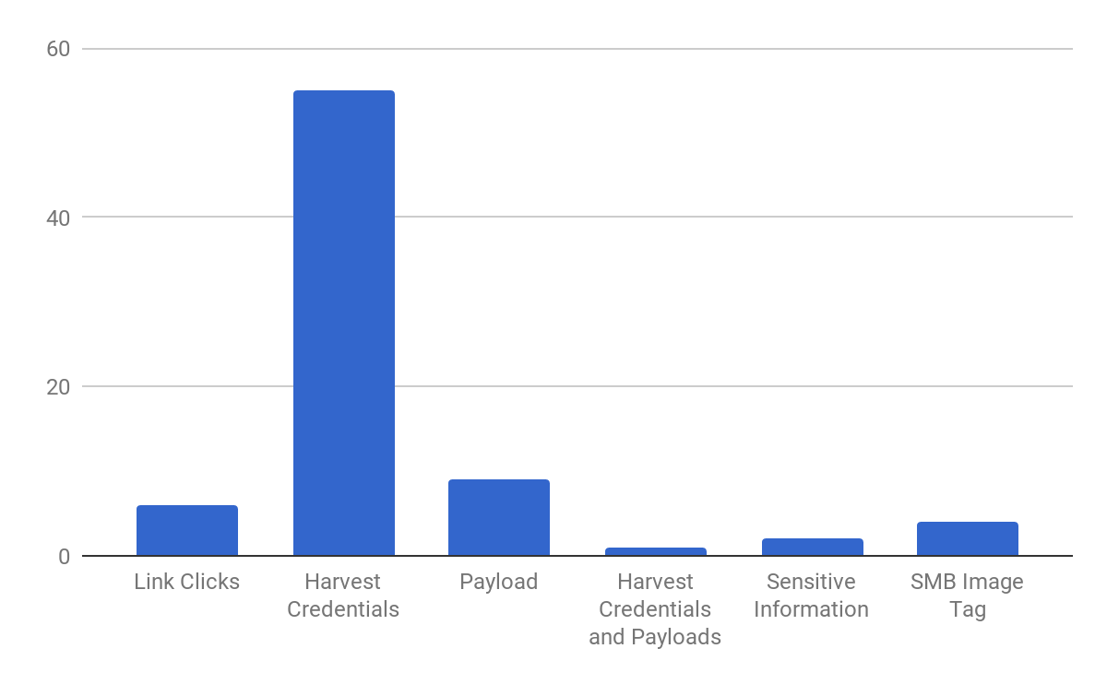
Types of Pretext

Slide 8
Let’s look at a Pretexts!
What Works
Targeted salutations
Using a domain similar to your target
Using categorized domains
Certificates
Customized signatures
What Doesn’t Work (most of the time)
Spoofing a domain that uses protections (IE SPF, DKIM and DMARC)
Overly-lengthy
Non-customized signatures
Notes:
In the next couple of slides I have two examples that we’ll look at that have positives and negatives.
Not going to say how well they worked during the testers engagements, but I want you to think how well would these have worked against your own company.

Slide 9
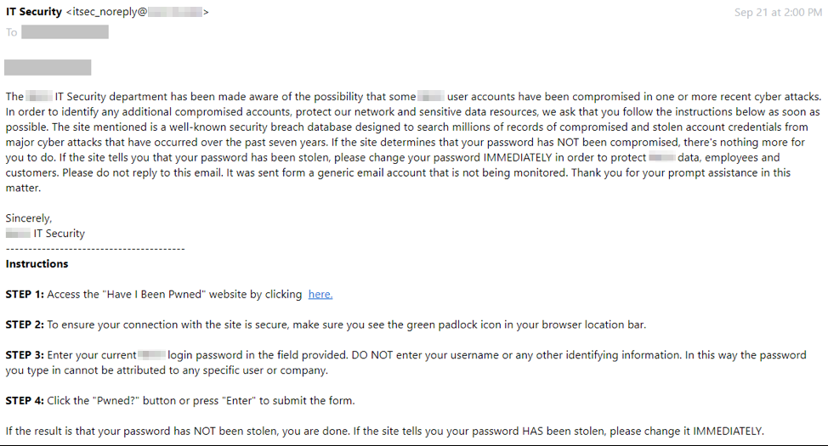
What Works? - (Harvesting Credentials)
Notes:
In this Phish we see that the tester is attempting to convince users to click on a link to validate their corporate password. To ensure if the were part of a recent “cyber attack”
What’s good about it?
Subject (the topic of the phish is frightening, encouraging the target to )
Incentive (the target has an incentive to validate their corporate password)
Time critical (the phish is proposed to be done “IMMEDIATELY”, even mentioning it 2x)

Slide 10
What Doesn’t Work? - (Harvesting Credentials)
Notes:
What’s bad about it?
Length (the phish is very lengthy and requires the target to read a lot, this could be a negative)
Signature (it’s brief and not customized for the target company)
The from address is itsec_NOREPLY (that could set off alarms for the target)

Slide 11
SMB IMG Tags to Harvest Creds!!
Include it on Phishing emails to capture creds,
Include it on Landing pages to capture creds,
Include it on Everything!!
Notes:
If you’re not already doing it, use SMB IMG Tags!
Metasploit
Responder
Multirelay
Just an smb server to capture the hashes.
Then crack them with hashcat.

Slide 12
Storytime!
Catching Entry
Notes:
I want to start with a story.
A few months ago, I was conducting a phishing pentest for a large healthcare client. It went really well, my colleague and I were able to show some ways to bypass their security appliances, etc.
At the end of the engagement, my client asked for certain statistics such as # of emails opened and who opened them. Realized client wanted data to integrate results with their internal phishing awareness program campaigns.
On one side, we had the client assuming that this data was part of phishing because that’s how they do it.
On the other side, I’m doing a pentest, so although I do get some data, my main focus is to really show the different steps I took towards compromise.
This is why we need to get the right goals discussed before we start our engagement and collecting our data, in this situation, we could’ve easily met halfway and looked at ways to obtain that data.

Slide 13
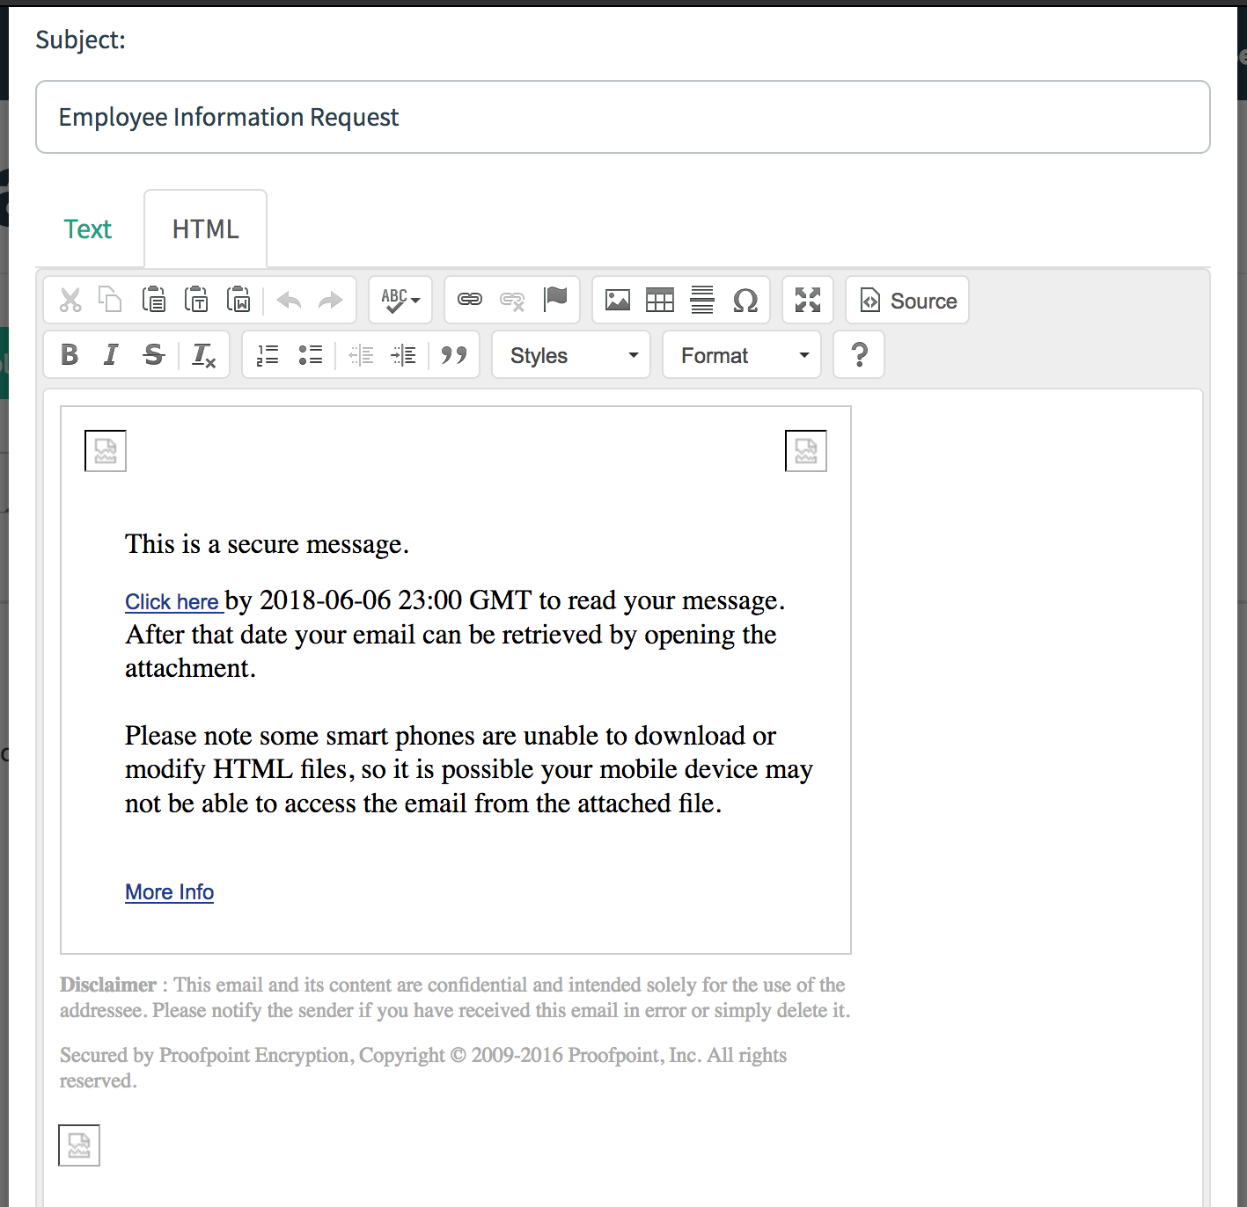
How could they have caught me?
Notes:
Setting and understanding our goals will not only shape how we approach doing our phishing engagements, but it also shapes how we perform Open Source INTelligence gathering and choose our pretexts.
Some good questions to ask are:
What are you looking to measure/test?
User behavior: Can your users tell when they’re being social engineered? Do they report suspicious incidents or e-mails?
Infiltration: Is it easy to bypass your target’s defenses? What steps can be taken to achieve that?
Detection: Does your team know when there’s a social engineering attempt happening? How?
What type of data are you or your client expecting?
Type of data:
Opened e-mails, link clicks, downloads, SE attempts reported, by whom, alerts from your e-mail security solution, etc.
Is this the first time, the n^{th} time?
If this is your first phishing engagement, you will likely want to start with a beginner-level phish. However, if this is your 25th or 100th engagement, then you’ll likely want something a bit more advanced.
I highly recommend the book Phishing Dark Waters by Chris Hadnagy and Michele Fincher, because they go over different levels of engagements from beginner phishing pretexts to more advanced ones, as well as a LOT of useful information to consider when setting up phishing engagements.
Will you be integrating an educational component?
Will users be notified immediately that they’ve been phished, or are you trying to stay under the radar because you’re focusing on testing your blue team’s response?
Will multiple pretexts be used during an engagement?
This is good to consider if for example you want a pretext which focuses on delivering a payload, vs. one which captured credentials.
There’s a lot to consider! Once we do have the answers to all of these questions, then we’re ready to take on OSINT.

Slide 14
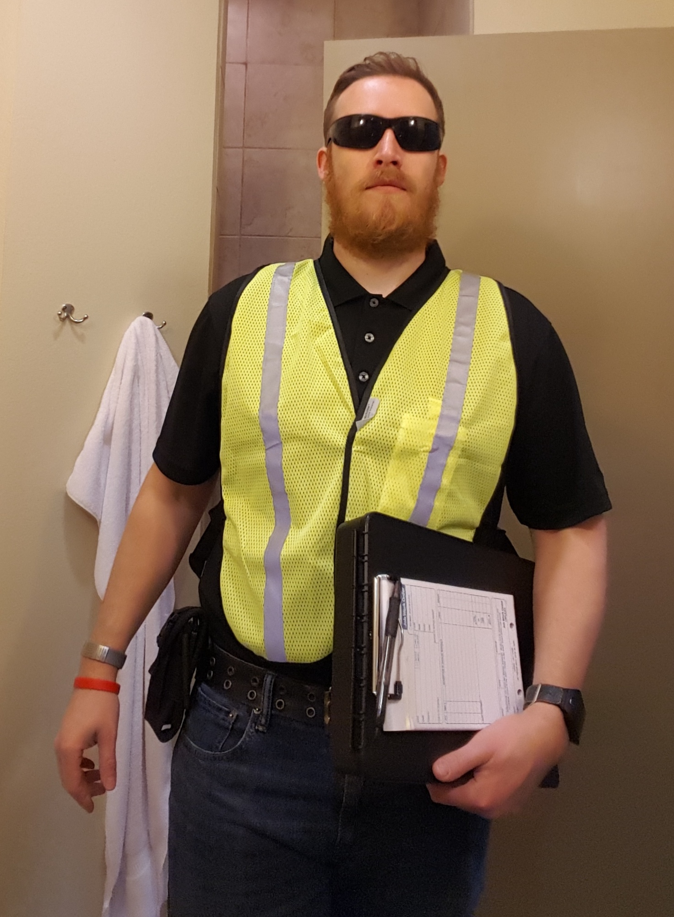
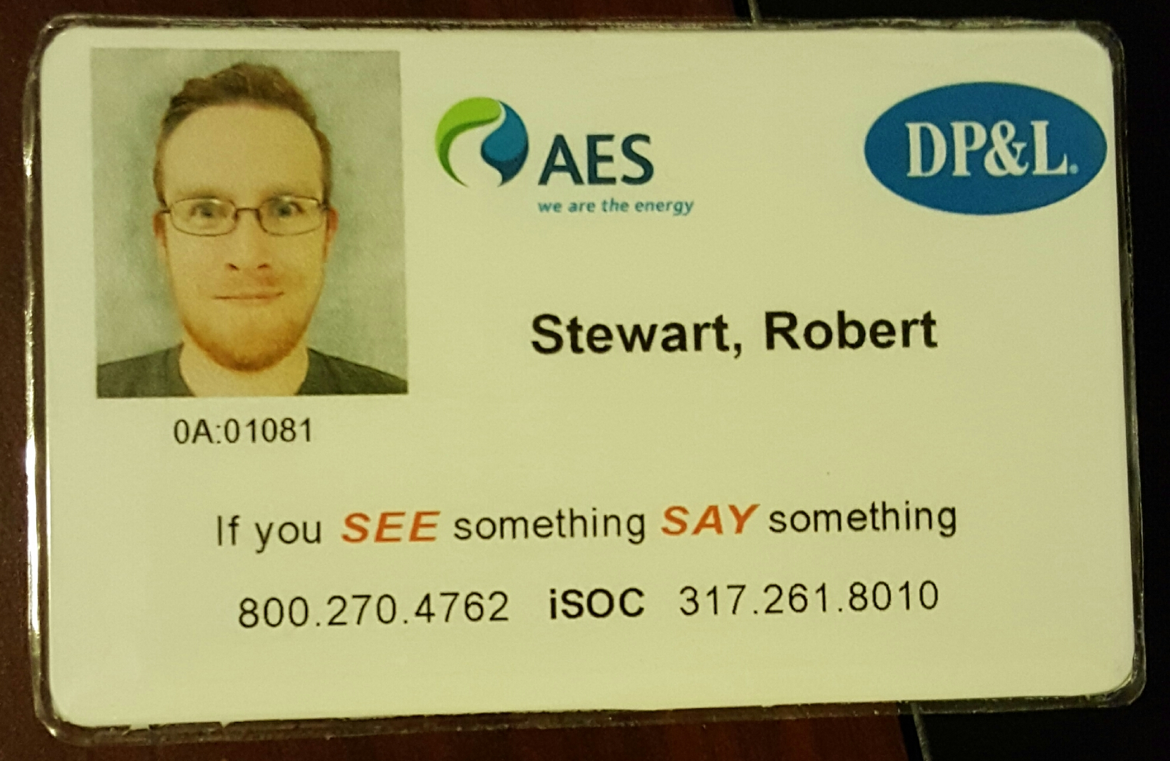
Master of Disguise

Slide 15
Questions?
Robert Stewart
Robert_Stewart@Rapid7.com
Twitter: @RizzyRong
Mad Props:
Émilie St-Pierre - Twitter: @L4bF0x
Free Pretexts: https://github.com/L4bF0x/PhishingPretexts
Slides: Slides: https://goo.gl/U6qiiy
Notes:
Contact info and link to GitHub Repo.

