Slide 1
DFIR Summit 2021
- Presentations
- Resources
- Tools
Dr. John W. Carls, CISSP, C|EH

Slide 2
Presentations
Keynote - Cobalt Strike Threat Hunting
A Holistic Approach to Defending Business Email Compromise Attacks
Breaches Be Crazy
Crossing the Threshold - Analysis of the Facebook Mini Portal
Exploring Windows Command-Line Obfuscation
Forensic Analysis of Xiaomi IoT Ecosystem
Order of Volatility in Modern Smartphone Forensics
The Cyber Kill Chain Meets Blockchain
UFOs - Unidentified Forenic Objects
Validating Evidence for Courtroom Testimony
Where Have UAL Been

Slide 3
Cobalt Strike Threat Hunting
Penetration testing and adversary emulation suite
Beacon is a stable platform for:
  Remote access • Exploit/payload deployment • Lateral movement
Memory Detection
Named Pipes
PowerShell Log Detection

Slide 4
A Holistic Approach to Defending Business Email Compromise (BEC) Attacks
Step 1 Investigation Kickoff
Step 2 Preparation Collection
Step 3 Forwarding Rules
Step 4 Login activity
Step 5 Permission changes
Step 6 OAuth 2 Abuse
Step 7 Evasion techniques
Step 8 Assess Data Accessed or Exfiltrated
Step 9 Threat Intelligence, Phishing Emails and Malware
Step 10 Recommendations

Slide 5
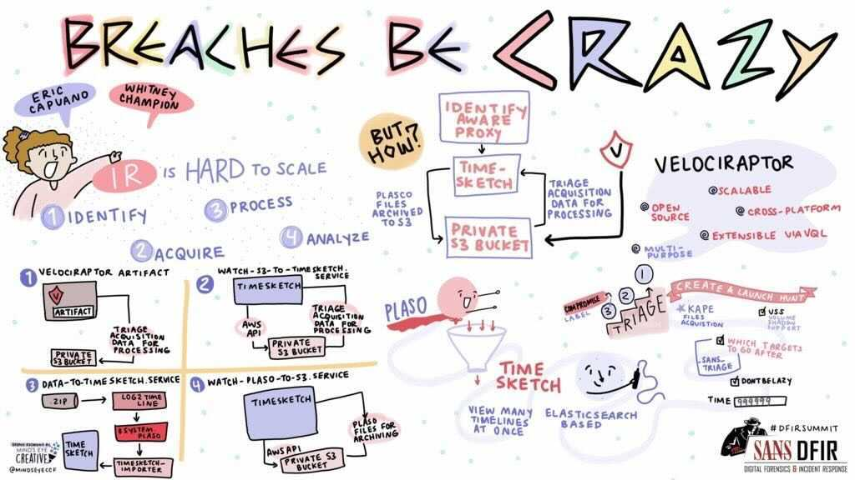
Breaches Be Crazy
Scaling Forensics Across Many Systems
IR is Hard to SCALE
  1. Identify compromised systems
    Without a SIEM? Good luck!
  2. Acquire forensics images
    Many+ hours
  3. Process forensic images
    Many+ hours *per* image
  4. Analyze forensic data
    One! system! at! a! time!
https://github.com/ReconInfoSec/velociraptor-to-timesketch

Slide 6
Crossing the Threshold - Analysis of the Facebook Mini Portal
Tested Portal & Apps
Found Hidden USB / Bluetooth Connection
Portal Mini Easter eggs can be found in Snapshots
Portal Mini Easter eggs can be found in Facebook messages
All kinds of Easter eggs present in Facebook data

Slide 7
Exploring Windows Command-Line Obfuscation
Historically the only way for a user to interact with their Computers
  Nowadays “under the hood”
Opportunities to bypass detection/prevention mechanisms
Replace the option char with another one
Instead of looking for a process/command
  Look for the file/registry/network events that follow
Even without command line obfuscation, we know command lines can be spoofed

Slide 8
Forensic Analysis of Xiaomi IoT Ecosystem
Introduction
  One of the world’s biggest manufacturers (smartphones and IoT)
Equipment and Setup
Evidence Extraction
Forensic Analysis
Findings and Points of Consideration
  The forensic analysis of Mi Home application can provide information about:
  Smarthome’s structure (Rooms, IoT devices present, etc.)
  Smarthome’s Automation system (Scenes’ configuration, logs, etc.)
  Smarthome’s devices’ logs or/and settings
  Owner’s personal information
Conclusion

Slide 9
Order of Volatility in Modern Smartphone Forensics
RFC 3227 – February 2002
When collecting evidence you should proceed from the volatile to the less volatile
Example order of volatility for a typical system
  registers, cache
  routing table, arp cache, process table, kernel statistics, memory
  temporary file systems
  disk
  remote logging and monitoring data that is relevant to the system in question
  physical configuration, network topology
  archival media
DUMPSYS is a tool that runs on Android devices and provides information about system services
  https://developer.android.com/studio/command line/dumpsys

Slide 10
The Cyber Kill Chain Meets Blockchain
Myth Busting
Why Blockchain for DFIR?
Case Studies
  Prevention
  Attribution Strategies
  Investigation + Disruption
Resources

Slide 11
UFOs - Unidentified Forenic Objects
Artifact Examiner

Slide 12
Validating Evidence for Courtroom Testimony
Six (6) Steps
Step 4: Validation
  Types:
    Visual
    Cross Tool
    Call Data Records
    CCTV
    Carving
    Replication
  Follow source file for artifact
  Explore relevant files
  Validate TimeStamps

Slide 13
Where Have UAL Been
Research/information about User Access Logging (UAL)
Demonstrate how to:
  Access UAL data
  Parse UAL data
Kstrike - UAL Data Parsing
  https://github.com/brimorlabs/KStrike
Eric Zimmerman’s “SumECmd”
  https://github.com/EricZimmerman/Sum

Slide 14
Resources
DFIR 101 - Digital Forensics Essentials
Automating Google Workspace Incident Response
EZ Tools, KAPE, and How to Contribute to and Benefit from Open Source Contributions
Greppin Logs
Incident Response 9-Line
IR Playbooks
OCR’ing the Bitmap Cache Puzzle
SANS 2021 DFIR Survey Results
SANS Technology Institute Information Session
Stringlifier - An Open Source Tool for Random String Classification
Reporting for Digital Forensics
Scoring and Judging Artifacts in Autopsy

Slide 15
DFIR 101 - Digital Forensics Essentials
101.1 What is Digital Evidence?
  Digital evidence is simply information that is stored or transmitted in a digital format that may be of value to an investigation
101.2 What is Digital Investigation?
  The process of gathering and analyzing data, with the purpose of determining and reporting on any actions that were performed on that system, which may be relevant to the case
101.3 What is Digital Forensics?
  The process of identifying, preserving, analyzing and presenting digital evidence in a manner that is legally acceptable
101.4 How can Digital Forensics Help me?

Slide 16
Automating Google Workspace Incident Response
To increase IR capabilities in Google Workspace:
  Provide better view of log data
  Enrich log data for more context
https://github.com/megan201296/gsuite-dfir

Slide 17
EZ Tools, KAPE, and How to Contribute to and Benefit from Open Source Contributions
Forensic Tools and their ancillary files covered
  RECmd - Batch files
  SQLECmd - Maps
  EvtxECmd - Maps
  KAPE - Targets/Modules
Why should I care about this topic?
  Know what makes your tools tick to better speak to the magic that’s going on behind the scenes
  Know what’s going on behind the scenes to help make it BETTER for yourself and others
  Strongly consider helping to make the tools better because it very well could save someone’s life or help solve a case/engagement that doesn’t involve life or limb

Slide 18
Greppin Logs
Introductions and Guiding Principles
Forensics is Data Engineering and Data Science
Core Unix Command Line Tools
Processing Structured Data
Performance Upgrades
Lightgrep - https://github.com/strozfriedberg/lightgrep
  Lightgrep is a new regular expression engine, designed specifically for digital forensics
Scaling with AWS

Slide 19
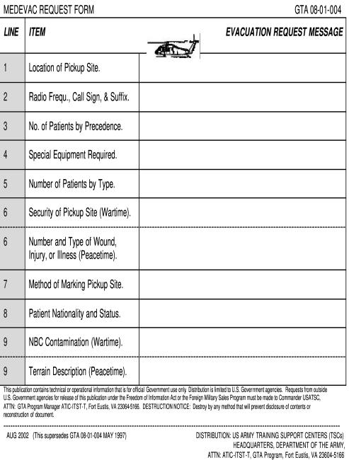
Incident Response 9-Line
Incident Response Challenges
  Various Teams: Security OPS, IR, Security Mgmt
  Logs roll over quickly and evidence at risk of destruction
  Stress of Incident creates comms gaps
Incident Response Questions
  What kind of incident? / How bad? / How many systems? / Are we blocking them?
Follow MEDEVAC 9-LINE
1. Date and Time of Detection 2. Reporting Person
3. Incident Type 4. Incident Severity
5. Number of Systems Impacted 6. Patient Zero Identified
7. Tactics Identified 8. Indicators of Compromise
9. Actions Taken

Slide 20
IR Playbooks
Background
Current Playbooks
Our Hybrid Format
Our Current Playbooks
How to Contribute
https://gitlab.com/syntax-ir/playbooks/

Slide 21
OCR’ing the Bitmap Cache Puzzle
WHAT IS IT?
  Small Cached images from RDP sessions
  Helps improve bandwidth of Remote Desktop sessions
WHAT DOES IT TELL ME?
  Provides snippets of visual information that can help confirm activity observed in other artifacts
  Programs open during RDP sessions
  Date / timestamps
  Files and folders accessed / viewed
  Can provide a small window into the perspective of the attacker
https://github.com/DFIR-Drew/OCR-Bitmap-Cache

Slide 22
SANS 2021 DFIR Survey Results

Slide 23
SANS Technology Institute Information Session
The SANS Technology Institute transforms the world’s best cybersecurity training and certifications into a comprehensive, rigorous, graduate and undergraduate education experiences
Academics
Degree Programs
  Certificate Program
  Bachelor’s Degree
  Master’s Degree
Student Resources

Slide 24
Stringlifier - An Open Source Tool for Random String Classification
How to simplify your data science life with one tool
Anomaly Detection
Engineering Solution: REGEX
https://github.com/adobe/stringlifier

Slide 25
Reporting for Digital Forensics
Introduction
The Importance of Reports
  Expect to be Cross-Examined
  Expert Witness Must Provide a Written Report
Guidelines for Writing
  Abstract (or summary)
  Table of Contents
  Body of Report
  Conclusion
  References
  Glossary
  Acknowledgements
  Appendixes
Generating Reports

Slide 26
Scoring and Judging Artifacts in Autopsy
Problem: Data Overload
  Cases involve an increasing number of devices
  Devices are getting bigger and bigger
  We’ve been talking about this for years…
  We need better solutions to deal with it
What is Autopsy?
  Open source digital forensics platform
  General purpose for all kinds of investigations
  Has been designed for:
    Ease of use
    Showing results ASAP
    Extensibility (many plug in frameworks)
    Has the features you need
  Free to download:
    http://www.autopsy.com

Slide 27




Tools
https://www.sans.org/tools/?&focus-area=digital-forensics

Slide 28

SIFT Workstation
Collection of free and open-source incident response and forensic tools
Designed to perform detailed digital forensic examinations in a variety of settings
Can match any current incident response and forensic tool suite
Demonstrates advanced incident response capabilities and deep-dive digital forensic techniques
Accomplished using cutting-edge open-source tools that are freely available and frequently updated
https://www.sans.org/tools/sift-workstation/

Slide 29

Eric Zimmerman’s Tools
Open source digital forensics tools used in a wide variety of investigations
Cross validation tools
  providing insight into technical details not exposed by other tools
Continually improve over a dozen digital forensics tools that investigators all over the world use and rely upon daily
See POSTER

Slide 30

SOF-ELK
“Big data analytics” platform focused on the typical needs of computer forensic investigators/analysts and information security operations personnel
Customized build of the open source Elastic stack
Initially developed for SANS FOR572: Advanced Network Forensics and Analysis
https://www.sans.org/tools/sof-elk/

Slide 31

REM.NUX
REMnux® is a Linux toolkit for reverse-engineering and analyzing malicious software
REMnux provides a curated collection of free tools created by the community
Analysts can use it to investigate malware without having to find, install, and configure the tools
REMnux toolkit also offers Docker images of popular malware analysis tools
  Run tools as containers without having to install them directly on the system
Run the REMnux distro as a container
https://www.sans.org/tools/remnux/
https://remnux.org/

