Slide 1
Hybrid image-based approaches for modern malware classification
Ohio InfoSec Forum Anniversary Conference
July 9, 2022
Phu H. Phung
Intelligent Systems Security Research Lab (ISSecLab) https://isseclab-udayton.github.io

Slide 2
Overview of malware classification and detection
Traditional anti-virus software
Based on signatures/patterns comparison from known malware samples
Most modern malware can bypass it
Machine-learning based approaches
Based on supervised learning:
A large scale dataset with labels, i.e., benign or malicious
An algorithm/model to assess for correlations
Image source: https://semiengineering.com/deep-learning-spreads/

Slide 3
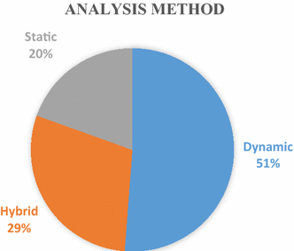
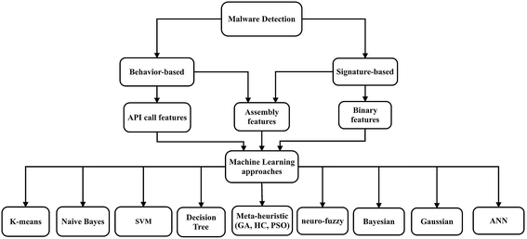
Machine learning-based malware classification – An Overview
Based on extracted features/labels from programs
Using static and/or dynamic approaches
Source: Souri, A., Hosseini, R. A state-of-the-art survey of malware detection approaches using data mining techniques. Hum. Cent. Comput. Inf. Sci. 8, 3 (2018). https://doi.org/10.1186/s13673-018-0125-x

Slide 4
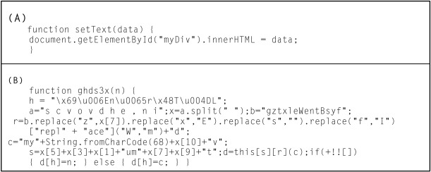
Machine learning-based malware classification-Challenges
Depending on the data mining techniques and tools to extract features
Depending heavily on the domain knowledge of malware internals to revise and disambiguate intermediate results
Modern malware employs obfuscation, packing, encrypting, and other evading techniques
Create a new variant of the same malware family that can hide malicious activities to bypass analysis and detection tools
Image source: https://www.sciencedirect.com/topics/computer-science/obfuscation-code

Slide 5
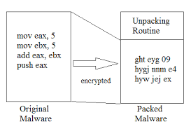
Malware evading techniques
Example: code obfuscation/packing
Can bypass traditional anti-virus software or even machine-learning based classifiers
Image source: https://dergipark.org.tr/en/download/article-file/2160186
Image source: https://www.socinvestigation.com/most-common-malware-obfuscation-techniques/

Slide 6
Our Research Motivation - Can we?
Propose a malware analysis method that overcomes the mentioned challenges, yet
Provide useful features for machine learning
Does not rely on security experts
Can still capture the malicious activities regardless evading techniques
Image source: https://www.securitymagazine.com/articles/96224-915-of-malware-arrived-over-encrypted-connections

Slide 7
Agenda
Hybrid image transformation for Binary malware
Vu, D. L., Nguyen, T. K., Nguyen, T. V., Nguyen, T. N., Massacci, F., & Phung, P. H. (2020). HIT4Mal: Hybrid image transformation for malware classification. Transactions on Emerging Telecommunications Technologies, 31(11), e3789. Online: https://onlinelibrary.wiley.com/doi/10.1002/ett.3789
Image-Behavior-based Approach for Java bytecode malware
Obaidat, I., Sridhar, M., Pham, K.M. , Phung, P.H. (2021). Jadeite: A Novel Image-Behavior-based Approach for Java Malware Detection using Deep Learning. Computers & Security, 102547. Online: https://doi.org/10.1016/j.cose.2021.102547
On-going and future work on machine learning-based malware analysis

Slide 8
HIT4Mal: Hybrid image transformation for malware classification
We propose a hybrid image transformation (HIT) method from binary executables
Integrating two of the best-combined image transformation methods with some parameters fine-tuning
Capturing the features of malware by highlighting different file sections, headers, or imports in an image using the entropy and character-based techniques
carries the semantic information of the binary encoded in the image's channels

Slide 9
The novelty of HIT4Mal
We generate a color image that carries the semantic information of the binary encoded in the image's channels.
Can solve the problems of obfuscations and packing techniques
Different malware variants are also captured
According to a recent study, if malware variants are created from the same original binary, its image retains the global structure

Slide 10
HIT-transformed samples
Benign
Malicious

Slide 11
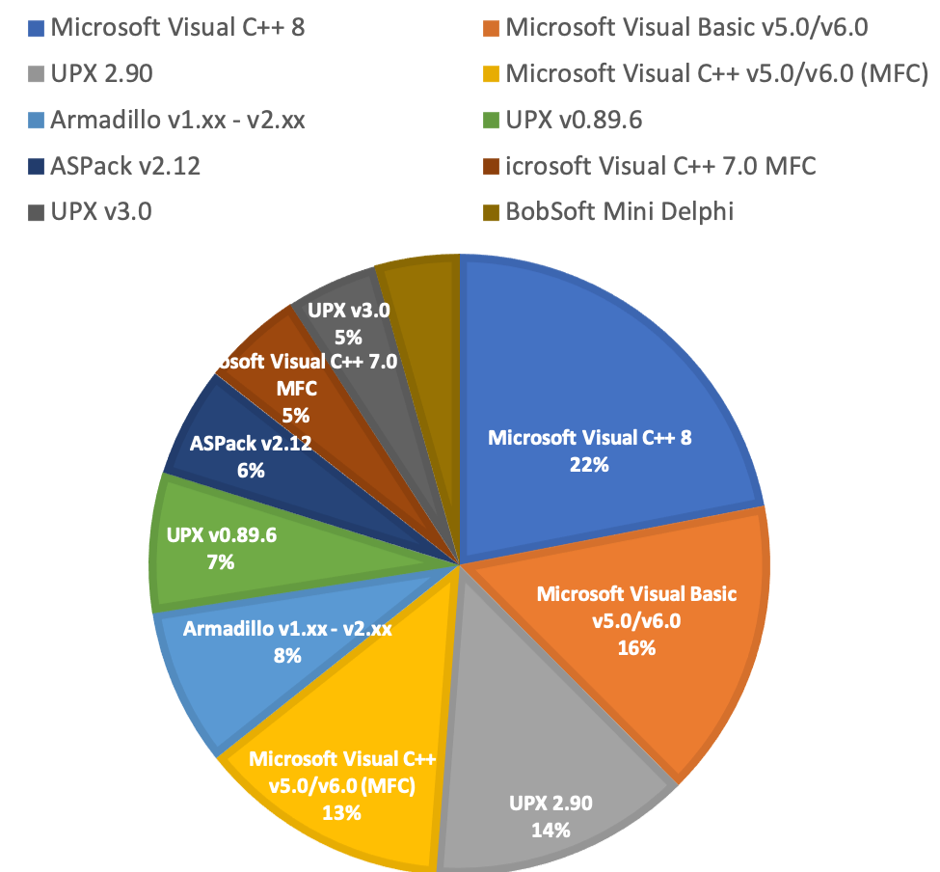
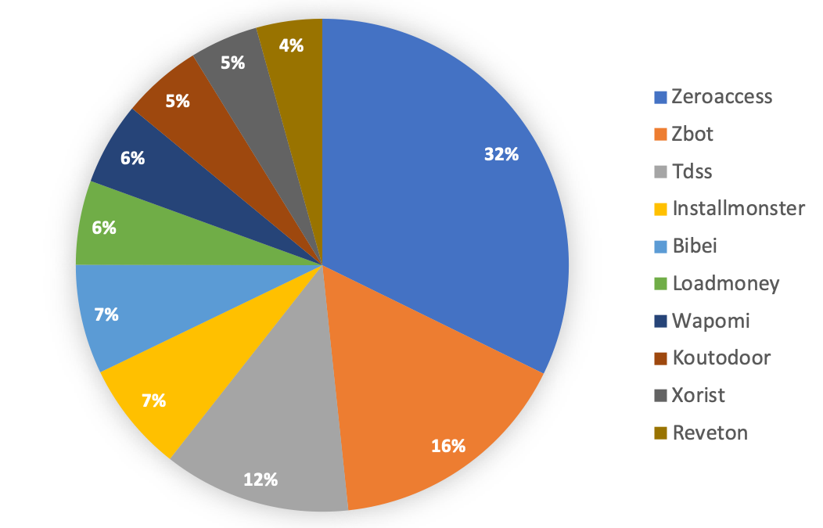
The dataset
16000 PE format samples
Top ten malware families in the collected dataset from VirusShare corpus
Top ten obfuscation techniques found in our dataset
The dataset and source code are available publicly: https://github.com/isseclab-udayton/hit4mal/

Slide 12
HIT4Mal Experimental Results Prototype and dataset are on GitHub: https://github.com/isseclab-udayton/hit4mal
convolutional neural networks (CNN) Classifier
XGBoost classifier
Convolutional neural networks (CNN) Classifier

Slide 13
HIT4Mal possible future work
Investigating intensively the performance of the approach on machine learning algorithms that should be more robust against attacks to the learning system itself
Different types of datasets, e.g., Mac, Windows, Linux, Android
Apply image segmentation for the malware segmentation
to highlight the malicious parts in the malware
Augmenting our training data by expanding other file formats or using generative adversarial network for data synthesis

Slide 14
Agenda
Hybrid image transformation for Binary malware
Vu, D. L., Nguyen, T. K., Nguyen, T. V., Nguyen, T. N., Massacci, F., & Phung, P. H. (2020). HIT4Mal: Hybrid image transformation for malware classification. Transactions on Emerging Telecommunications Technologies, 31(11), e3789. Online: https://onlinelibrary.wiley.com/doi/10.1002/ett.3789
Image-Behavior-based Approach for Java bytecode malware
Obaidat, I., Sridhar, M., Pham, K.M. , Phung, P.H. (2021). Jadeite: A Novel Image-Behavior-based Approach for Java Malware Detection using Deep Learning. Computers & Security, 102547. Online: https://doi.org/10.1016/j.cose.2021.102547
On-going and future work on machine learning-based malware analysis

Slide 15
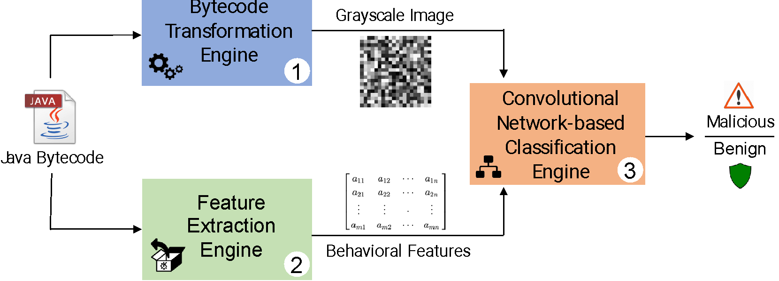
Jadeite: A Novel Image-Behavior-based Approach for Java Malware
(1) We extract the Interprocedural Control Flow Graph (ICFG) from a given Java bytecode file, prune and convert it into an adjacency matrix -> a grayscale image
(2) Additional set of features from the Java malware program are added to improve the accuracy of malware classification

Slide 16
Bytecode Transformation Engine
Captures the order of execution for all instructions in a program and create a directed Inter-Procedural Control Flow Graph (ICFG)
the nodes represent a sequence of all program instructions,
the edges between these nodes represent the execution order between these nodes

Slide 17
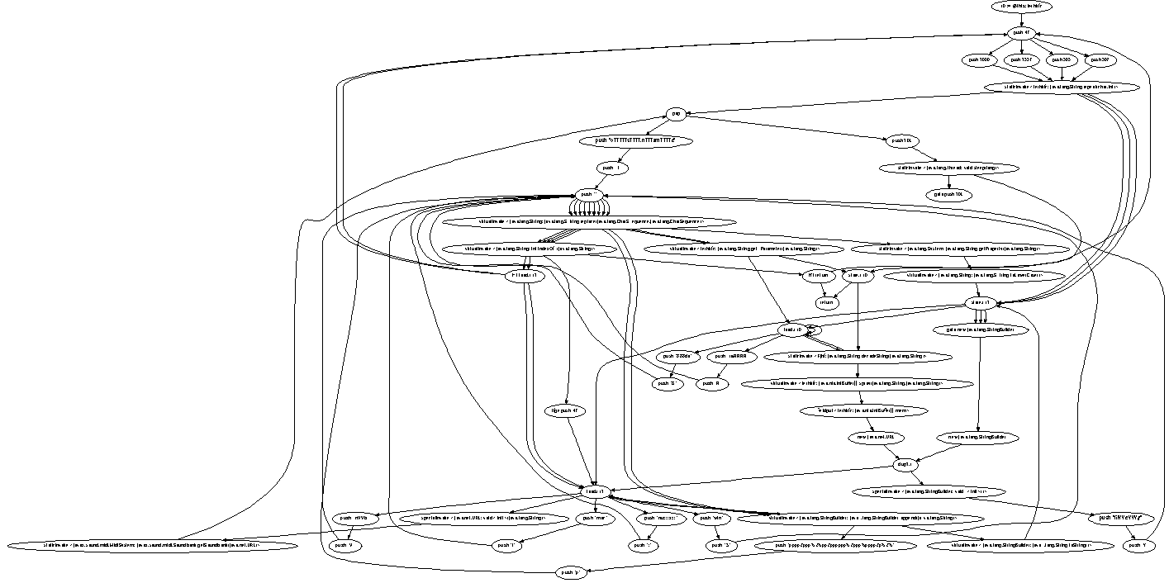
An example of Interprocedural Control Flow Graph (ICFG)

Slide 18
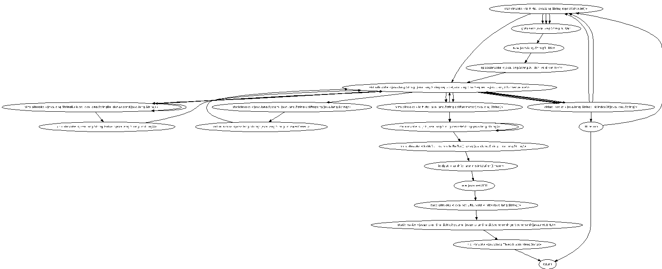
A Pruned ICFG Example

Slide 19
Feature Extraction Engine
We extracts a set of obfuscation and behavioral features from the disassembled Java code
Known Vulnerable Functions: the existence of vulnerable functions
“Download and Execute”: built-in functions to download and execute external files

Slide 20
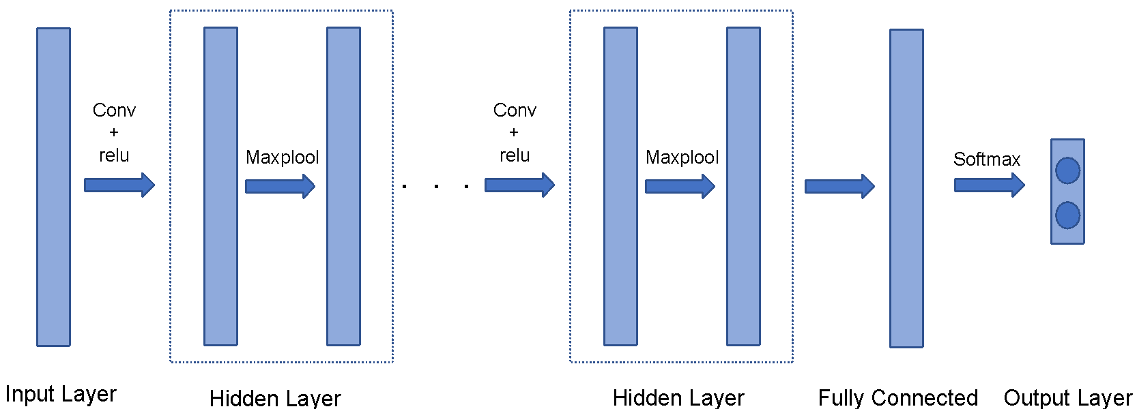
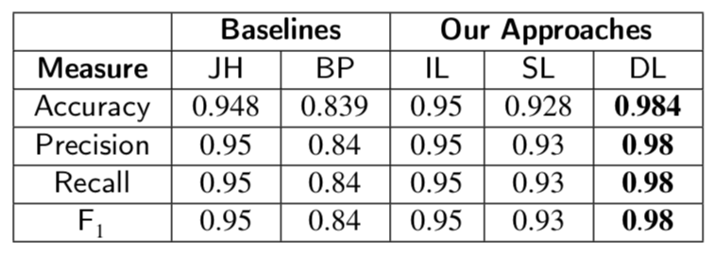
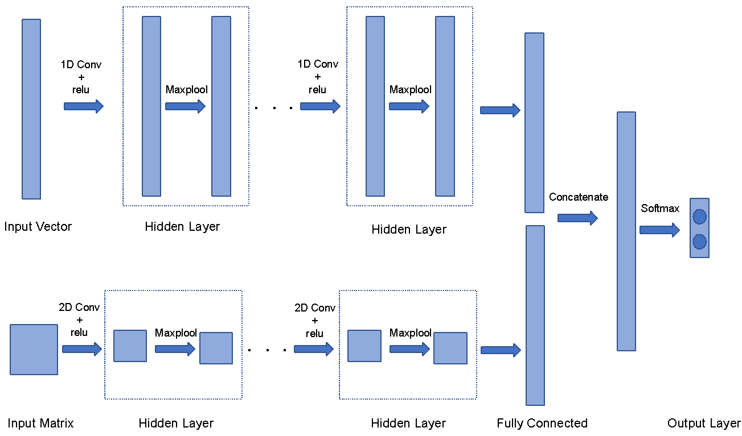
Experimental Results
We have 4000 samples of Jar files after cleaning
We run our methods and train with a Convolutional Neural Network-based Classifier with three hyperparameters – Image Load | Single Load | Double Load
Basic CNN structure
Double load CNN structure
Source code and dataset: https://github.com/sridhar-research-lab/jadeite

Slide 21
Agenda
Hybrid image transformation for Binary malware
Vu, D. L., Nguyen, T. K., Nguyen, T. V., Nguyen, T. N., Massacci, F., & Phung, P. H. (2020). HIT4Mal: Hybrid image transformation for malware classification. Transactions on Emerging Telecommunications Technologies, 31(11), e3789. Online: https://onlinelibrary.wiley.com/doi/10.1002/ett.3789
Image-Behavior-based Approach for Java bytecode malware
Obaidat, I., Sridhar, M., Pham, K.M. , Phung, P.H. (2021). Jadeite: A Novel Image-Behavior-based Approach for Java Malware Detection using Deep Learning. Computers & Security, 102547. Online: https://doi.org/10.1016/j.cose.2021.102547
On-going and future work on machine learning-based malware analysis

Slide 22
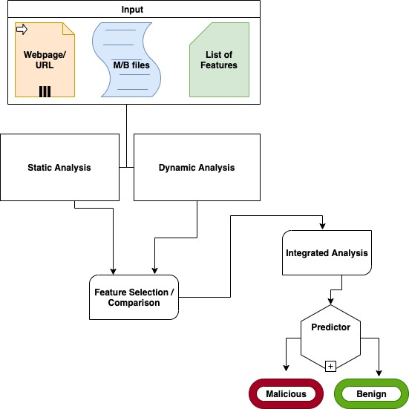
Malicious Webpages Detection
Hiremath, P. N. (2021). A Novel Approach for Analyzing and Classifying Malicious Web Pages [Master's thesis, University of Dayton, Advisor: Phung, P.H. ]. Online: http://rave.ohiolink.edu/etdc/view?acc_num=dayton1620393519333858
We combine static and dynamic analysis methods to extract JavaScript features
To classify the maliciousness of web pages

Slide 23
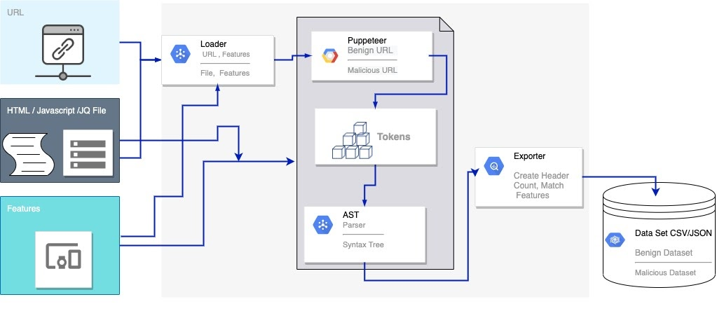
Our static analysis method
Based on AST (Abstract Syntax Tree):
Representation of the abstract syntactic structure of source code

Slide 24
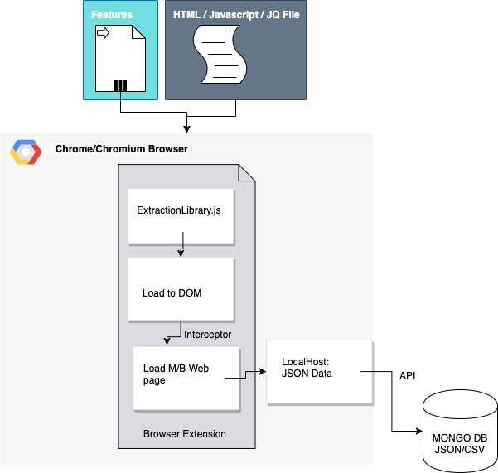
Our dynamic analysis method
Based on a runtime monitor, can be integrated within a browser
Currently implemented as a browser extension
The browser extension is based on our previous work MyWebGuard [FDSE’19, SNCS’20]
https://doi.org/10.1007/s42979-020-00237-5

Slide 25
Current experimental results
64 features from a dataset based on the static analysis experiments
Benign: 11,109
Malicious: 11,148
Limited dataset from the dynamic analysis due to security issue with UD networks
We seek for collaboration on this !!!
Sl.No | Classifier | Accuracy (%)
1 | Linear Model | 93.03
2 | K Nearest Neighbor Model | 97.14
3 | Naive Bayes | 74.16
4 | Decision Tree | 97.87
5 | Random Forest | 97.26
6 | Support Vector Machine | 71.20
7 | MLPN Model | 88.79
8 | LSTM Model | 73.54

Slide 26
A Brief Introduction to
and
Intelligent Systems Security Research Lab (ISSecLab) https://isseclab-udayton.github.io

Slide 27
UD’s Computer Science Department became one of the first computer science undergraduate programs in the nation in 1961: https://udayton.edu/artssciences/academics/computerscience/index.php
Majors: Computer Science (CPS) and Computer Information Systems (CIS)
Concentrations: AI and Data Science, Cyber Defense, Software Engineering
Minors for non-major students: AI and Data Science and Computer Science
Bachelor's Plus Master's Program (BPM), students can usually complete a master's within a year of finishing their bachelor's. Graduate assistantship positions available where students can get tuition remission and a stipend.
The Computer Science degree is accredited by ABET (Accreditation Board for Engineering and Technology, Inc.), meaning our program meets the standards that prepare our graduates to enter the critical fields of applied science and computing.
Our Cyber Defense Concentration (1st certificate issued in 2019) is recognized by the National Security Agency as a National Center of Academic Excellence in Cyber Defense.

Slide 28
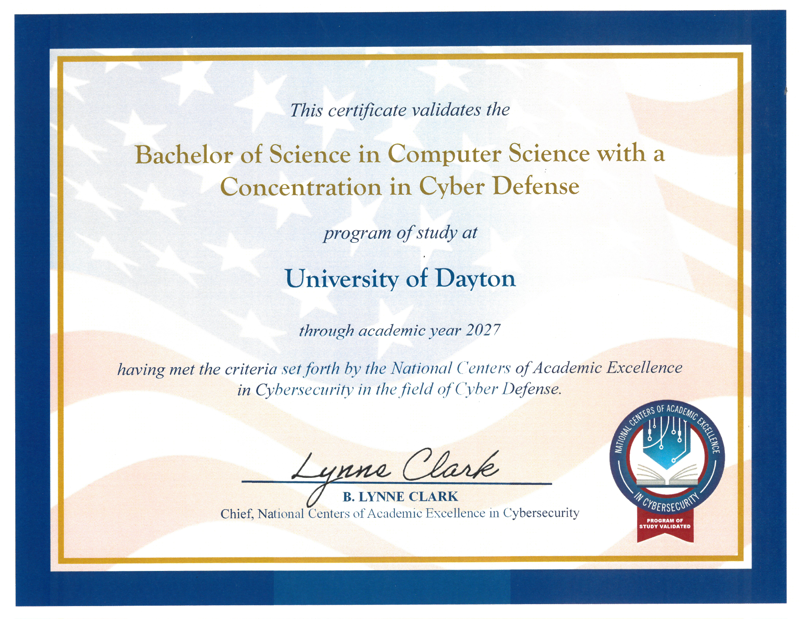
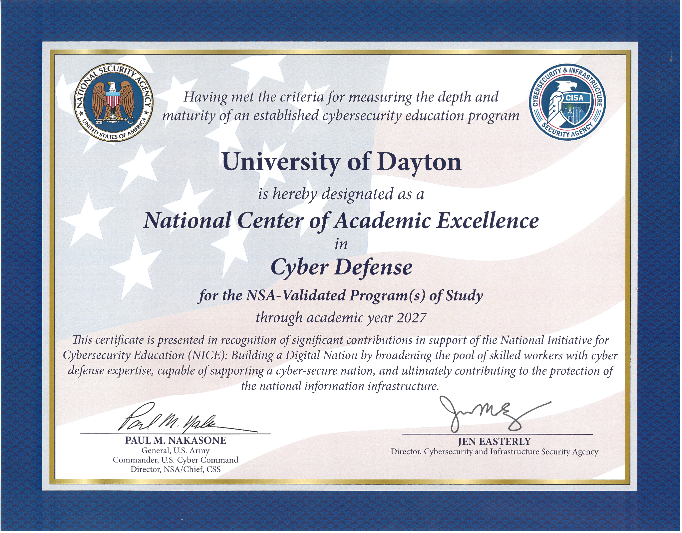
UD’s Cyber Defense Concentration

Slide 29
Graduate programs:
Master of Computer Science (~550 + ~150 students)
Graduate Certificate in Autonomous Systems
Doctor of Philosophy (Ph.D.) in Computer Science

Slide 30
Brief Introduction to the Intelligent Systems Security Lab https://isseclab-udayton.github.io
Founded in 2015, and directed by Dr. Phu Phung, Associate Professor, Department of Computer Science, University of Dayton
Funded grants
(PI) Ohio Third Frontier/ODHE, $50,000 (July 2022 - June 2023). Load-and-Play Interactive Cyber Security Labs for the Ohio Cyber Range.
(Co-PI ) National Science Foundation (NSF), $248,338 (August 2020 - July 2022). EAGER: Crowd-AI Sensing Based Traffic Analysis for Ho Chi Minh City Planning Simulation.
(Sole-PI) Novobi LLC, $76,800 (January 2020--December 2021). Security Issues and Solutions for a Software-as-a-Service Product
Student research engagement
Four master theses successfully defended
8 graduate students (with internal and external grants)
10 undergraduate students (with internal grants)

Slide 31
ISSecLab’s Research Directions https://isseclab-udayton.github.io

Slide 32
Thank you!
Phu H. Phung
Intelligent Systems Security Research Lab (ISSecLab) https://isseclab-udayton.github.io
phu@udayton.edu
Department of Computer Science

