Slide 1
BONDS Robotics
FIRST Robotics Competition
Team 5811
Notes:
reah

Slide 2
BONDS Overview
Bringing
Opportunities
Near
Dayton
Students
Our Mission: to bring STEM opportunities to students in our community
Participate in FIRST Robotics Competition (FRC)
8th year competing
BONDS is run like a small business
Currently 20 students from 10 schools in the Dayton area
Student captains lead & direct the team
Practice @ K12 art gallery in downtown Dayton
Notes:
nicole

Slide 3
Competition Season
FIRST Robotics Competition (FRC)
We work together to build a robot that competes in a sport-like challenge against other teams from around the country
First 10 weeks of the year, 5 days a week
One week to strategize, then split into subteams
build, programming, electrical, marketing, etc
We participate in 1-2 competitions per year
BONDS went to World Championships in 2016 & 2019 and we are hoping to go back this year!
Notes:
nicole

Slide 4
https://youtu.be/sFr33sZBRMA?si=LYeZDLTRoaH87FPq
Notes:
reah

Slide 5
Accomplishments
2016 - Rookie All-Star, competed at Worlds, WPAFB Award for FLL Support
2017 - WPAFB Award for FLL Support
2018 - Entrepreneurship Award, Imagery Award, Regional Finalist
2019 - Industrial Design Award, Chairman’s Award, competed at Worlds
4+ Dean’s List Finalists + 1 Dean’s List Winners at Worlds
2022 - WVRox SemiFinalists and Spread the Word Award
2023- Ohio State Championship 5th/6th place in playoffs, and 7th seed alliance captain
Notes:
david

Slide 6
Notes:
david

Slide 7
Off-Season
Meeting 1-2 times a week for 2-3 hours
Outreach to kids and other teens at community events: CJ STEM camp, Boys & Girls club, etc
Recruiting new members for our team
Talking to businesses interested in BONDS
Attending smaller competitions
Fixing up our shop and previous robots
Notes:
david

Slide 8
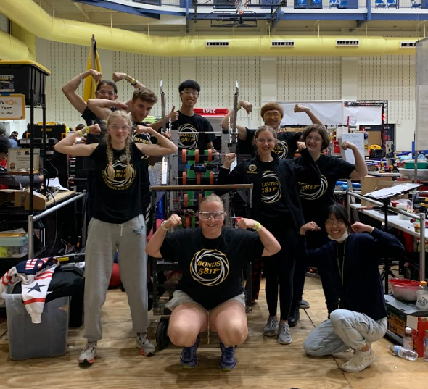
Why BONDS is Important
Teaches technical and soft skills
engineering, CAD, machining, programming, public speaking, fundraising, money management, etc
Prepares students to handle real-world issues and encourages them to pursue secondary education
Connects students across the Dayton area
Notes:
abby

Slide 9
How You Can Help
Money: Running and maintaining this team is expensive (over $35,000 a year) and that is only possible because of the generosity of our sponsors.
Mentors: A key component of the team, they provide guidance and expertise. We couldn’t do it without them!
Materials: We greatly appreciate any material donations, or the purchase of materials from our wishlist.
Machines: Our machines at K12 can only do so much. More advanced machining would really help, especially during build season.
Marketing: Help us get the word out about our team!
Notes:
abby

Slide 10
Computers and Applications Used by BONDS
Build Team
Build Team are responsible for the design process, work in our shop with power tools, & manufacture parts. The Build Team uses Computer Aided Manufacturing (CAM) software for manufacturing the robot parts on a Computer Numerical Control (CNC) machine.
Programming Team
The Programming Team are responsible for programming every robot that we create and they write thousands of lines of code in Java every year.
Electrical Team
The Electrical Team is responsible for wiring our robots. This team works closely with both the Programming and Build Teams.
Notes:
guy

Slide 11
Computers and Applications Used by BONDS
Computer Aided Design (CAD) Team
The CAD Team is responsible for our design process. Before building our robots, each robot is designed on the computer using CAD software for designing parts of our robot & assembling them on the computer before they are built.
Marketing Team
Our Marketing Team is responsible for keeping our website and social media up to date, as well as creating binders and flyers about the team. The Marketing Team also designs our shirts, banners, and the sponsor panel on each year’s robot.
Business Team
Our Business team is responsible for managing the budget and works with the Marketing Team to create informational flyers and reports about the team.
Notes:
guy

Slide 12
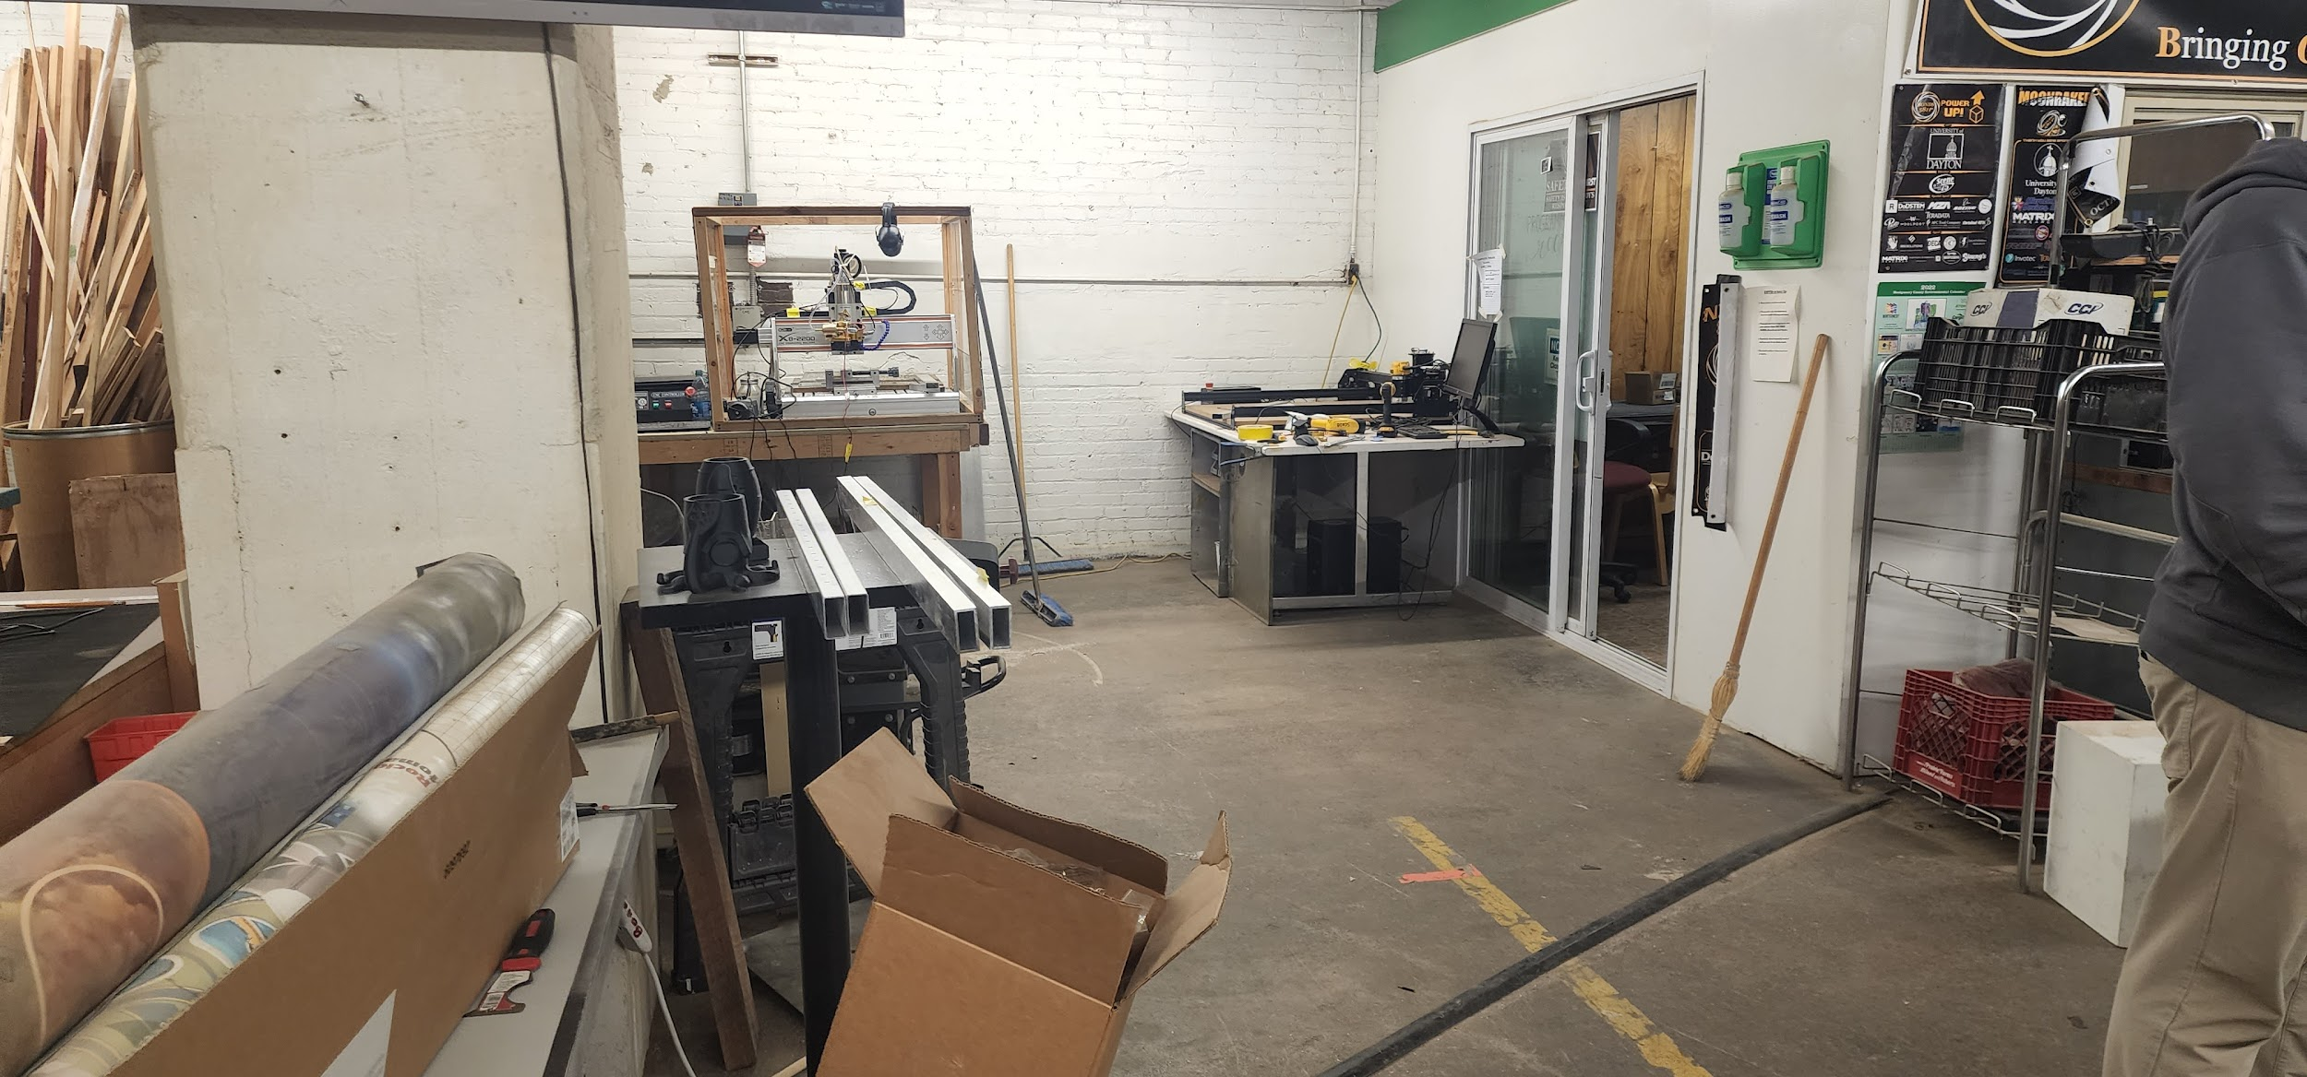
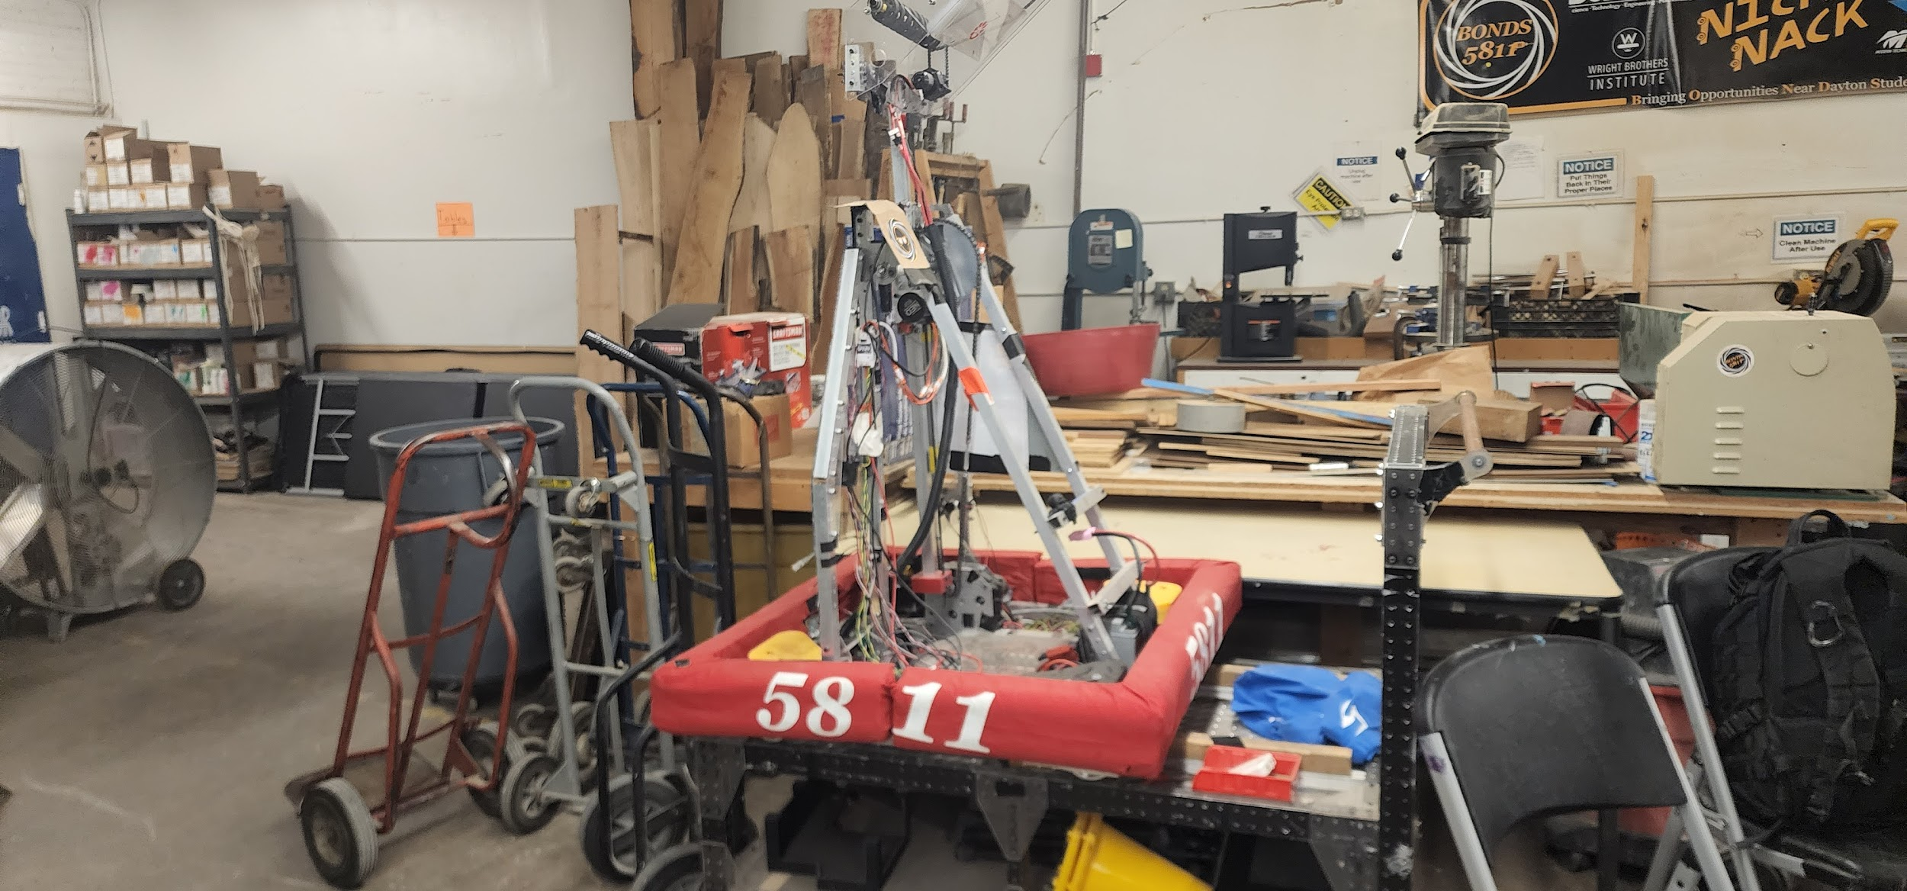
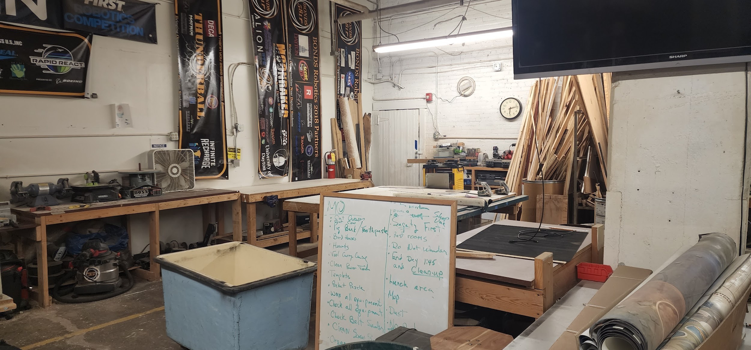
Build Team - Our Shop
Notes:
brian

Slide 13
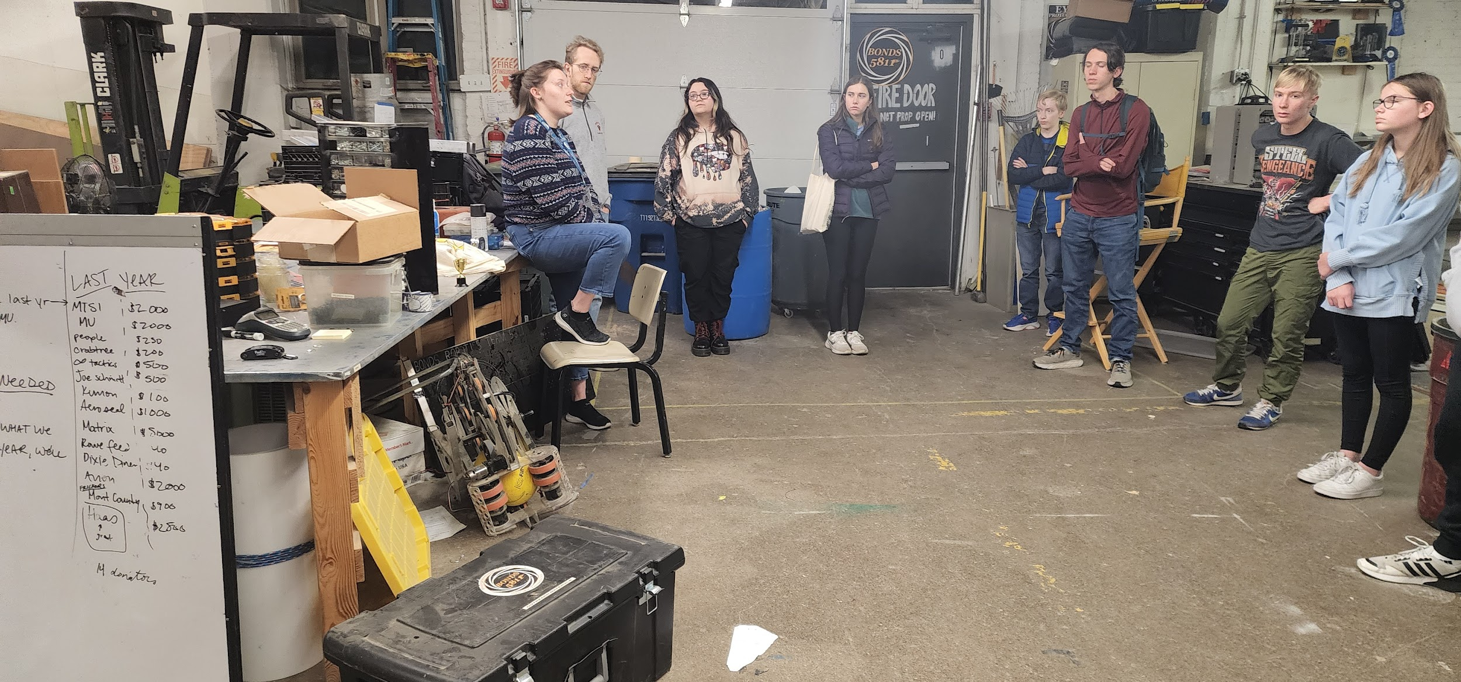
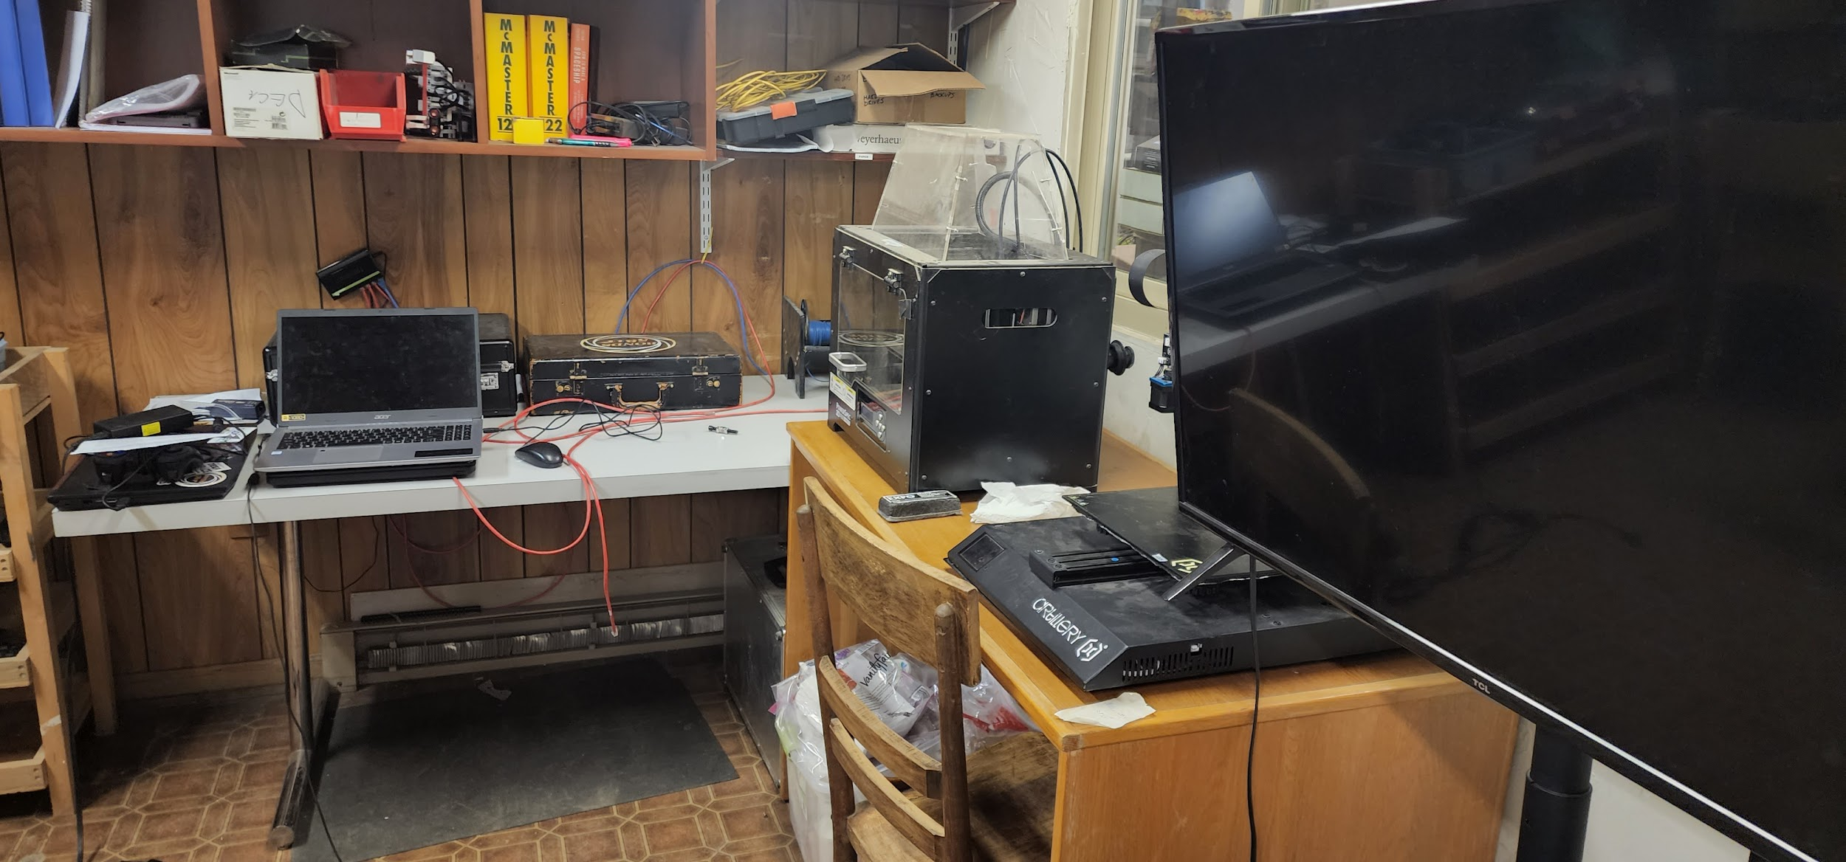
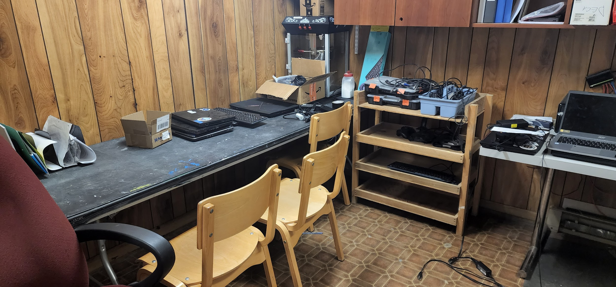
Build Team - Our Shop
Notes:
brian

Slide 14
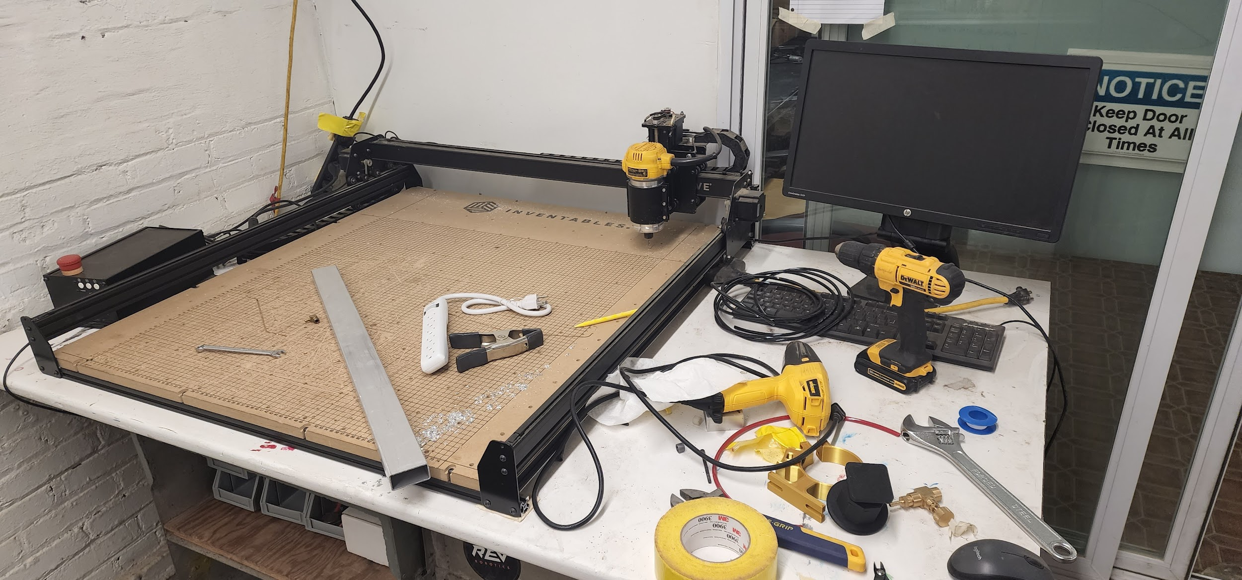
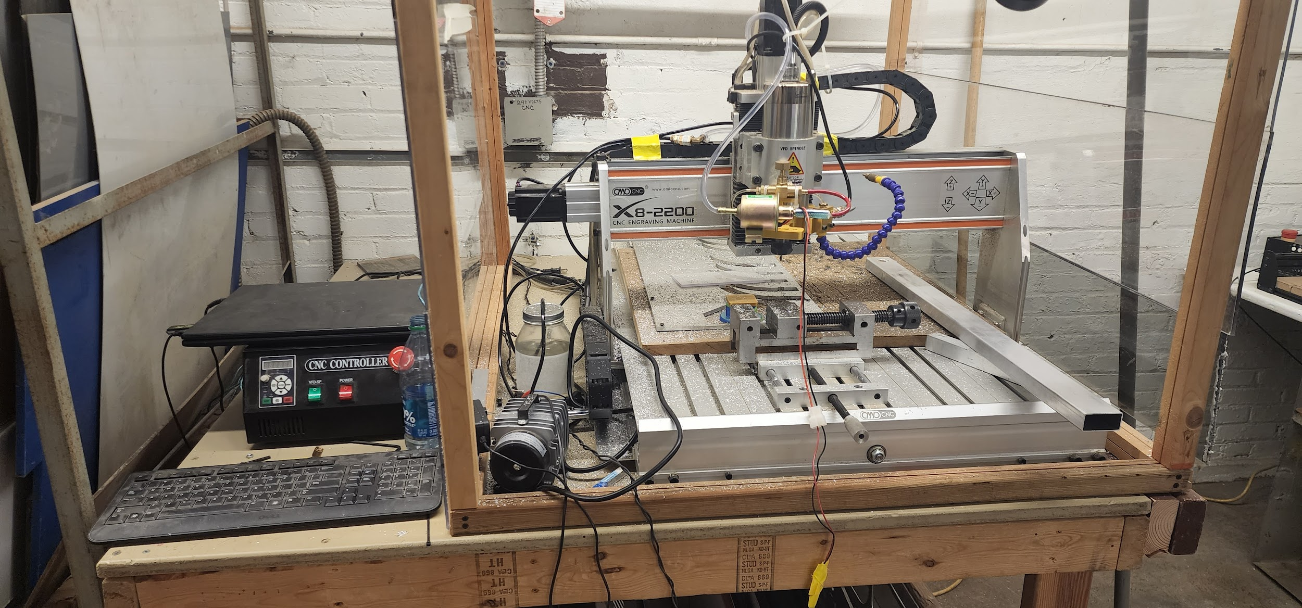
Build Team - Computer Numerical Control (CNC) machine
Notes:
brian

Slide 15
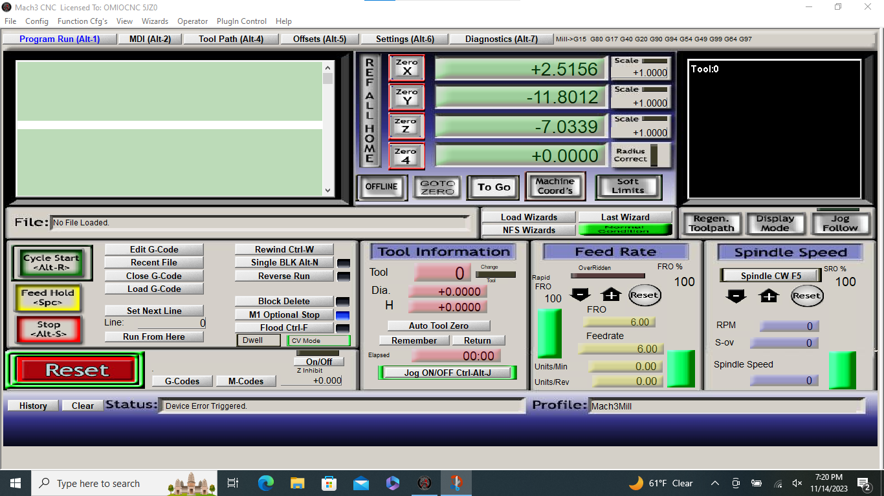
Build Team - Computer Aided Manufacturing (CAM)
Notes:
briam

Slide 16
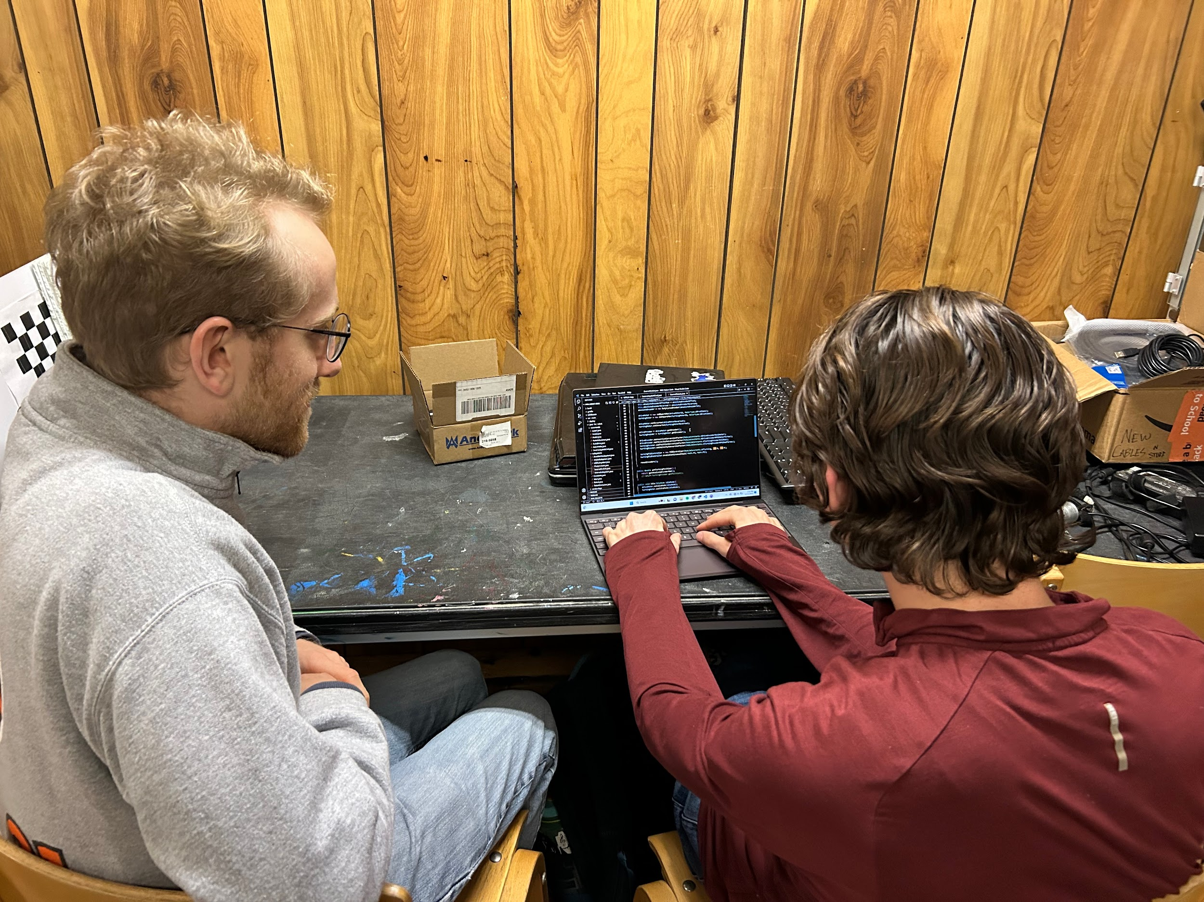
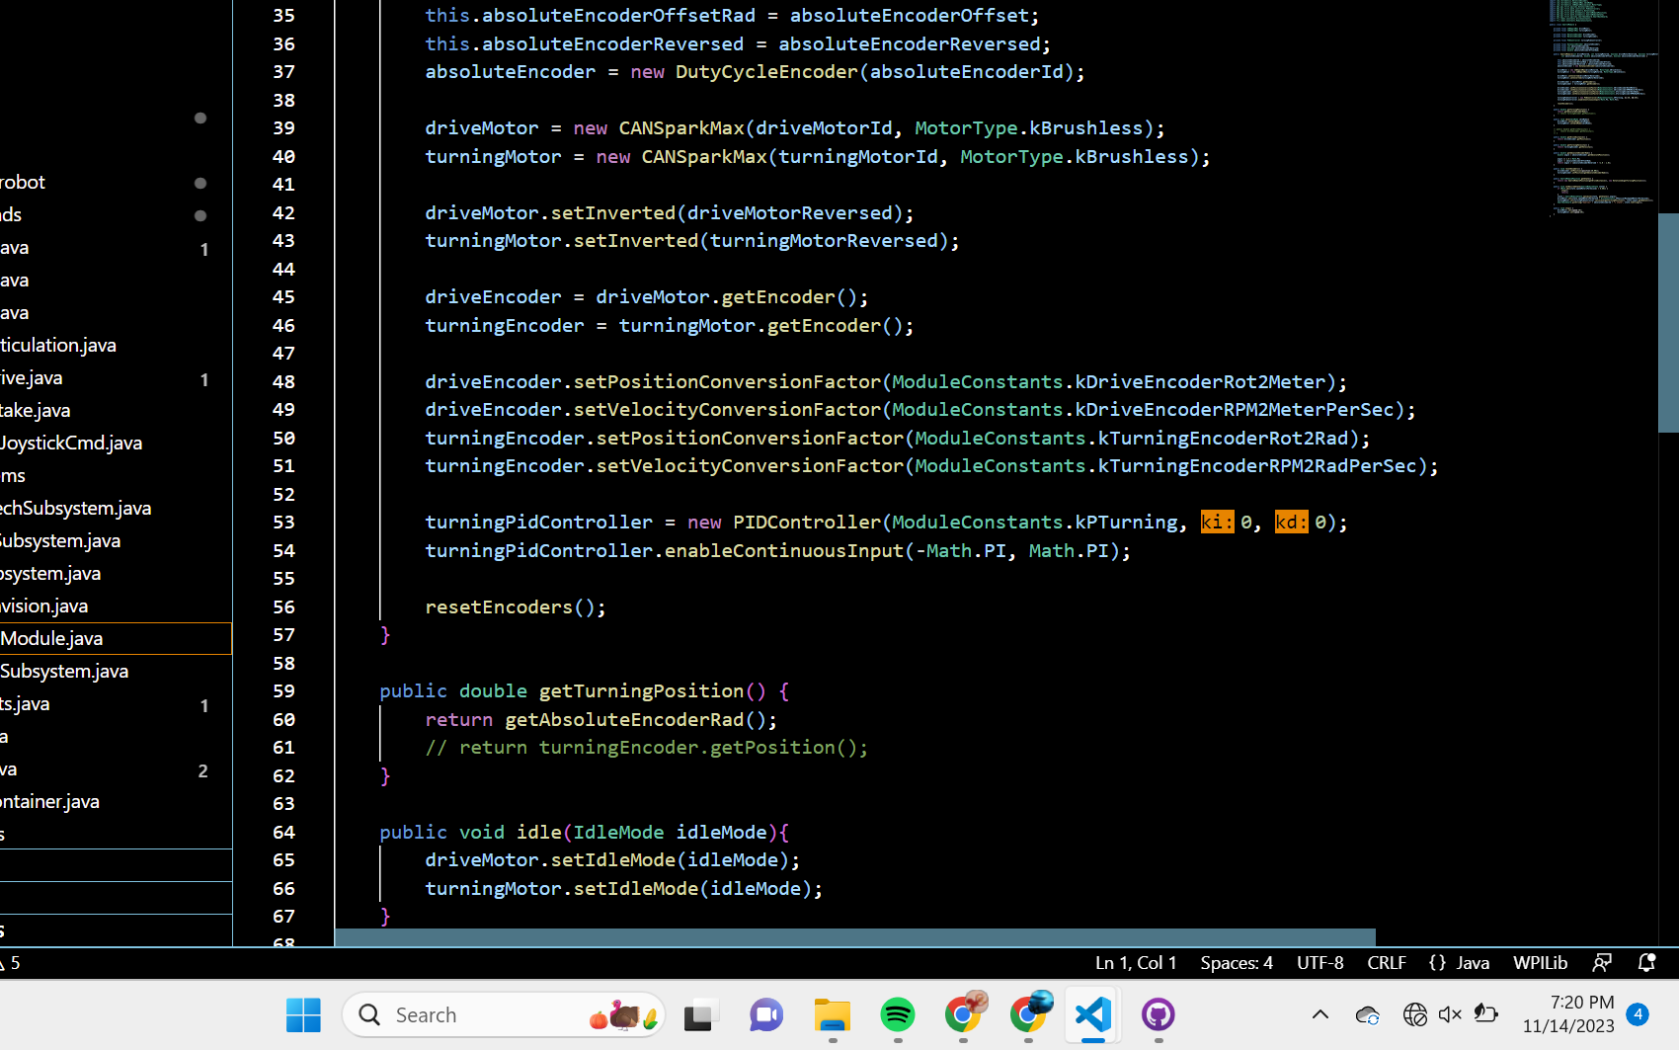
Programming Team - Java programming
Notes:
oliver

Slide 17
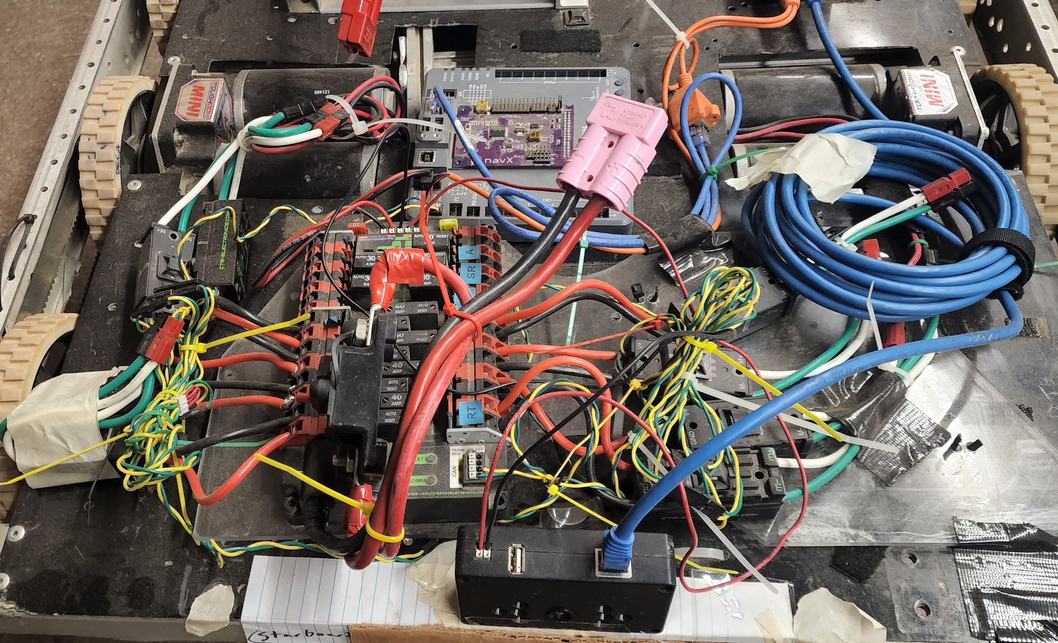
Programming Team - Java programming
Notes:
oliver

Slide 18
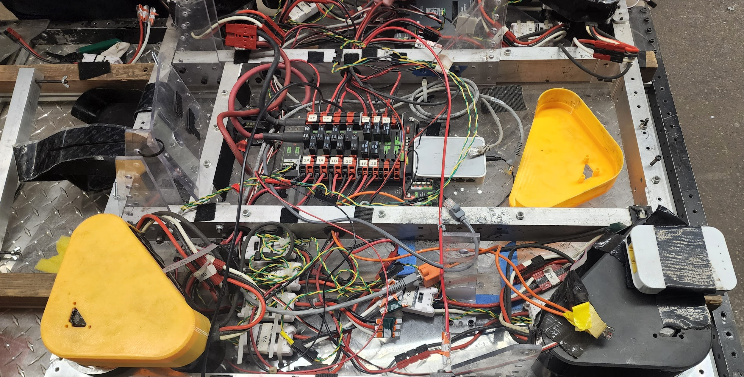
Electrical Team - Wiring our robots
Notes:
oliver

Slide 19
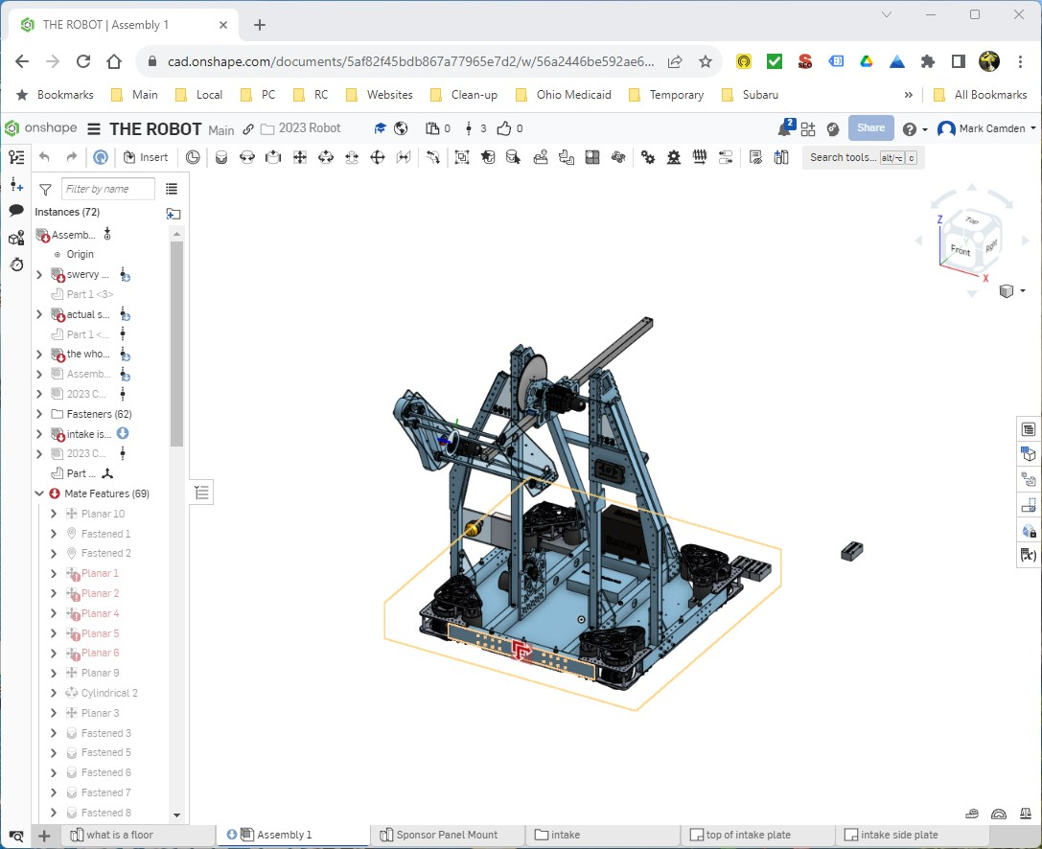
Computer Aided Design (CAD) Team
Notes:
brain

Slide 20
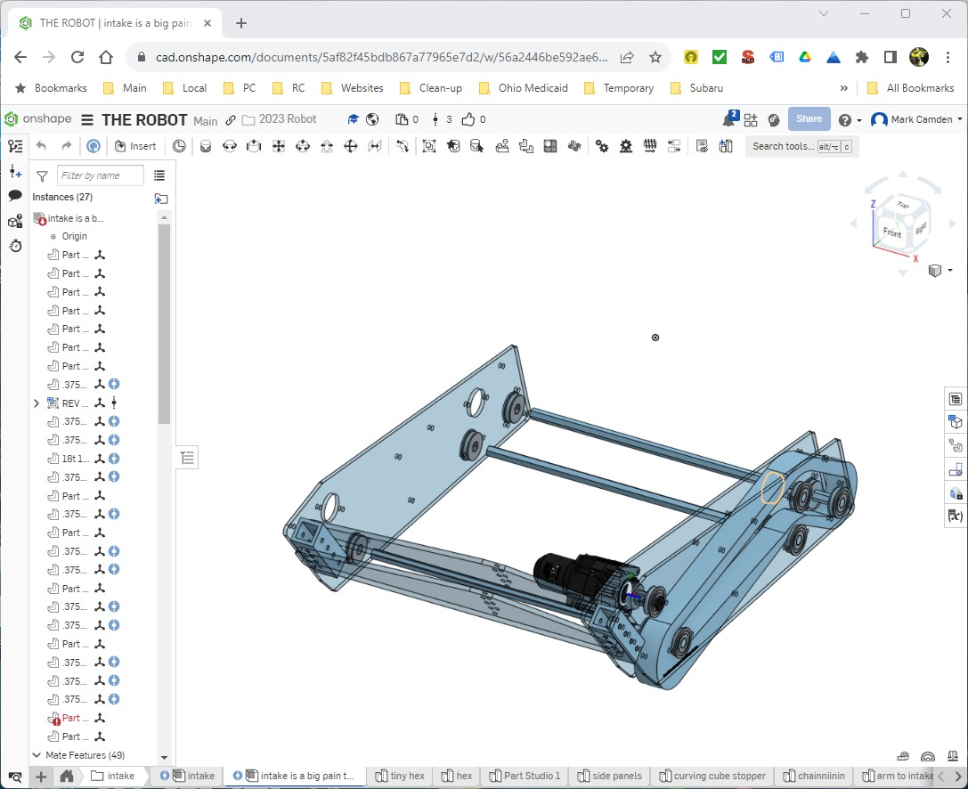
Computer Aided Design (CAD) Team
Notes:
brian

Slide 21
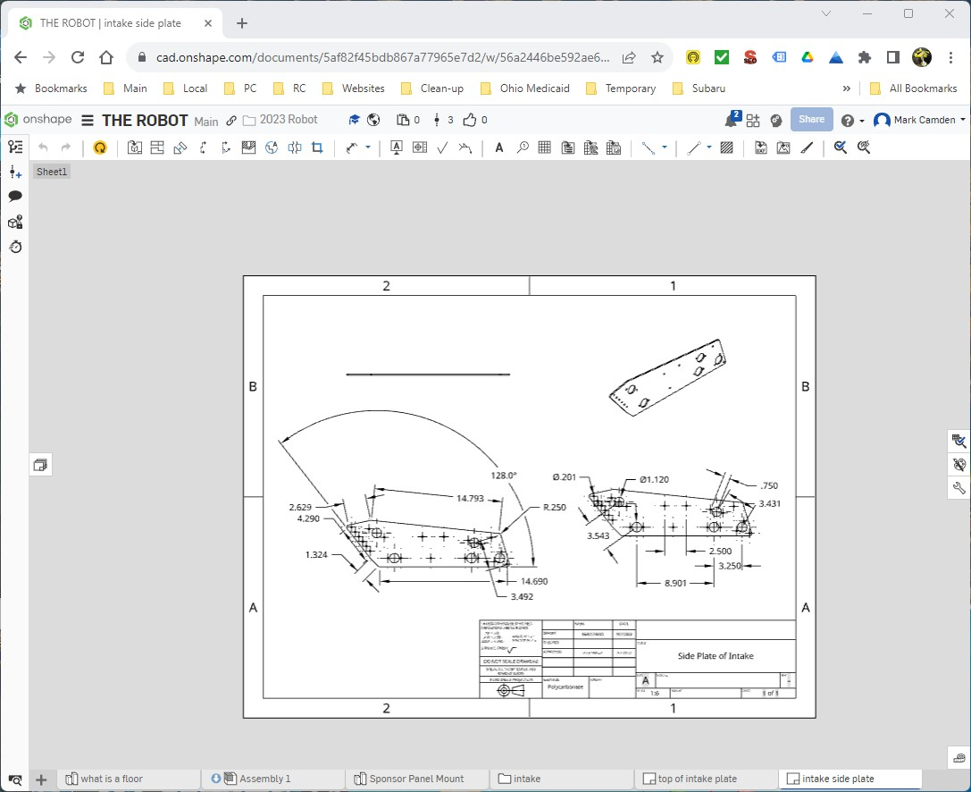
Computer Aided Design (CAD) Team
Notes:
brian

Slide 22
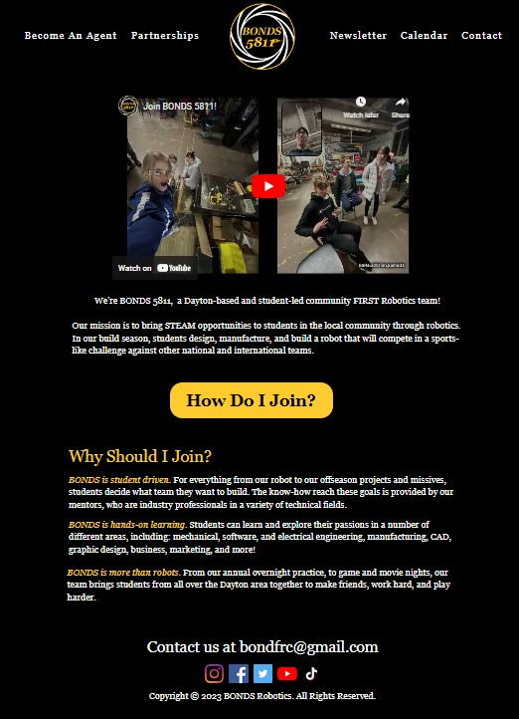
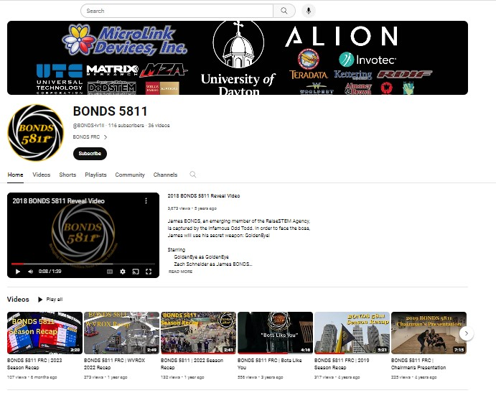
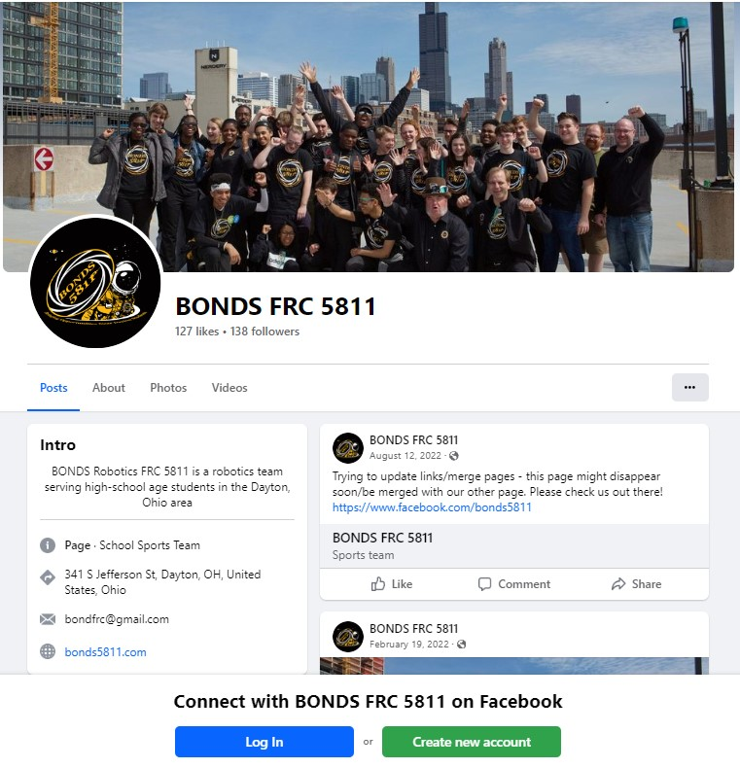
Marketing Team - website, social media, binders, flyers, designs our shirts, banners, & sponsor panel
Notes:
Nicole grace

Slide 23
Marketing Team - website, social media, binders, flyers, designs our shirts, banners, & sponsor panel
Notes:
Nicole gace

Slide 24
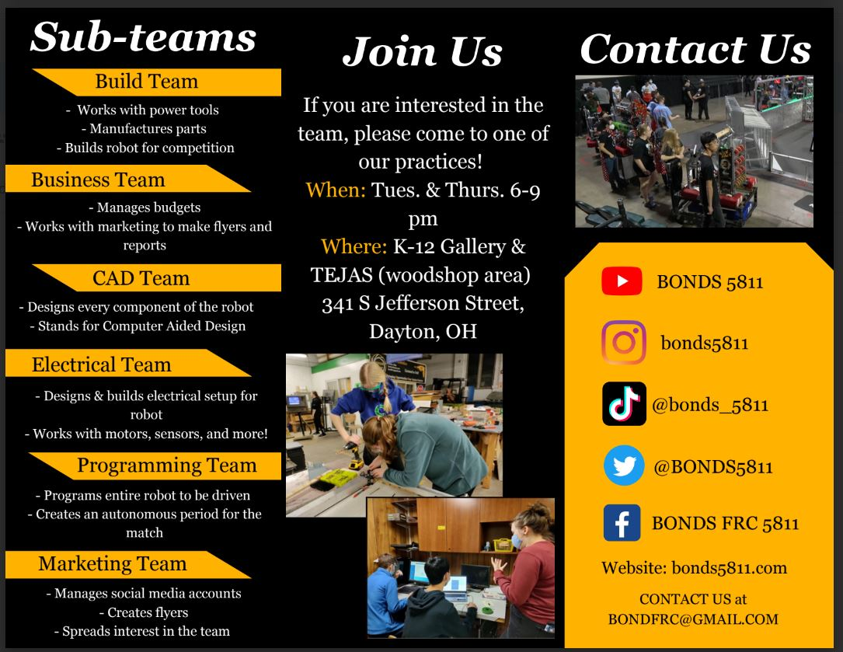
Marketing Team - website, social media, binders, flyers, shirts, banners, & sponsor panel
Notes:
Nicole grace

Slide 25
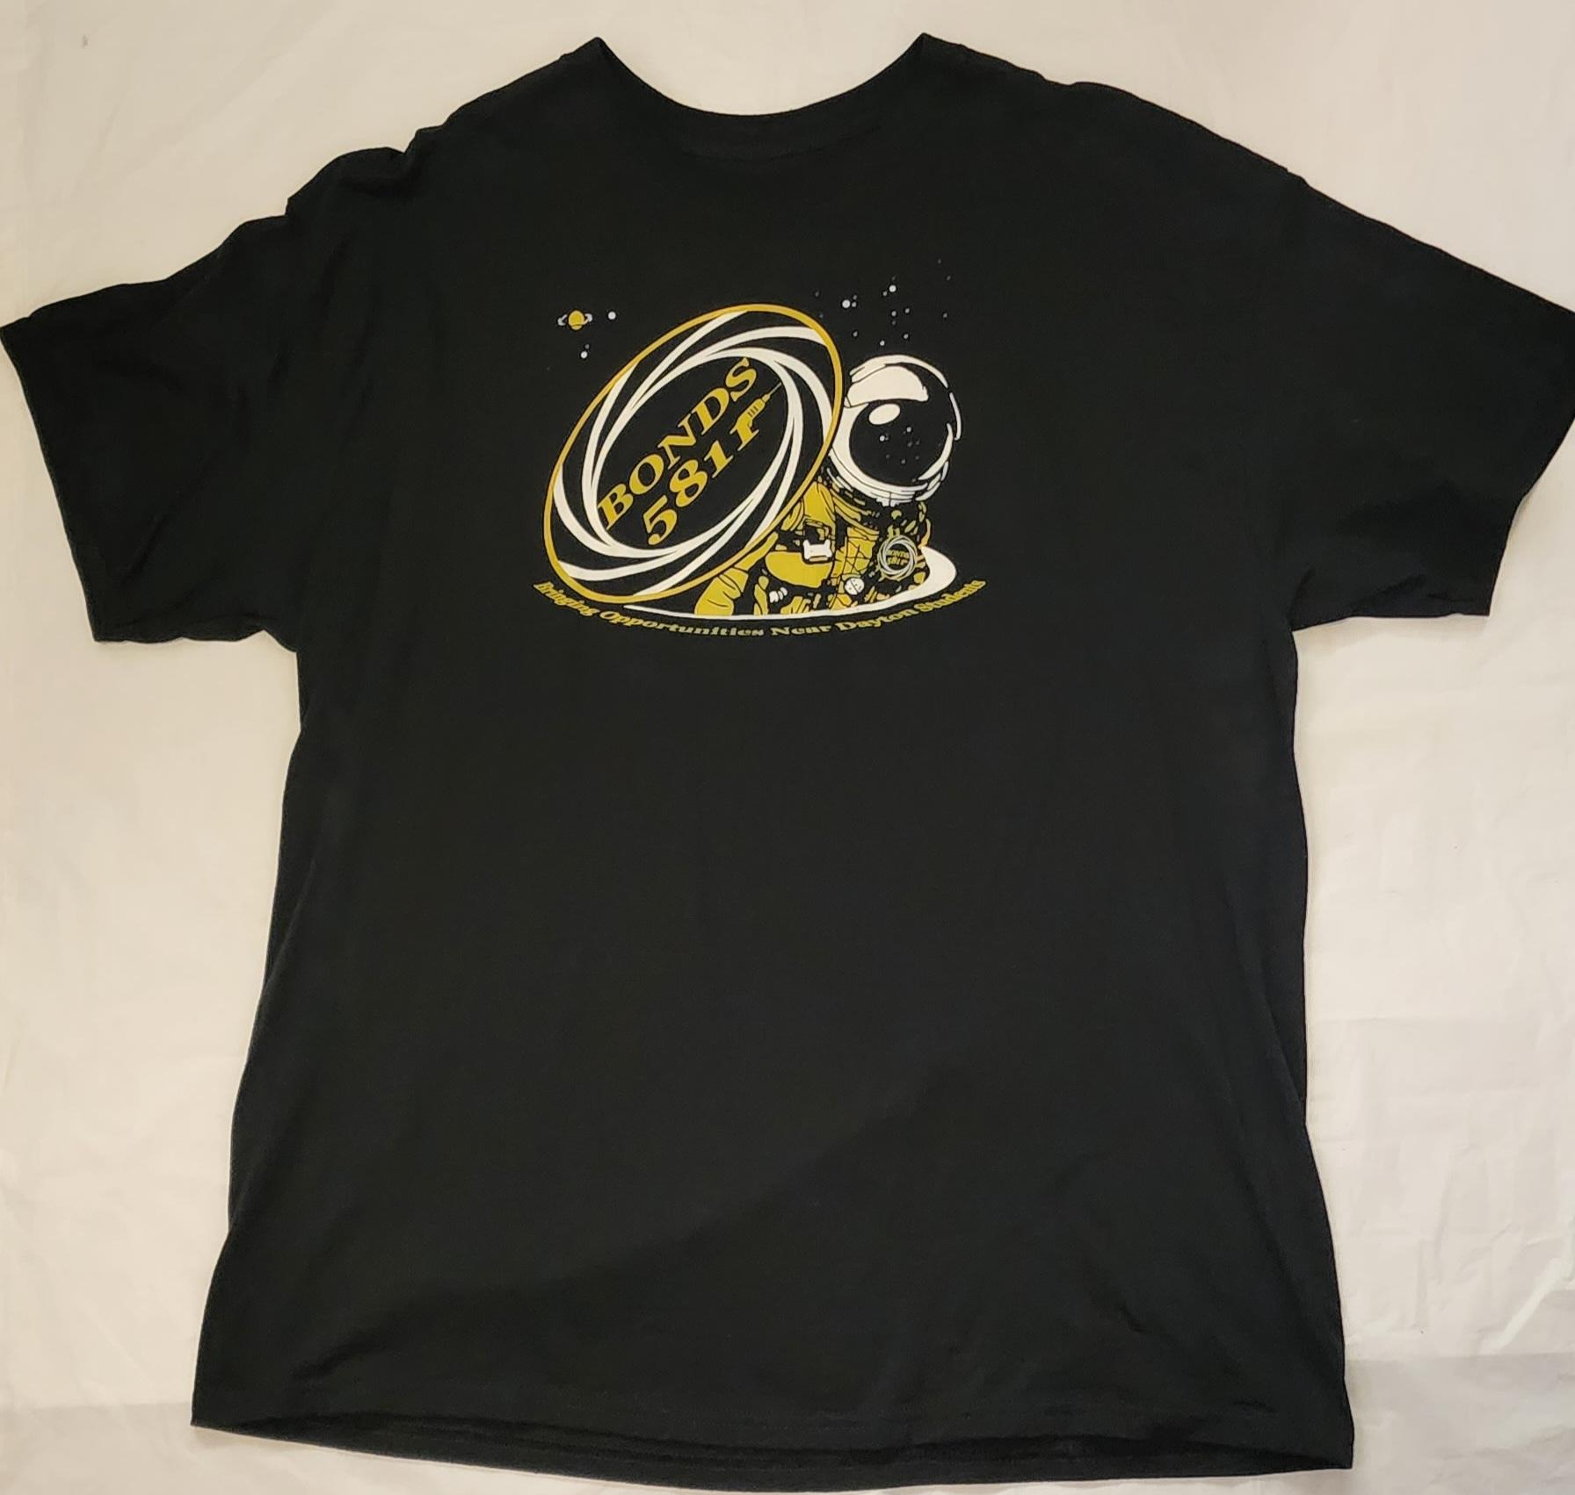
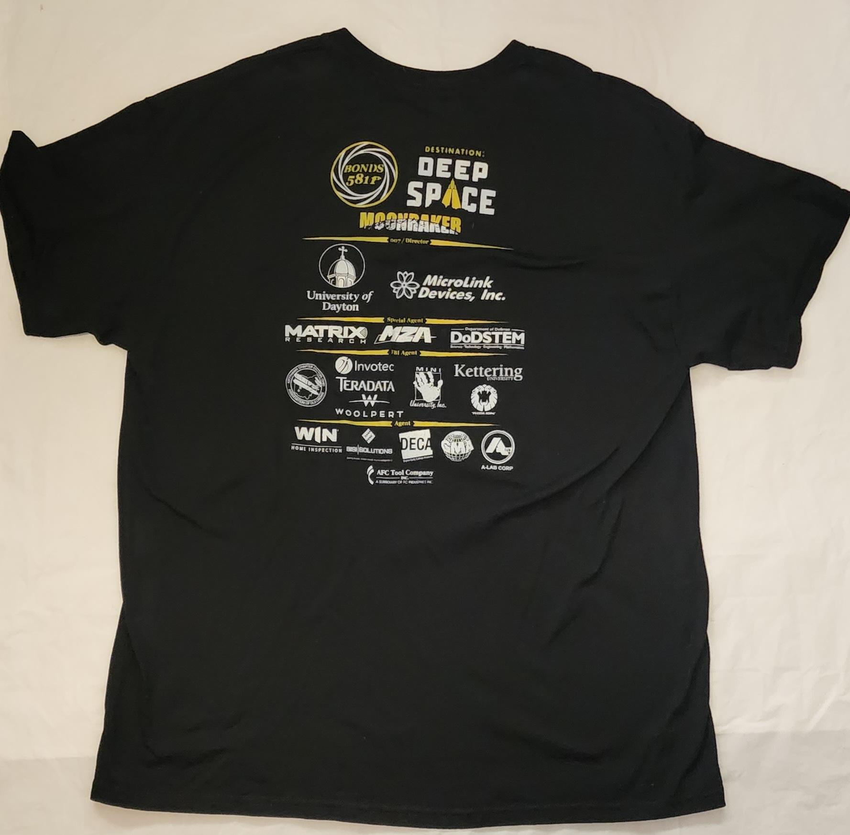
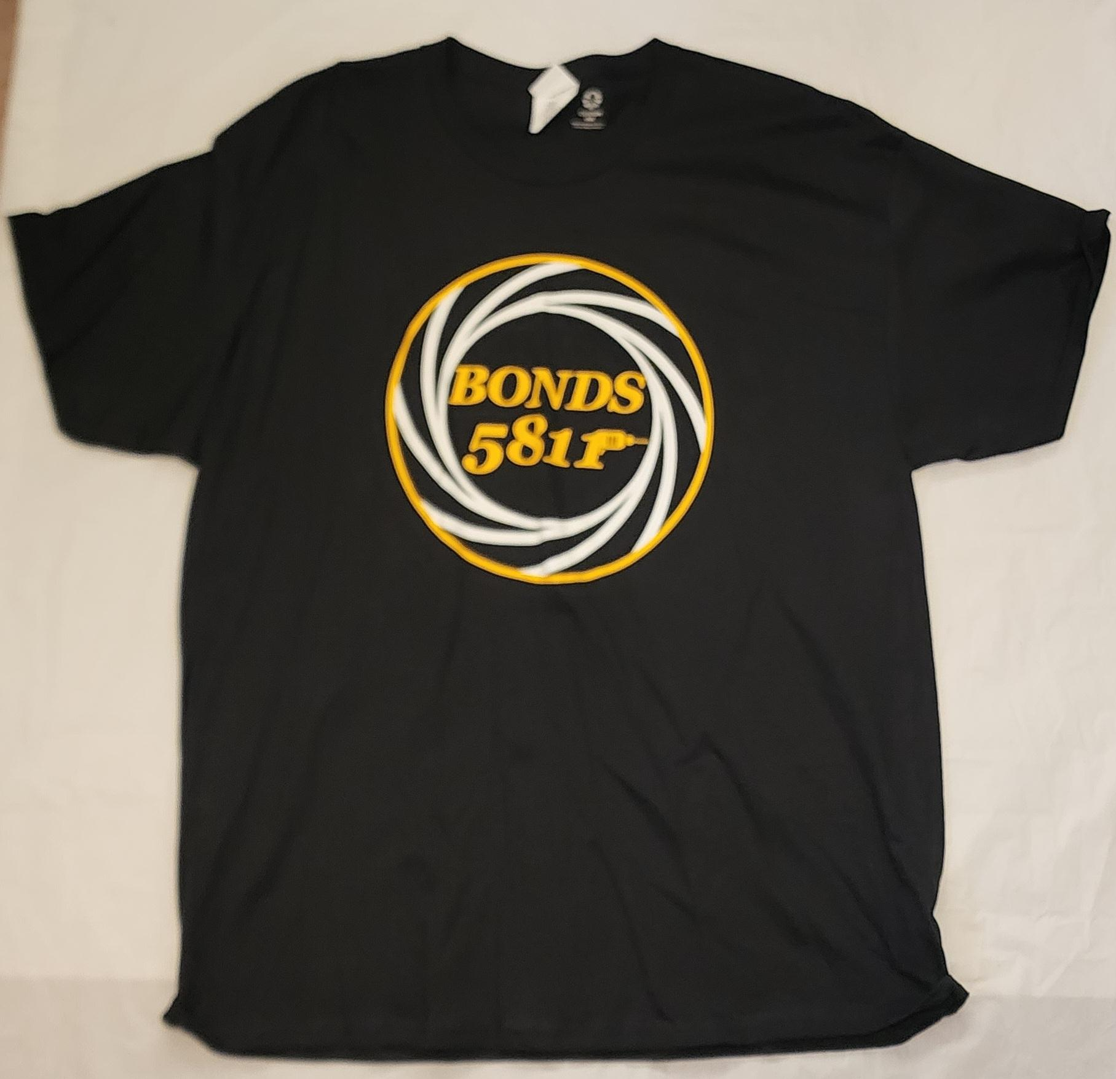
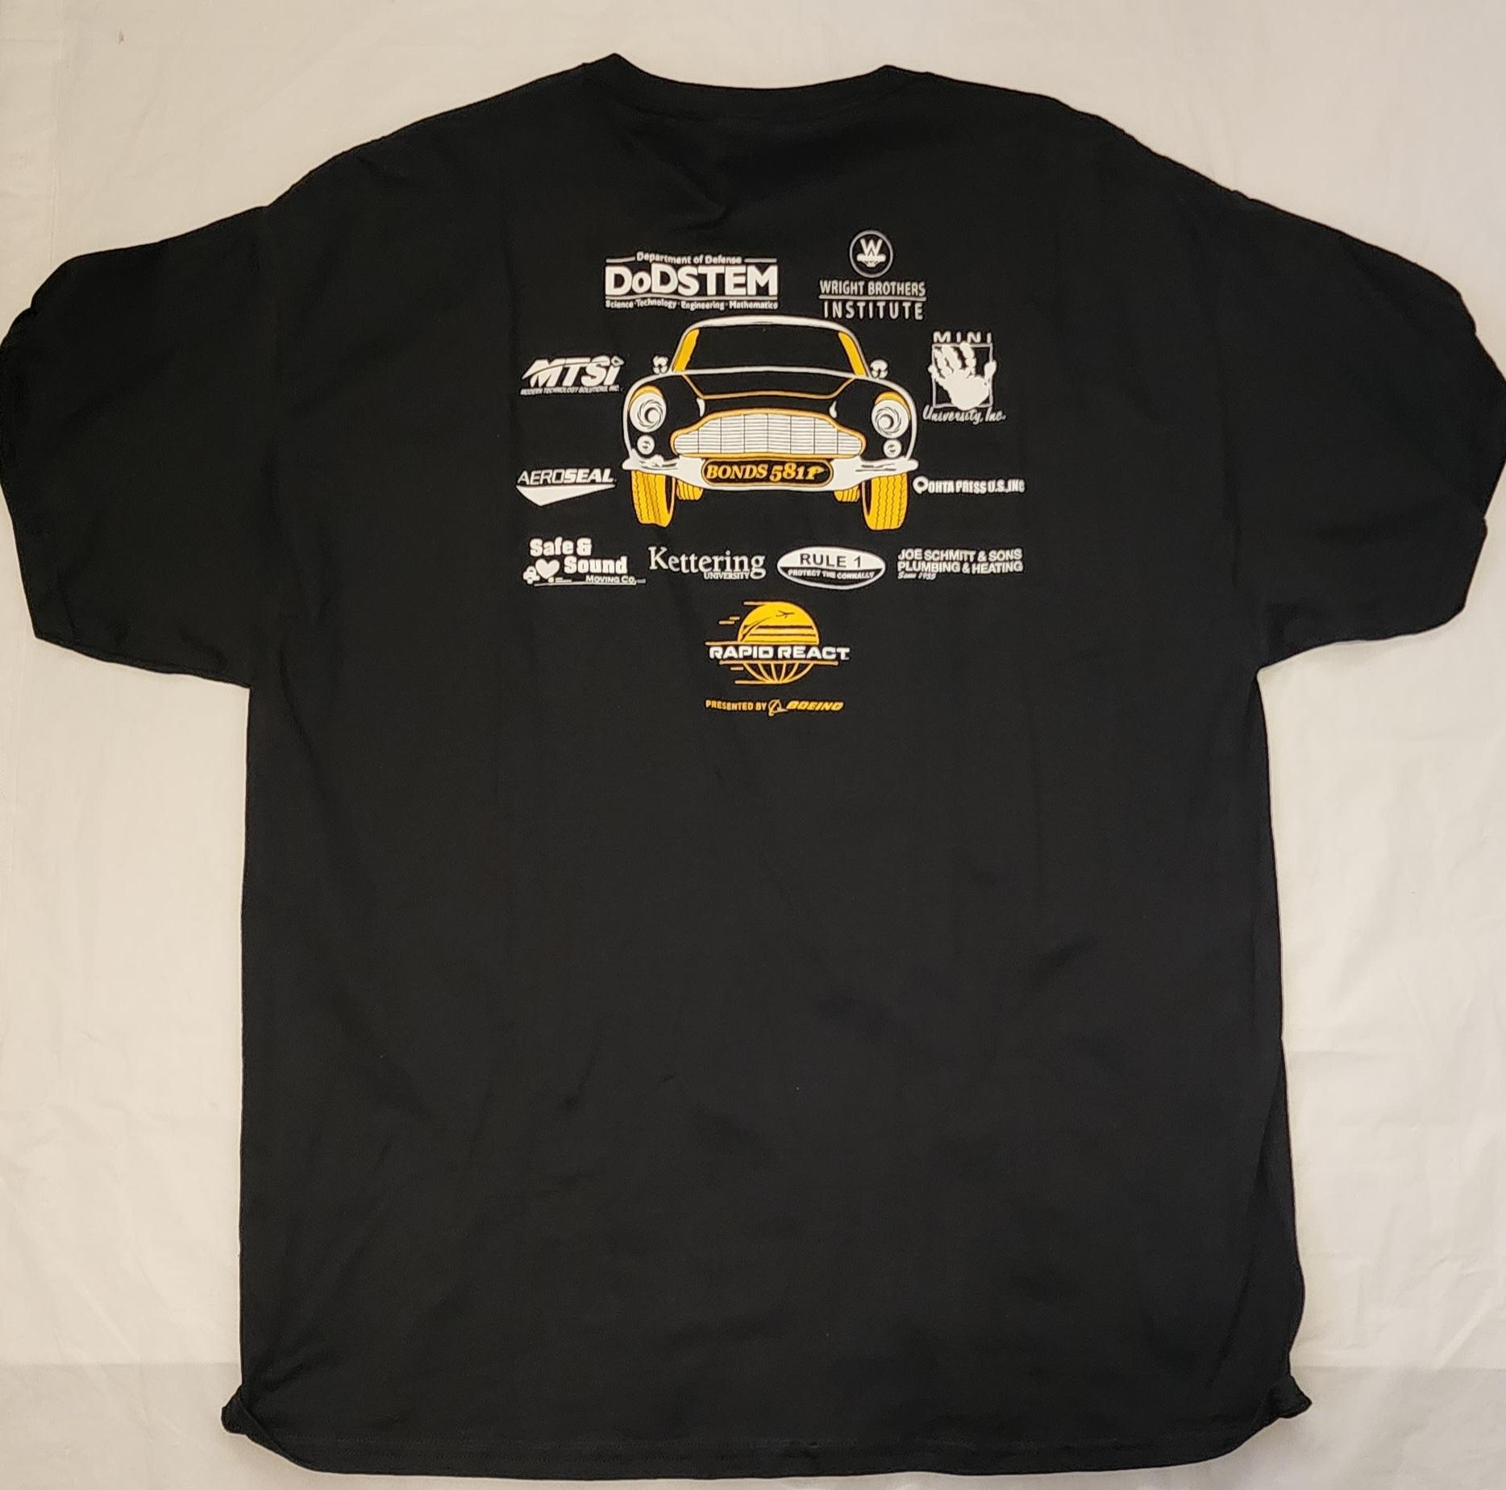
Marketing Team - website, social media, binders, flyers, shirts, banners, & sponsor panel
Notes:
Nicole grace

Slide 26
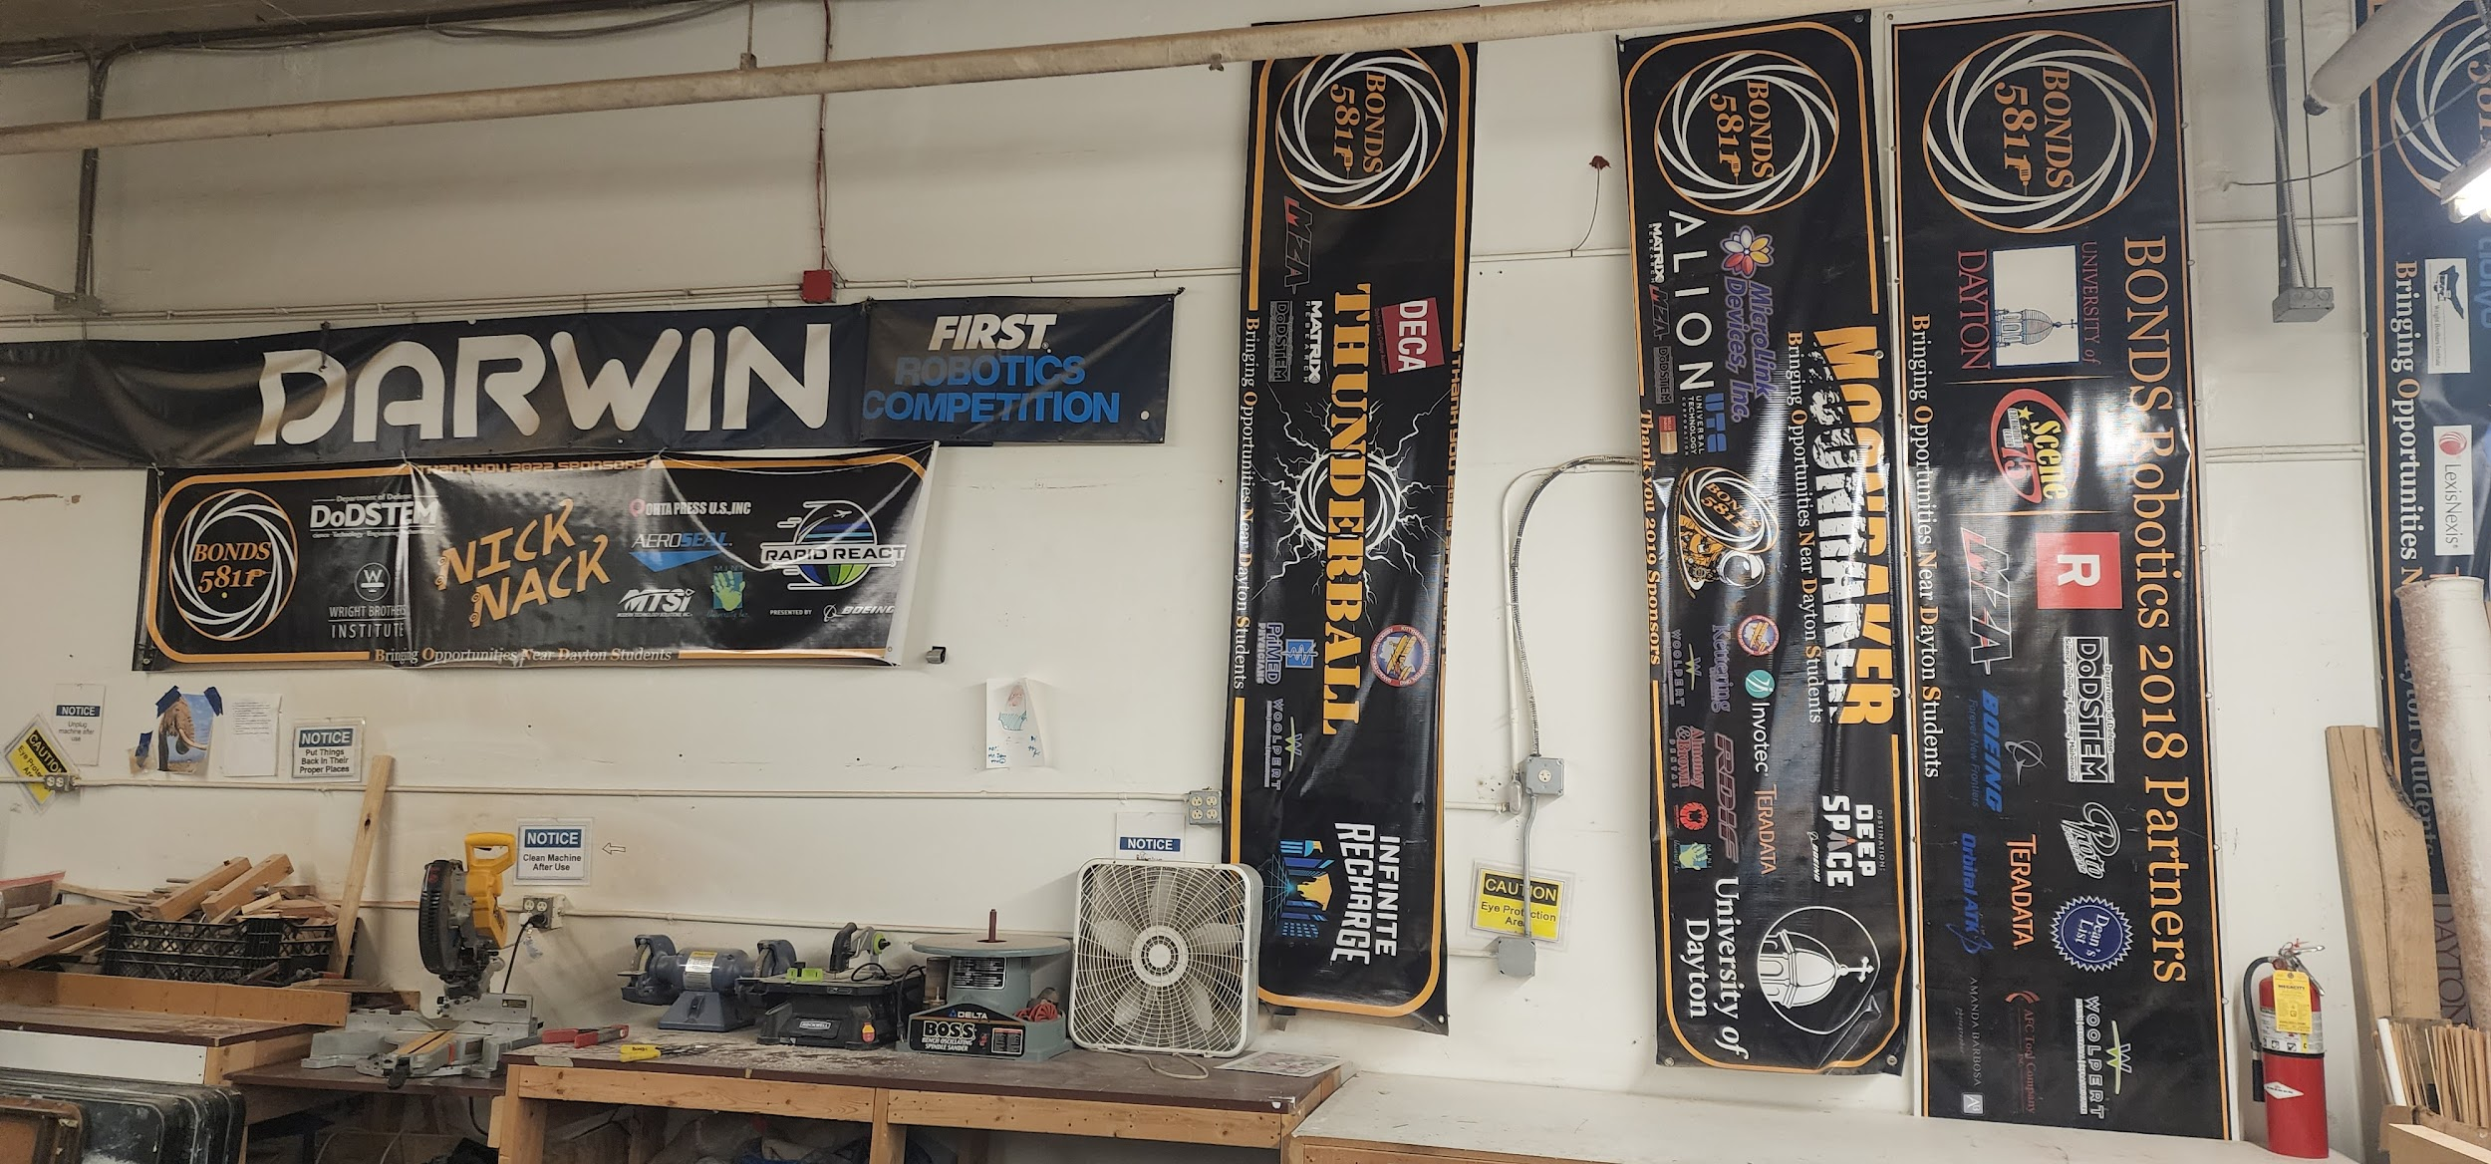
Marketing Team - website, social media, binders, flyers, shirts, banners, & sponsor panel
Notes:
Grace nicoel

Slide 27
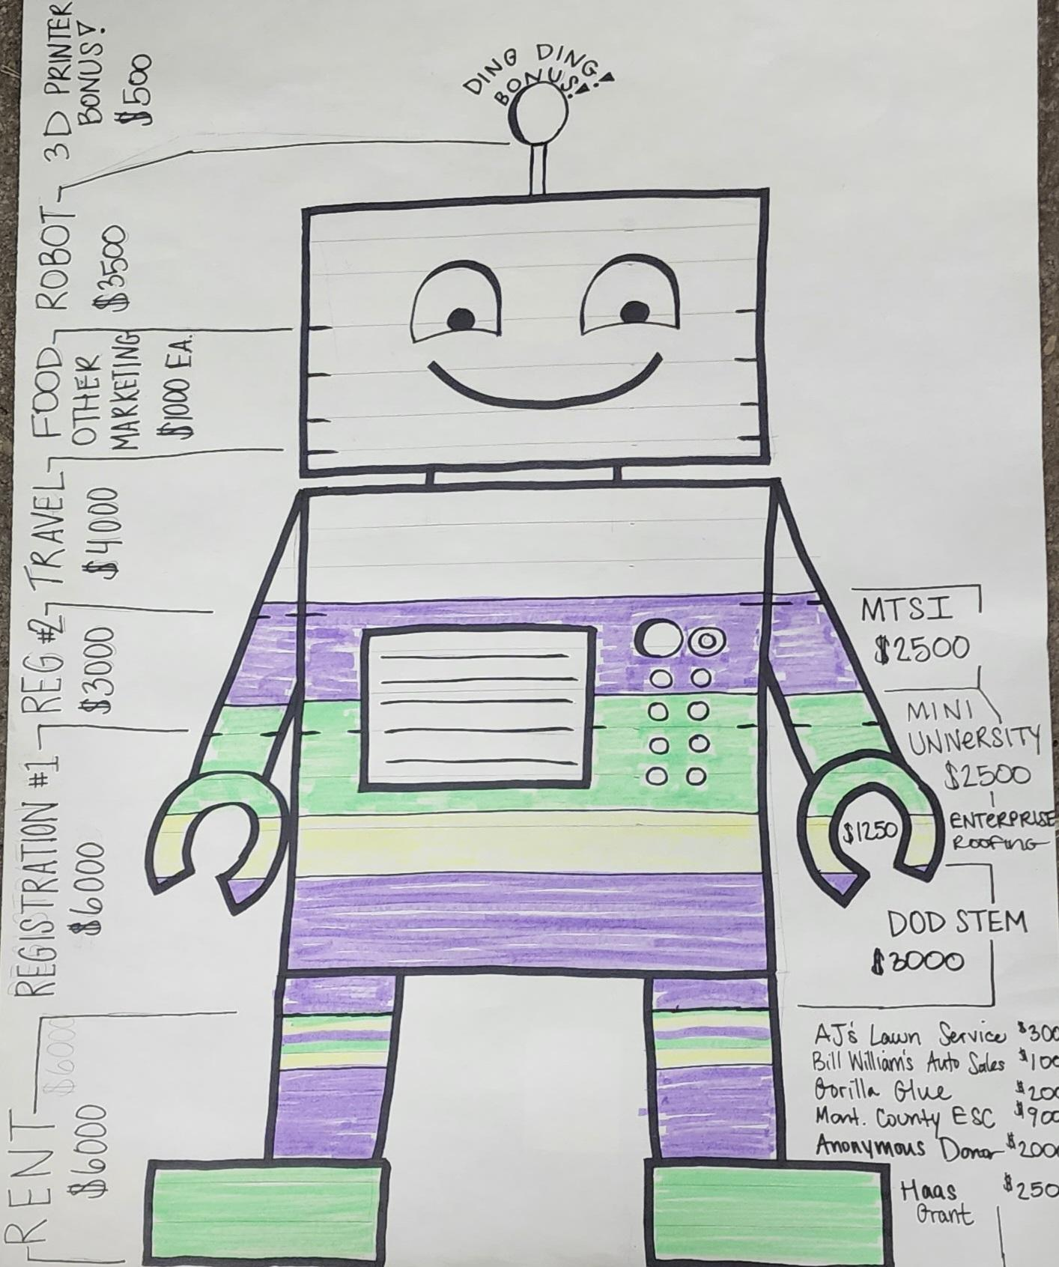
Business Team - budget, informational flyers & reports
Notes:
Nicole grace

Slide 28
Thank you!
Any questions for the BONDS Team
Go to our website! https://www.bonds5811.com/
Email us at bondfrc@gmail.com
Check us out on social media...
Notes:
reah

