Slide 1
Intro to Reverse Engineering
/home/AaronJoiner | 9 February 2023 | OISF

Slide 2
Disclaimer
“The demonstration of reverse engineering techniques provided in this meeting is intended for educational and informational purposes only.”
“It is not intended to be used for illegal or unethical purposes. The demonstration is not intended to encourage or endorse the violation of any intellectual property rights or applicable laws.”
“I cannot be held responsible for any misuse of the information or techniques presented in this meeting.”
“My opinion is my own and does not reflect the position of my employer, MTSI.”

Slide 3
Overview
whoami
Concepts and methodologies
Tools

Slide 4
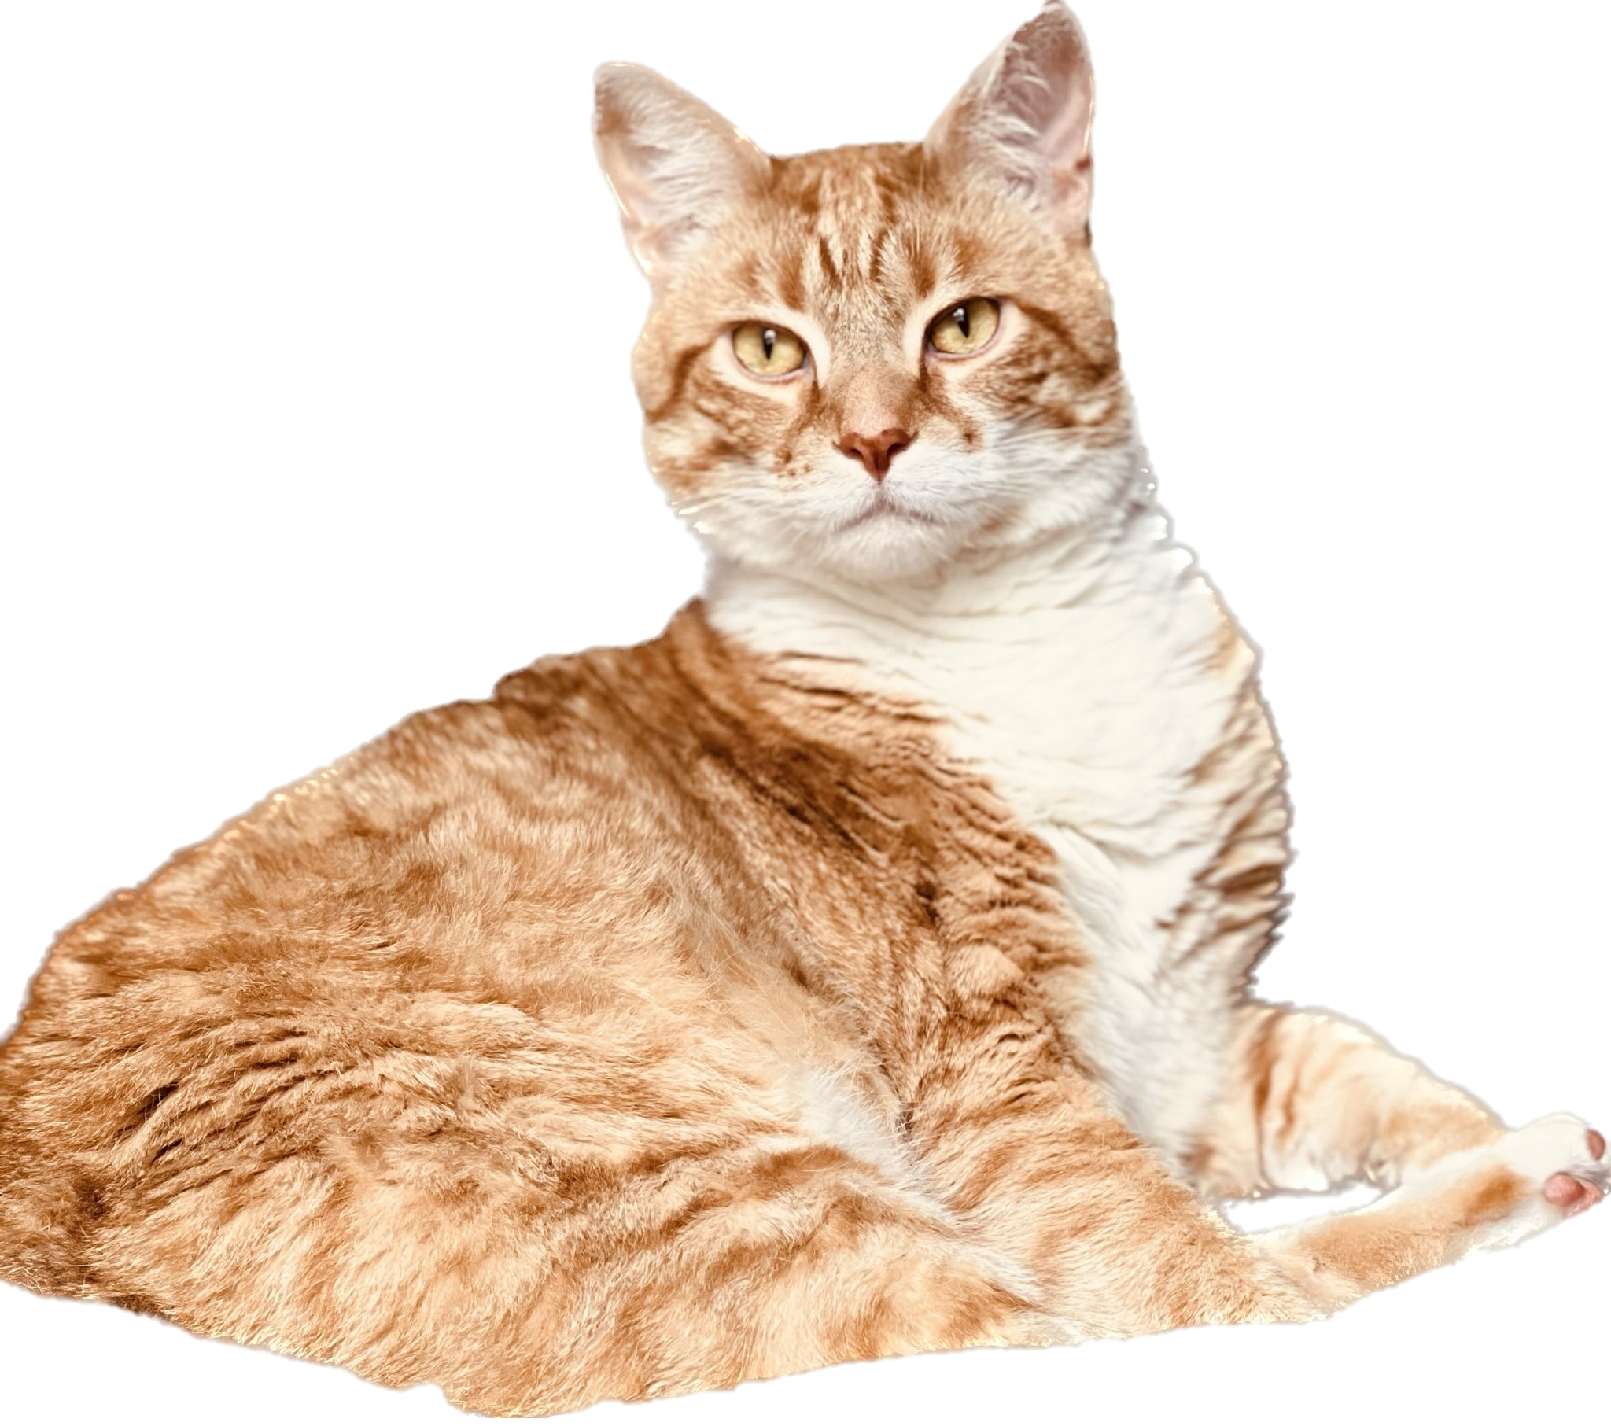
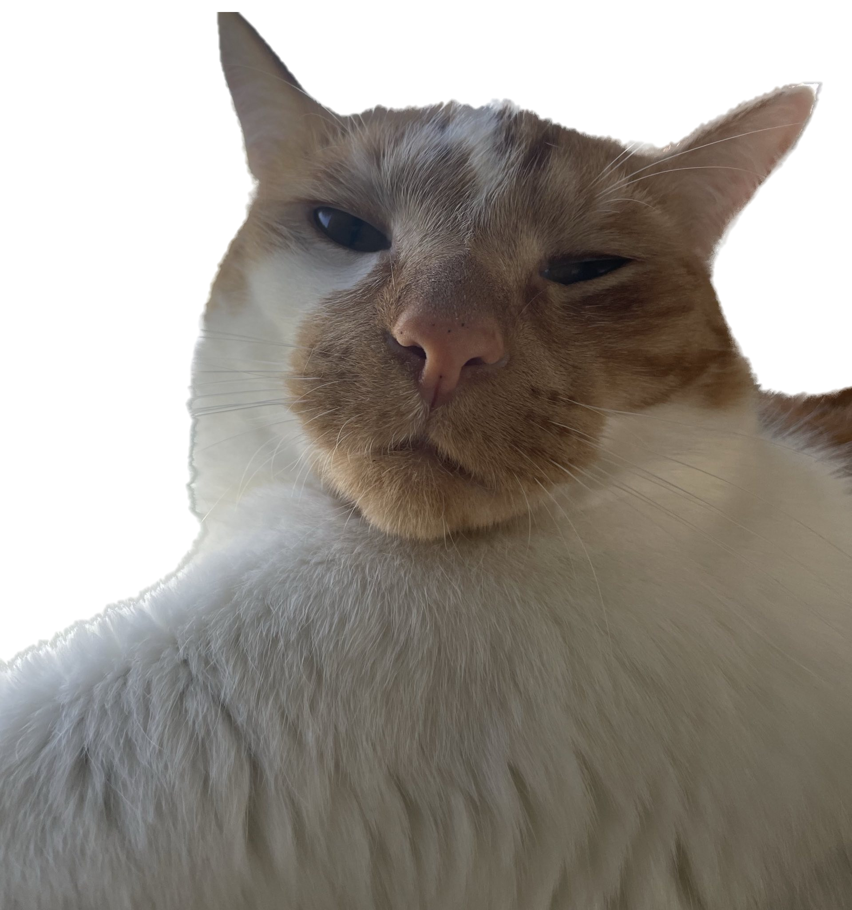
$ whoami
Email:
aaron.joiner@mtsi-va.com
LinkedIn:
linkedin.com\in\aaron-joiner\

Slide 5
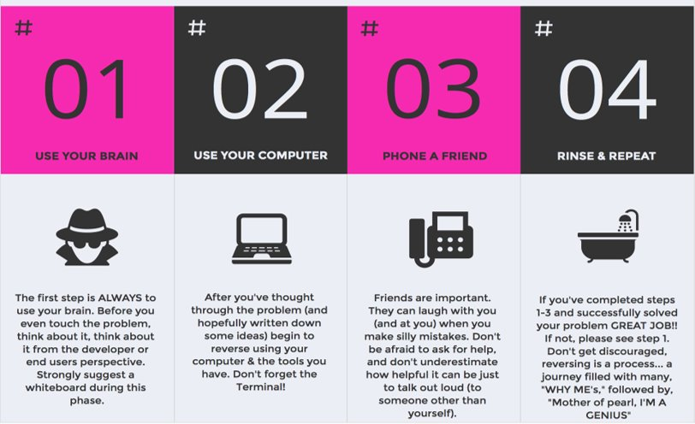
Concepts and methodologies

Slide 6
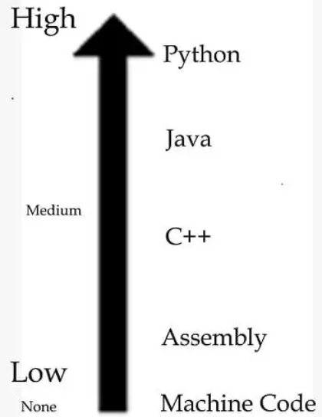
Concepts and methodologies

Slide 7
Tools
Strings
Binwalk
Ghidra
IDA
Extras
Compiler Explorer
Decompiler Explorer

Slide 8
Ghidra
“A software reverse engineering (SRE) suite of tools developed by NSA's Research Directorate in support of the Cybersecurity mission”
https://ghidra-sre.org/

Slide 9
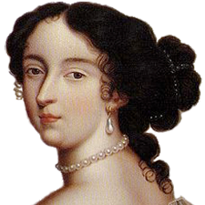
IDA
“This (completely!) free version of IDA offers a privilege opportunity to see IDA in action. This light but powerful tool can quickly analyze the binary code samples and users can save and look closer at the analysis results.”
https://hex-rays.com/ida-free/

Slide 10
staticString.c

Slide 11
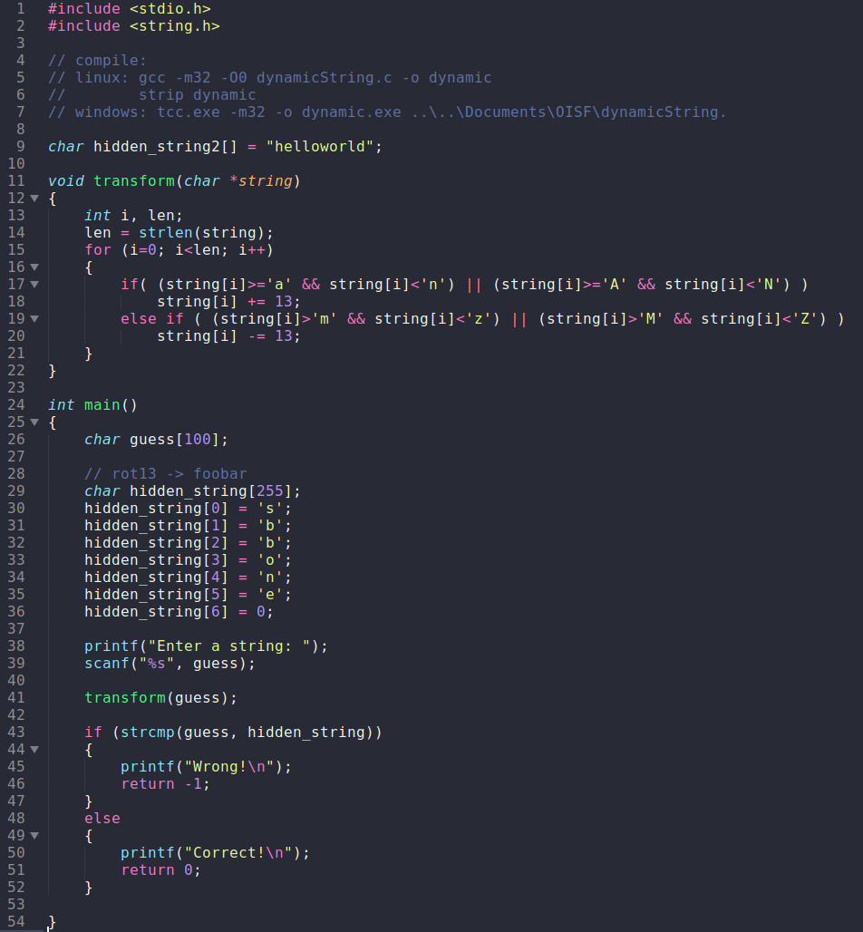
dynamicString.c

Slide 12
Compiler Explorer
** Be careful what you upload/write in this tool. All data is stored in the cloud. Don’t upload anything you wouldn’t want posted on a billboard. ☺ **
https://godbolt.org/

Slide 13
Decompiler Explorer
** Be careful what you upload/write in this tool. All data is stored in the cloud. Don’t upload anything you wouldn’t want posted on a billboard. ☺ **
https://dogbolt.org/

