Slide 1


ON TECHNOLOGY PARTNERS PRESENTS:
RELAX:
Humanizing Security
Ken Fanger, President of On Technology Partners
kfanger@ontechpartners.com
216-920-3100

Slide 2

We Will Cover
Victim Shaming
Aware – Address – Arise
RELAX – Evaluate – Act

Slide 3


Meet Your Presenter
30 years of experience in technology field
CMMC-RP
Cyber Security Focus
Author

Slide 4

Questions?

Slide 5

“YOU
CAN’T
PATCH
STUPID!”

Slide 6

NERD
DORK

Slide 7

STUPID
FOOLISH
DUMB
IDIOT

Slide 8

SHAMING

Slide 9

SHARING

Slide 10

It all started when…
STORIES

Slide 11

SYMPATHY

Slide 12


Slide 13


Slide 14




AWARE
ADDRESS
ARISE

Slide 15

Learn to:
Relax
Evaluate
Act

Slide 16


No one wants to care about cyber security…
but we all care about SAFETY!

Slide 17

RELAX

Slide 18

Most people react,
rather than think,
in a crisis…

Slide 19

Nigerian Prince needs your help!

Slide 20

Let’s get modern

Slide 21

Stop… breathe… relax… and collect yourself.

Slide 22

Evaluate

Slide 23

Remind them:
NEVER click first and ask questions later…
It WILL backfire!

Slide 24

Trying to pass as you:
Who’s that vishing on my phone?

Slide 25

First, they came for our phones…
then they came for our texts…

Slide 26

Think and evaluate before acting.

Slide 27

Now you are ready to ACT.

Slide 28

Stop!
Disconnect
Contact your trusted support

Slide 29

Despite what we may think sometimes…
your phone is your friend.

Slide 30

Follow your procedures.

Slide 31

Always follow:
Relax
Evaluate
Act
when facing hackers.

Slide 32
Fun from the book!

Slide 33
Enter for a chance to win a FREE copy!
Email me at info@ontechpartners.com with the subject line: “Free Book” for a
chance to win a FREE copy of
RELAX: A Guide to True Cyber Security!

Slide 34

Don’t worry– it’s never collapsed before.

Slide 35
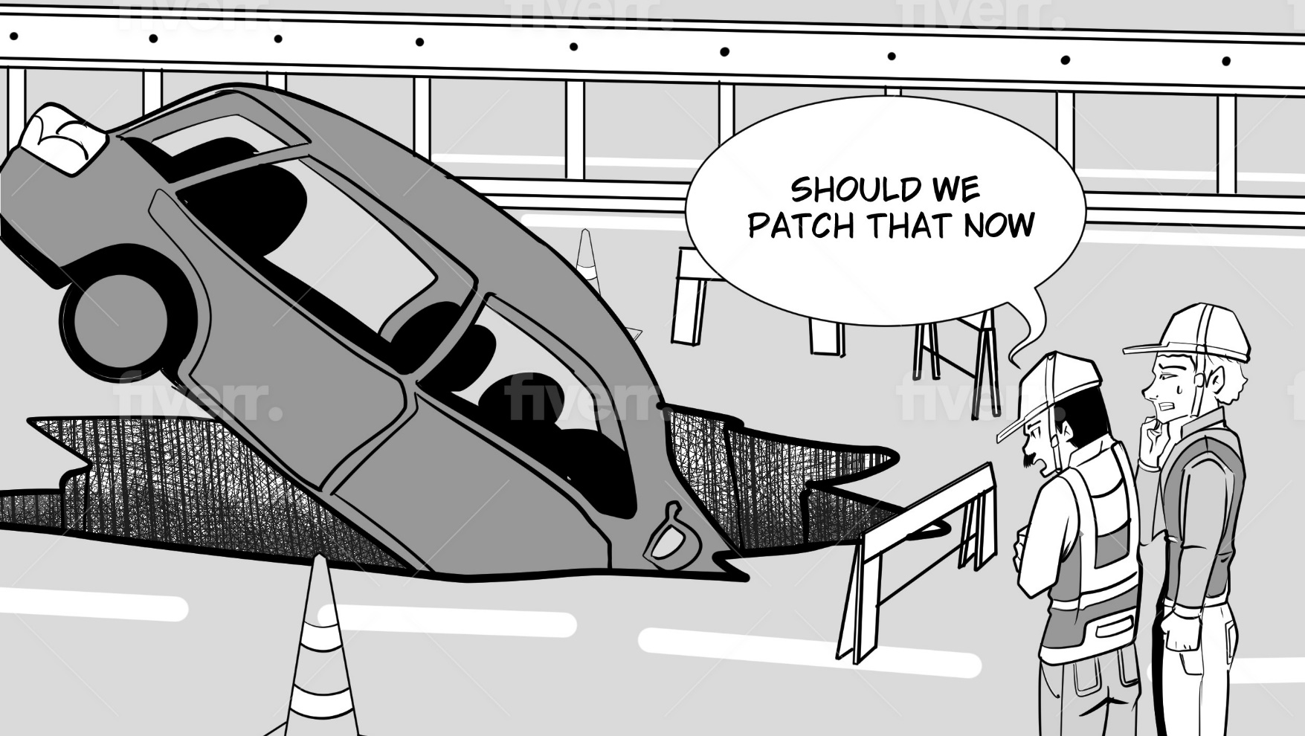

Slide 36
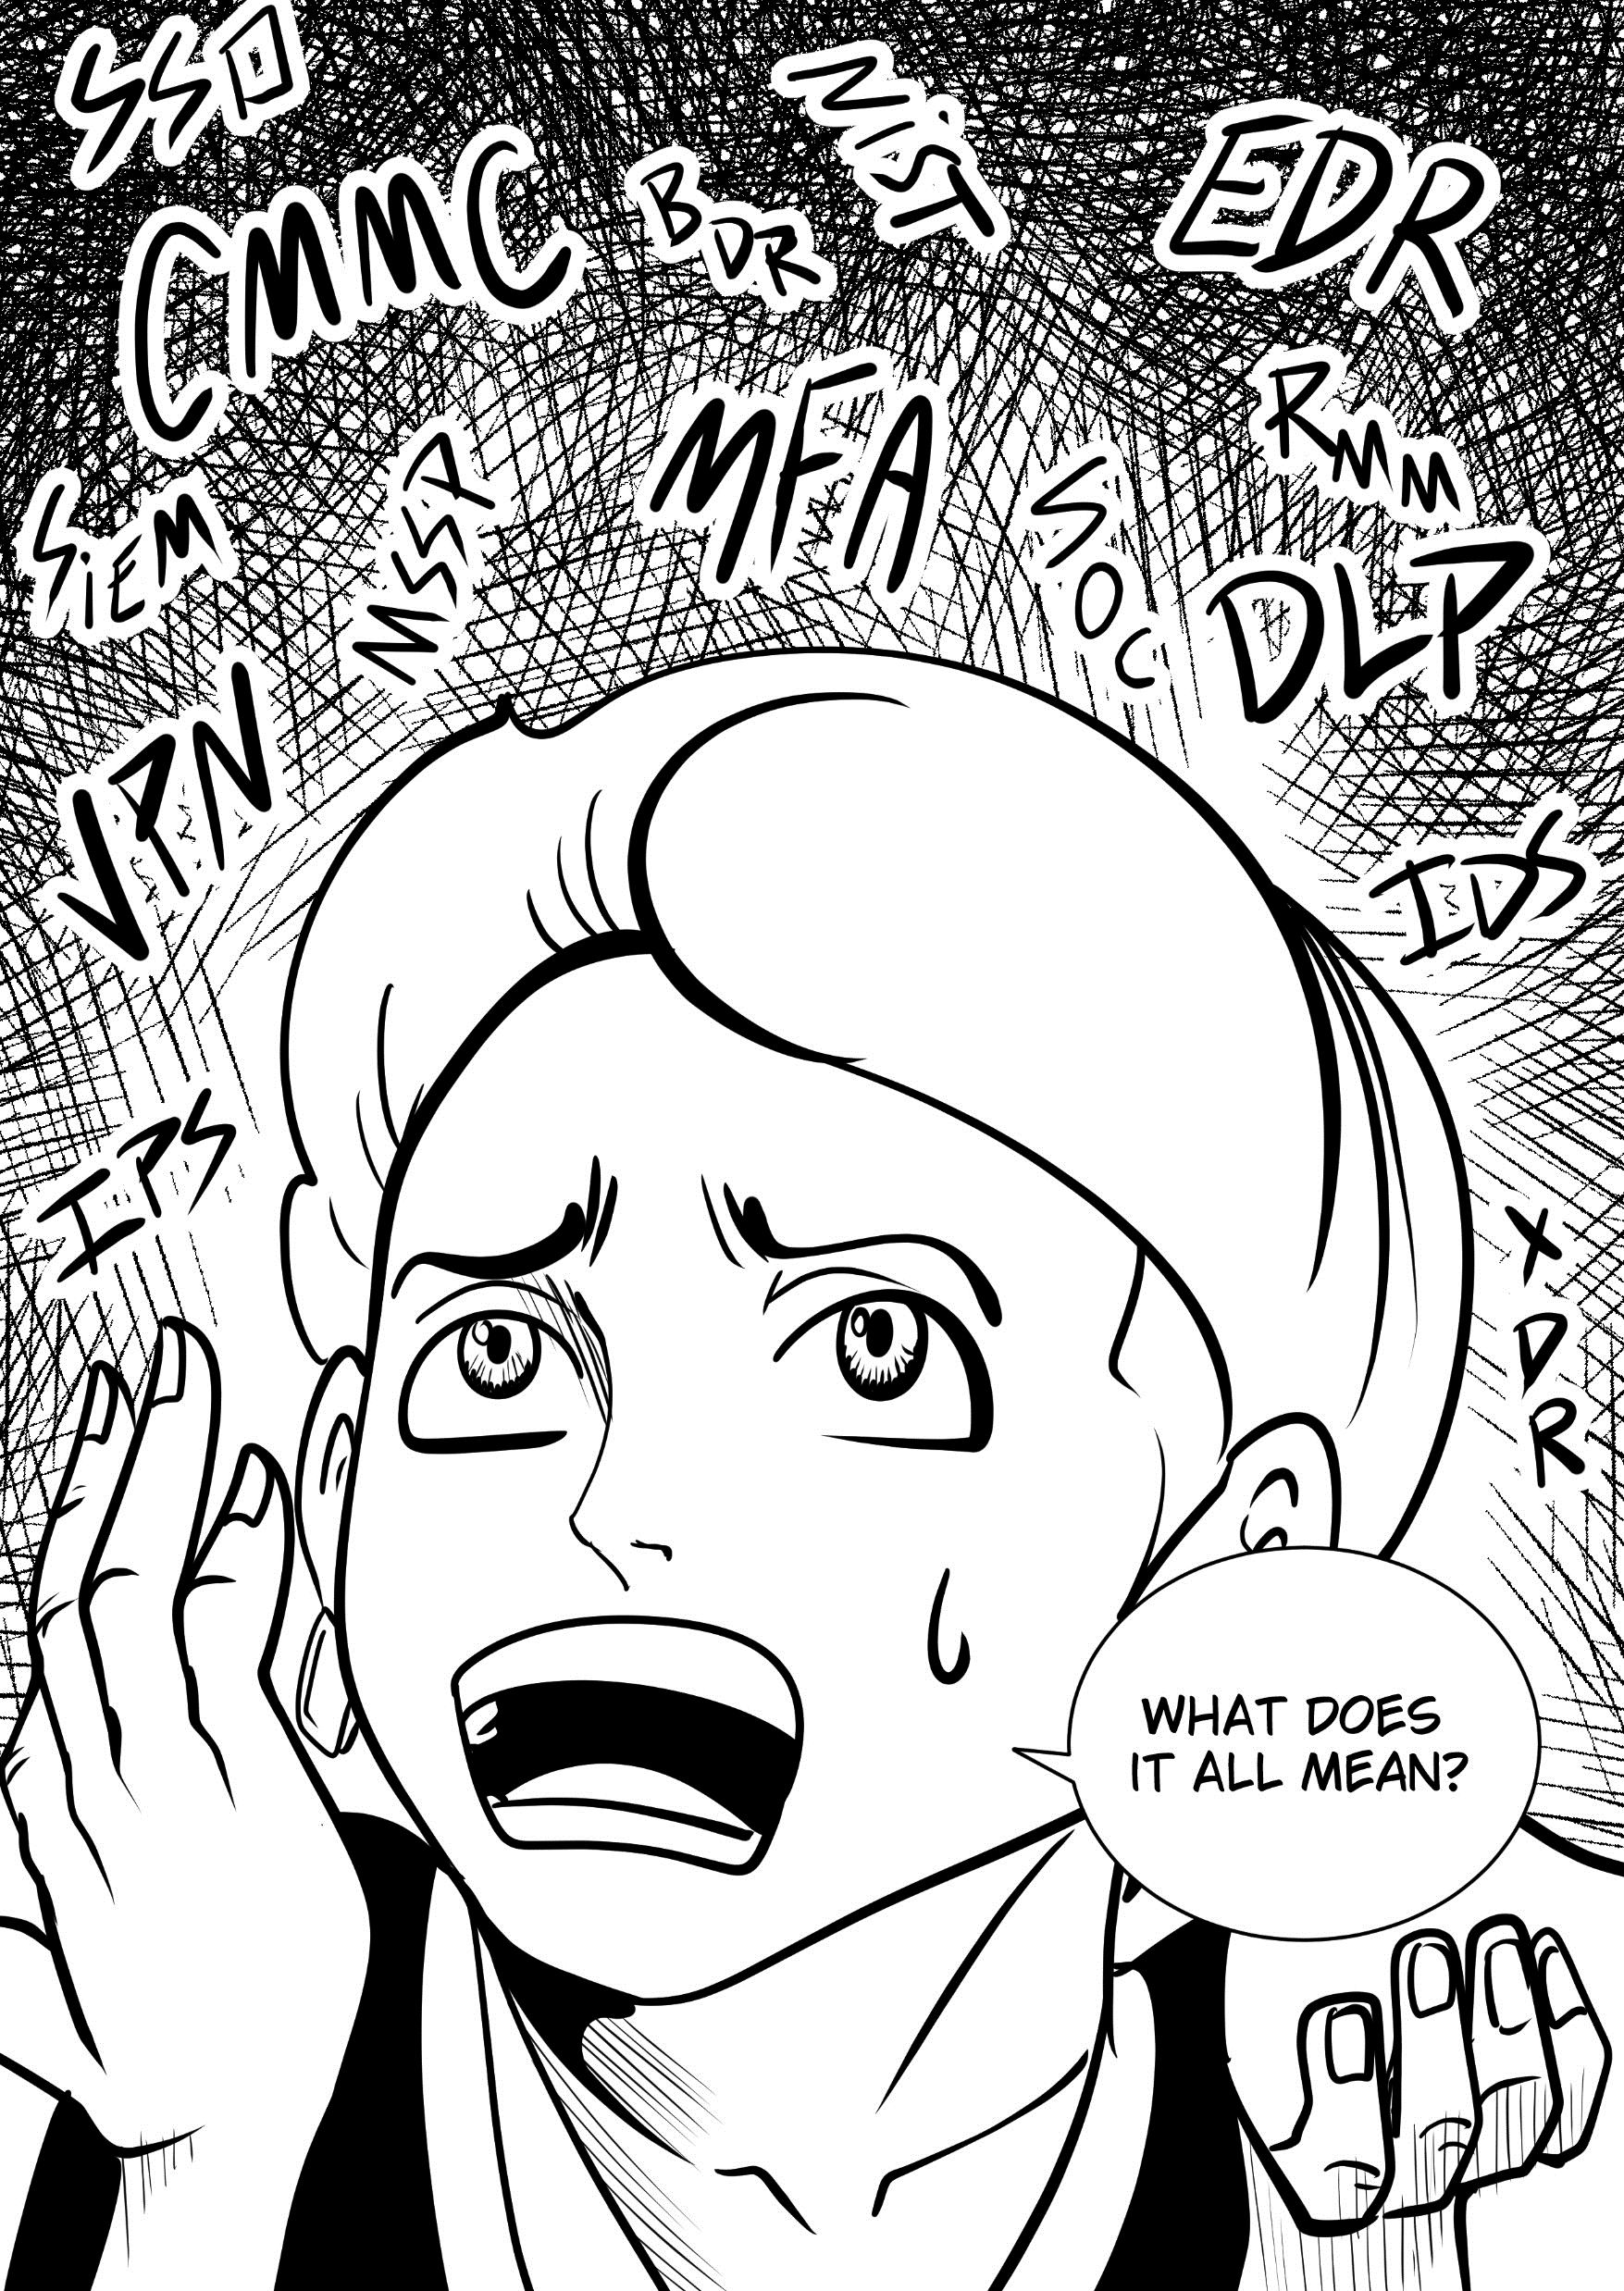

Slide 37


Help us do our jobs better by taking a brief survey to be entered to win a
$50 Amazon Gift:
https://www.surveymonkey.com/r/22SZ696?rexr_p=current

Slide 38

Thank you for attending:
RELAX: Humanizing Security
Ken Fanger, President
Email: kfanger@ontechpartners.com
Phone: 216-920-3100
Website: ontechnologypartners.com

