Slide 1
Pixel Tracking
What’s it really doing ?
Barry Kimball

Slide 2
What we will cover
What a Pixel is
How they are used
How its abused and seen attacks
Things you can do or not….

Slide 3
Who Am I ?

Slide 4
What is a pixel
Short for Picture element
A Dot that makes up the screen usually square
Properties of a pixel include RGB #’s or CMYK
the new RGBY in recent years
First use in print 1965

Slide 5
The Code
Examples in HTML
<img src="TRACKING-PIXEL-URL" style="position:absolute;visibility:hidden">
<img src="TRACKING-PIXEL-URL" style="display:none">
<img src="TRACKING-PIXEL-URL" width="0" height="0">
What’s it doing ?
Image request from external site giving your IP

Slide 6
What was it for ?
Originally used to save space
Page Counters
Where are people from looking at my site

Slide 7
Some the uses today
Used to trigger cookies
Web Page Traffic
Email tracking
Advertising
Making money
Weaponized ?

Slide 8
What every browser knows about you
Your IP , Previous Site
Internet speed
Software – OS , Browser, Plugins,
Hardware specs - Cpu , Video card, Resolution, Battery level
Devices on your local Lan
Social Media – Logged in to
Autofill
Geolocation and Gyroscope

Slide 9
Reason to use pixel’s
Track clients traffic
Analytics / Ad Sales
Direct Marketing
Regional / Interest
Save Money
Spam Cost
Data Intelligence
Document usage

Slide 10
Email Tracking
Recent years email even joined in pixel tracking
Companies like
Yesware
Bananatag
Streak

Slide 11
Online Spies
Amazon has a disconcerting habit of following you around the web.
Apple - iPhones and iPads collect a lot of data about you and it’s accessible 3rd party apps too.
Facebook - tracks your visits to other websites to build up a scarily detailed profile of your lifestyle and interests.
Google - knows a huge amount about our movements and interests. You can find out everything it’s learned about you at myaccount.google.com

Slide 12
Darkside of Pixel’s
Malware tracking
Banner infection
Steganography attack
Phishing attack informing
Microsoft document passing
Script execution
Cookie query
3rd party cookie replacement
Allows ad retargeting on other sites

Slide 13
Check Point Report (4/17/2017)
When you look at files from your cloud, are they looking back at you?
Warning pixels capture information such as IP addresses, hostnames, operating systems, Web-browser types, dates the image was viewed, use of cookies, and other information
Allowing better phishing attack demographic
if your IT workloads are on a cloud platform, you should add pixel tracking to your list of cloud security issues

Slide 14
Types of data leaks from pixel
Web beaconing Microsoft documents
Cloud documents
Who is using the document
Where is the user
How often is it used
Office 365 delivering Trojans via pixel call in documents
Advises use Protected View to read files local install

Slide 15
Types of data leaks from pixel
Flash -
Ursnif family - stealing e-mail credentials, logging keystrokes, taking screenshots and videos, and acting as a backdoor
Ramnit variety of malware - most of the same capabilities and mainly targets the banking industry
Countly – Heavily modified and using javascript to execute code imbedded in the images
JavaScript – Parse file system, detect AV , site redirects
AdThink and OnAudience – scripts datamine by injecting invisible login forms in the background

Slide 16
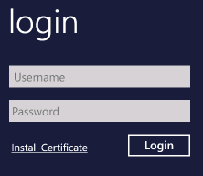
More recent attacks
South Korea attack on bank

Slide 17
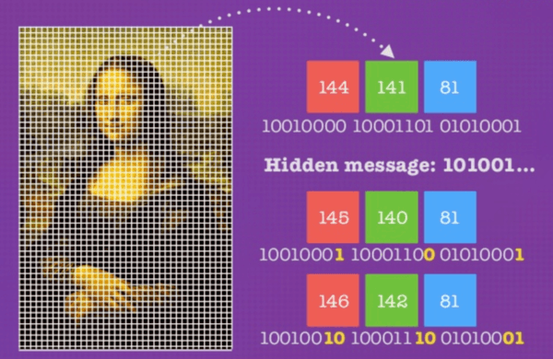
Steganography example

Slide 18
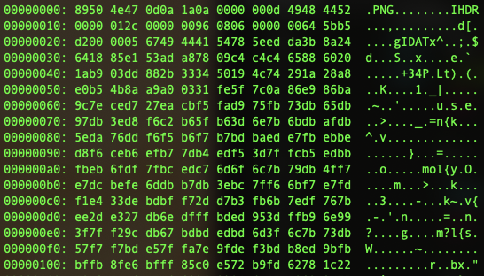
Confiant & Malwarebytes
Uncover Steganography Based Ad

Slide 19
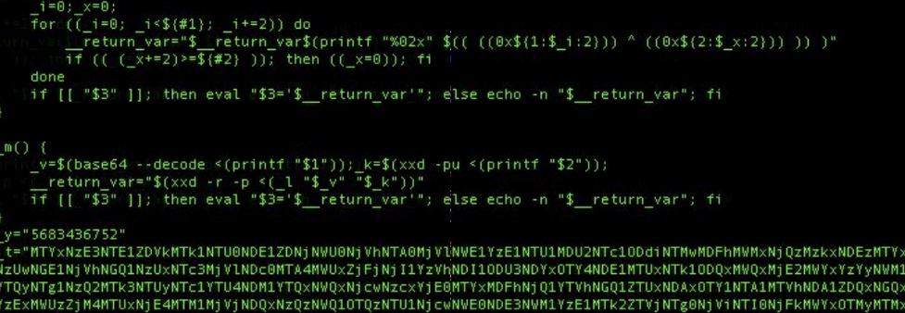
Remove the base64 coding and Decrypt with OpenSSL
Notes:
The script removes another layer of base64 leaving string of HEX converted to ASCII Give us the code

Slide 20
Options
Major web browsers - donottrack.us – Electronic Frontier Foundation
Incognito - fingerprinting
The only problem with this system is that compliance is completely optional, so websites that want to follow you still can.
VPN / TOR
OS
TENS / Tails / variety of linux distro’s

Slide 21
Plugin Options
Email
Thunderbird
Chrome - UglyMail
Browser Add-on
Chrome / Foxfire / Safari –High Sierra (Intelligence Tracking Prevention)
Ad block - uBlock Origin
Pixel Track
Ghostery
PixelBlock
NoScript

Slide 22
Controversy
Ad-Blocker
Microsoft
Website retaliate

Slide 23
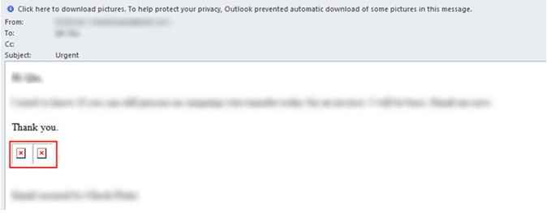
Thunderbird

Slide 24
Ugly-Mail

Slide 25
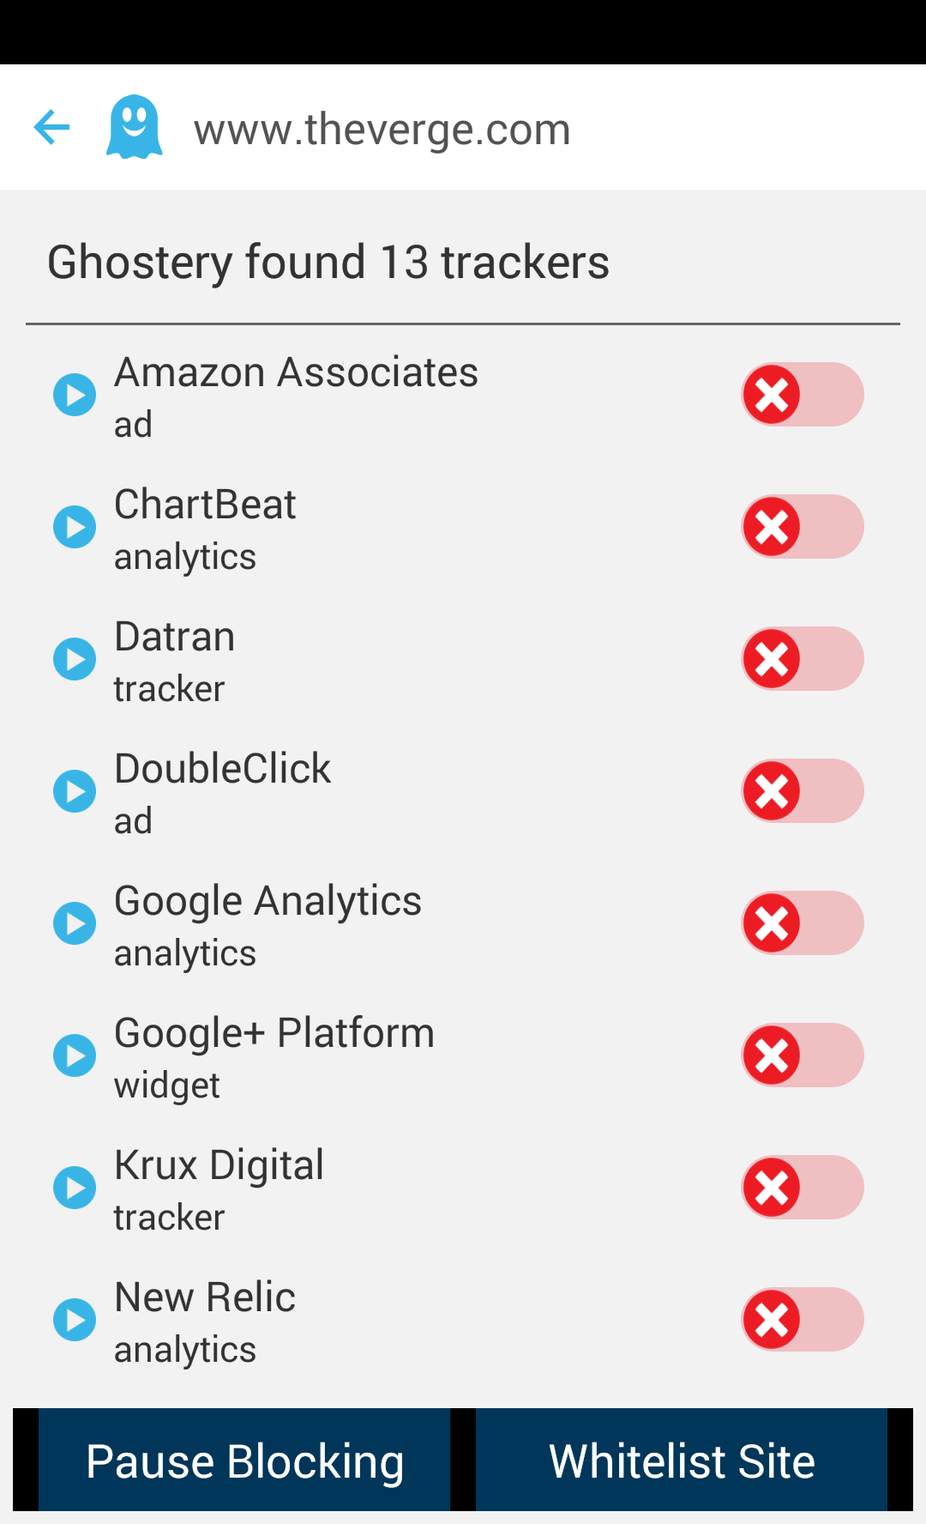
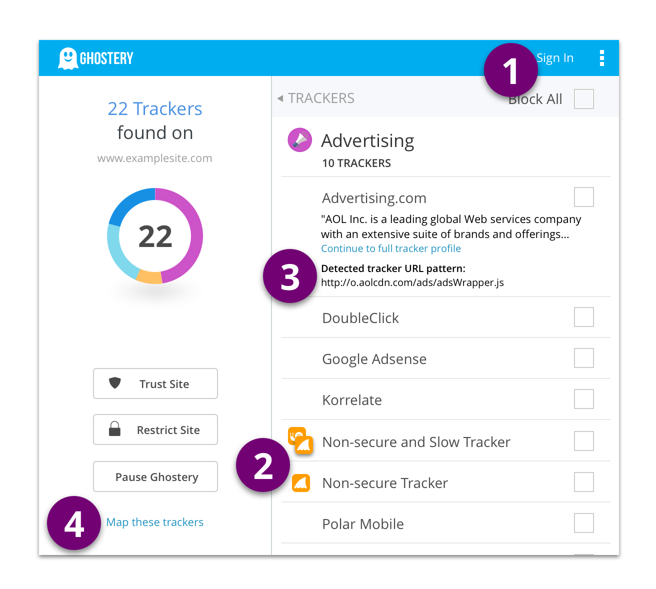
Ghostery

Slide 26
PixelBlock

Slide 27
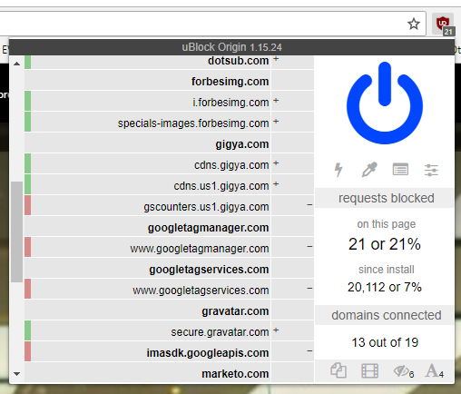
uBlock Origin / Nano Defender

Slide 28
NoScript

Slide 29
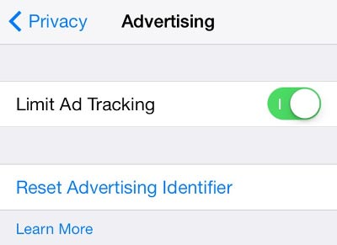
Apple Devices

Slide 30
Privacy Badger

Slide 31
Firewall Packages
PFSense
pfBlockerNG
EasyList
https://forum.pfsense.org/index.php?topic=125911.0
Several good links for Malware trackers and AdAway lists

Slide 32
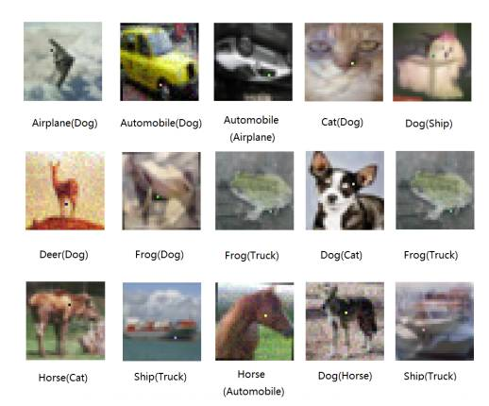
Cornell Research
Effects of a Pixel on AI Machine Learning
Changing as many as 5 pixels cause 87% misidentification drift

Slide 33
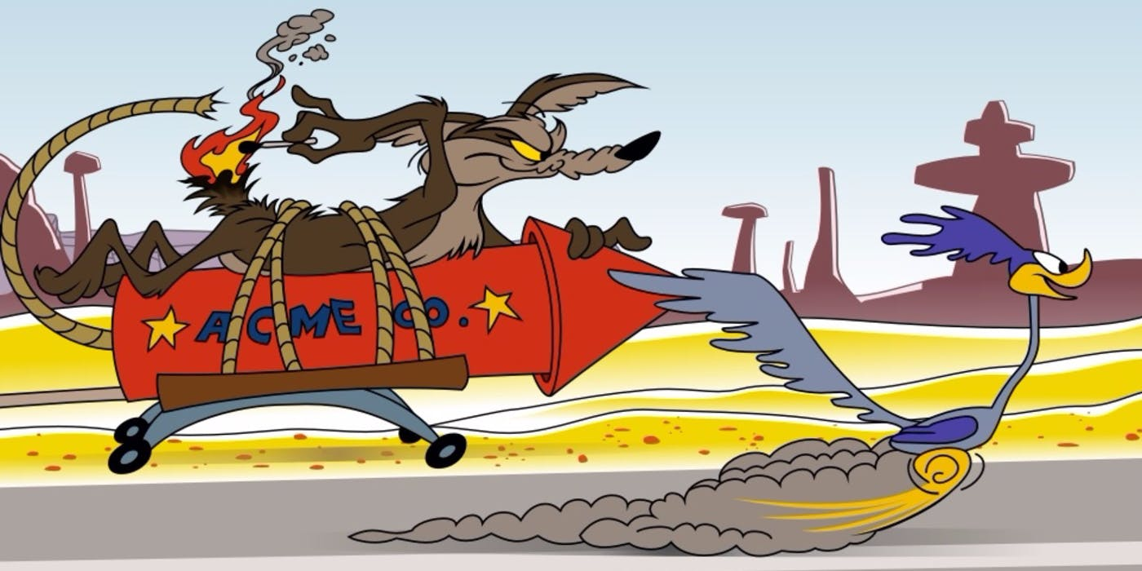
Facebook Pixel
Oct 5th Announced they would give 1st party cookie access to advertisers
Advertisers have till Oct 24th to opt out of this changed model
Allows 3rd parties to trace data via hosting site access unable to filter ad’s from content

Slide 34
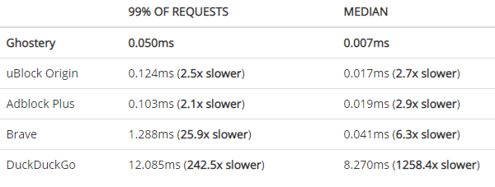
Google targeting plugin ad Blockers
Rolling out their own AdBlocker in Chrome later this year
Google Ad’s get a pass

Slide 35
Joe Chasinga

Slide 36
Interesting Sites
https://www.eff.org/privacybadger
http://webkay.robinlinus.com/
info your browsing is leaking
https://takeout.google.com/
What Google/YouTube knows about you
https://www.facebook.com/help/1701730696756992
What Facebook knows about you

