Slide 1
Software Security: The Critical Role of Software Bill of Materials (SBOM)
Dave Hatter, CISSP, CISA, CISM, CCSP, CSSLP, PMP, ITIL
Director of Business Growth Intrust IT
linkedin.com/in/davehatter twitter.com/davehatter

Slide 2
Agenda
Software Defined Everything (SDE)
Software Supply Chain Threats
Changing Nature of Software Development
Increasing use of Free and Open Source Software (FOSS)
Executive Order 14028
Software Bill of Materials (SBOM)
Why we need them
SBOM Requirements
SBOM Formats
Secure by Design / Secure By Default

Slide 3
Notes:
https://benitocastrocom.files.wordpress.com/2019/11/e58d3-startups.jpg
Software Defined Everything (SDE) / Internet of Everything (IoE)
So much of an organization’s operations and sensitive data are online and in the cloud.

Slide 4
Digital-first Economy
Software Defined Everything (SDE): Traditional, hardware-centric components are abstracted and controlled through software, enabling dynamic provisioning, management, and optimization of resources across various domains. This approach extends across networks, storage, computing, and even security.
Software Defined Networking (SDN)
Software Defined Storage (SDS)
Software Defined Data Center (SDDC)
Notes:
ChatGPT v3
Ten years after the publication of the oft-quoted Marc Andreessen op-ed ”Why software is eating the world,” lines of code are still revamping industry dynamics and generating fresh revenue streams. Disruption has even accelerated given wider cloud adoption and the influence of AI.
Internet of Everything (IoE)

Slide 5
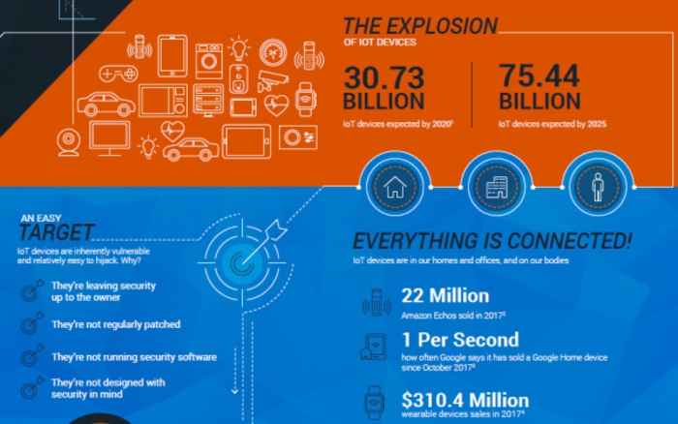

Slide 6
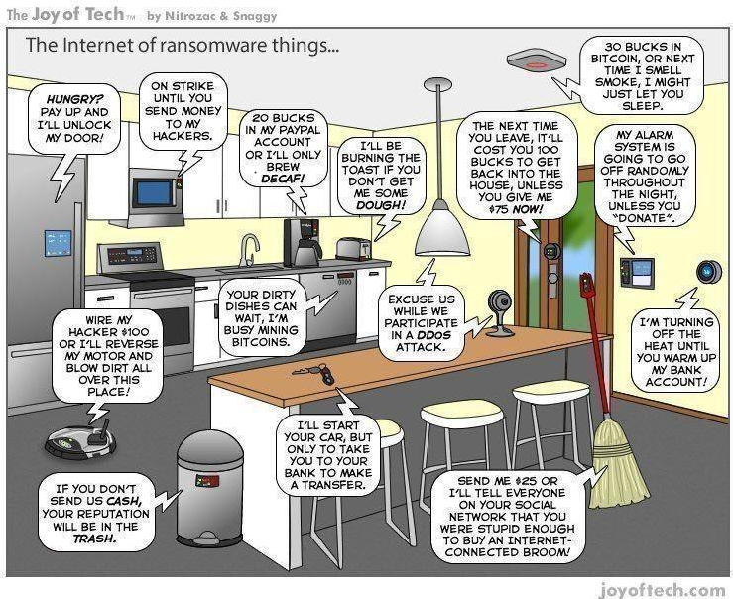
Notes:
Internet of Insecure Things

Slide 7
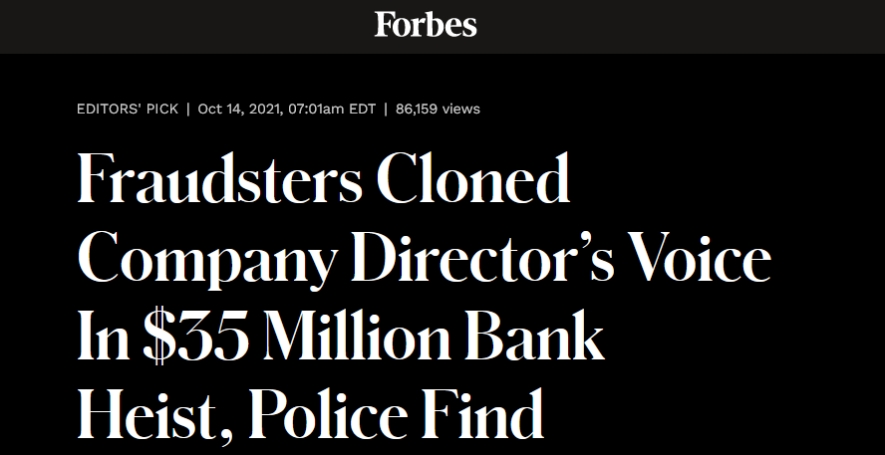
Notes:
ransomware attacks globally surged 40 per cent to reach 199.7 million hits in the third quarter of this year, according to a report from cybersecurity firm SonicWall.
https://phoenixnap.com/blog/ransomware-statistics-facts

Slide 8
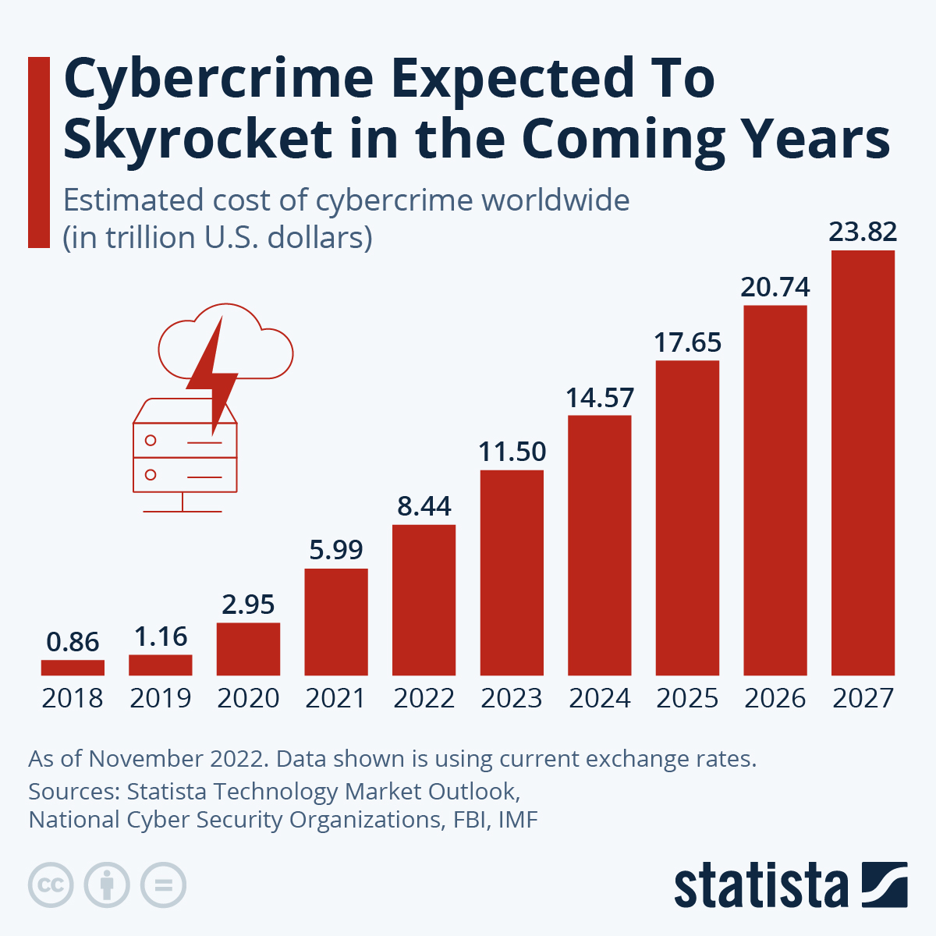

Slide 9
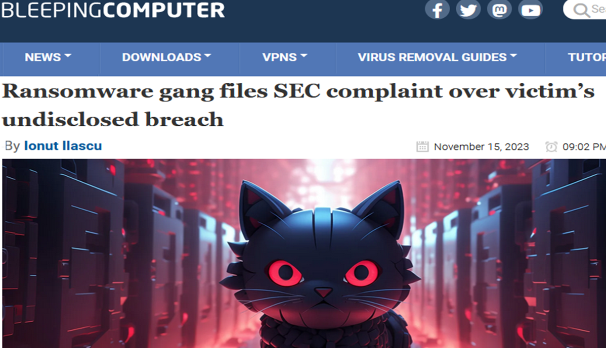
In their own words, the attacker told the SEC that MeridianLink suffered a “significant breach” and did not disclose it as required in Form 8-K, under Item 1.05.
Notes:
The ALPHV/BlackCat ransomware operation has taken extortion to a new level by filing a U.S. Securities and Exchange Commission complaint against one of their alleged victims for not complying with the four-day rule to disclose a cyberattack.

Slide 10
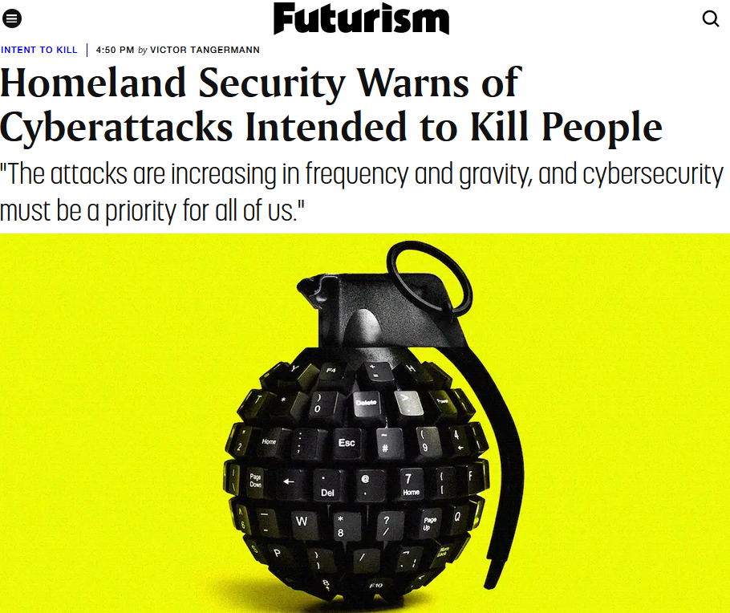
Notes:
Warnings from WH, FBI, DHS

Slide 11
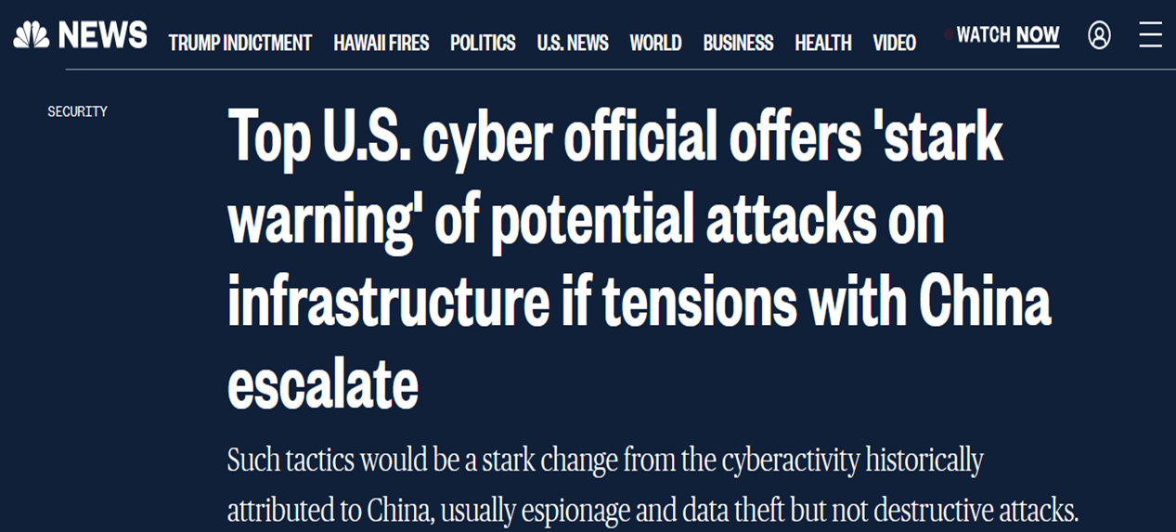
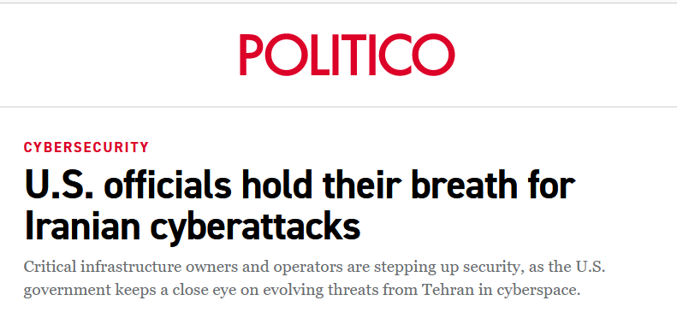
Notes:
Warnings from WH, FBI, DHS

Slide 12
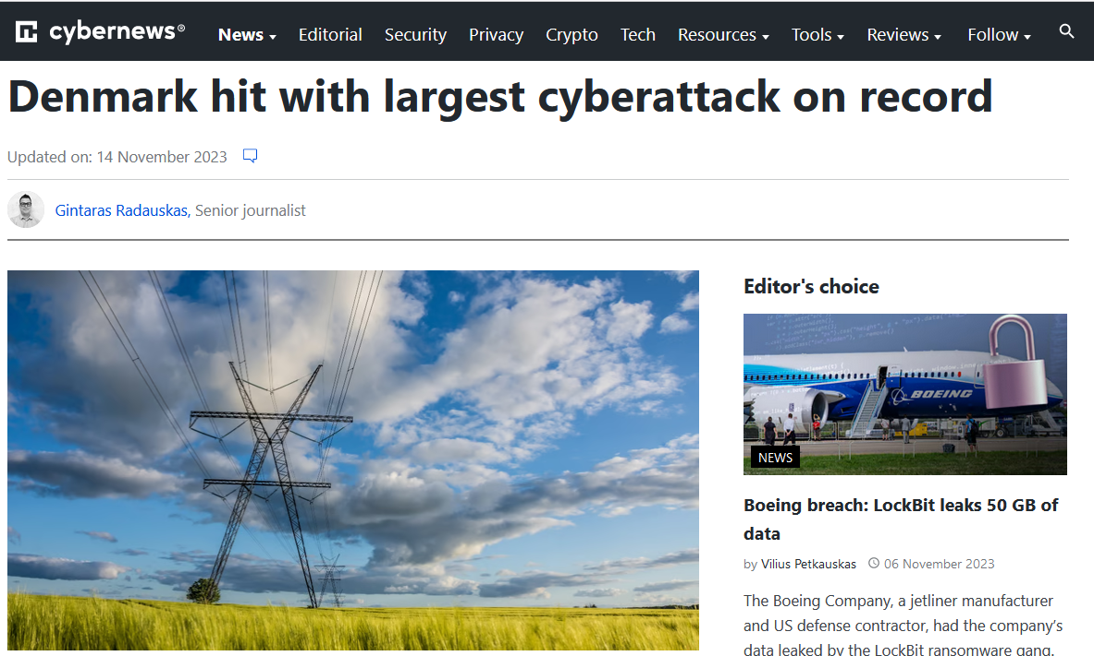
Notes:
According to SektorCERT’s experts, attackers gained access to the systems of 22 companies overseeing various components of Denmark’s energy infrastructure in May 2023.
The report (PDF) says that zero-day vulnerabilities in Zyxel firewalls used by many Danish infrastructure operators to protect their networks were exploited.
Australian ports, Colonial pipeline, JBS, Oldsmar, Huber Heights

Slide 13
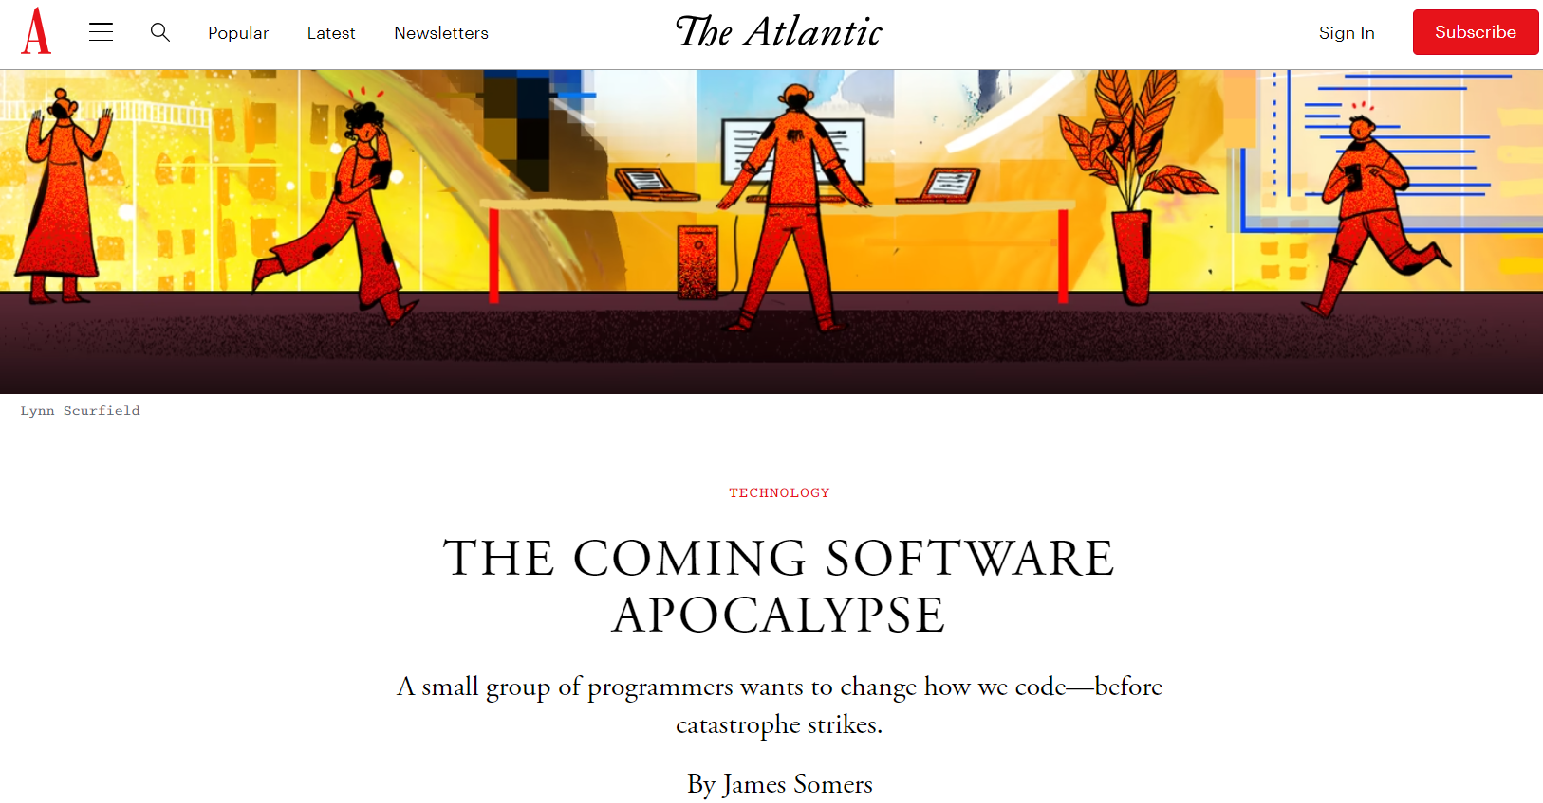
Notes:
According to SektorCERT’s experts, attackers gained access to the systems of 22 companies overseeing various components of Denmark’s energy infrastructure in May 2023.
The report (PDF) says that zero-day vulnerabilities in Zyxel firewalls used by many Danish infrastructure operators to protect their networks were exploited.
Australian ports, Colonial pipeline, JBS, Oldsmar, Huber Heights

Slide 14
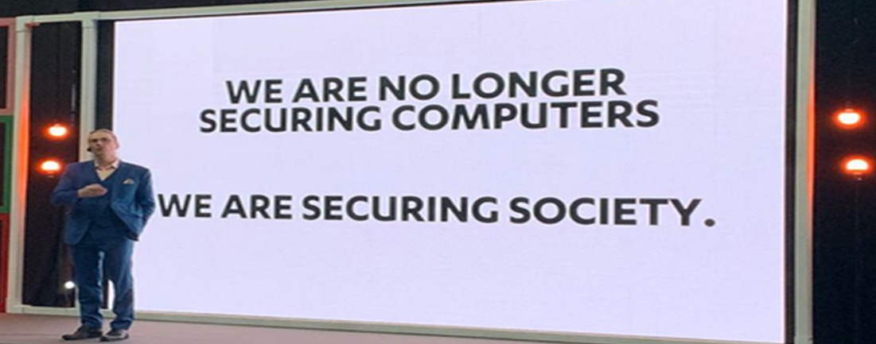
Notes:
Mikko

Slide 15
Security
The protection of information and systems from unauthorized access, use, disclosure, disruption, modification, or destruction. It involves implementing a range of technical, administrative, and physical controls to safeguard against potential threats and vulnerabilities.
Notes:
ChatGPT

Slide 16
Security Control
A measure or mechanism put in place to reduce the risk of a security threat, vulnerability, or attack. They protect the confidentiality, integrity, and availability of information and systems and
reduce or eliminate threats and vulnerabilities that could lead to unauthorized access, use, disclosure, disruption, modification, or destruction of data or systems
Notes:
Countermeasures or safeguards that reduce the likelihood of a threat exploiting a vulnerability
They protect the confidentiality, integrity, and availability of information and systems and reduce or eliminate threats and vulnerabilities that could lead to unauthorized access, use, disclosure, disruption, modification, or destruction of data or systems.

Slide 17
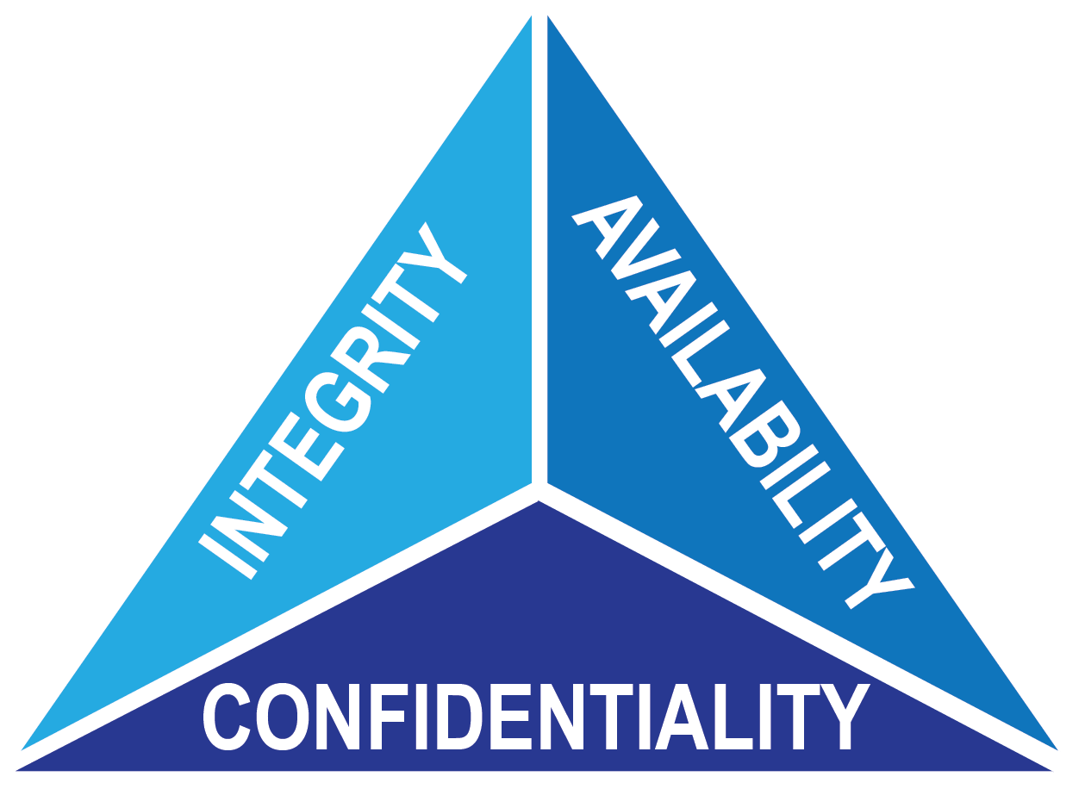
Notes:
https://www.energy.gov/eere/femp/operational-technology-cybersecurity-energy-systems

Slide 18
Software Demand Is Exploding
500 million apps will be built over the next five years – Microsoft
76 billion IoT devices online by 2025
Demand to increase at least 5x faster than conventional IT departments – Gartner
Average IT project backlog between 3 and 12 months – Appian
Notes:
A World of Software Defined Everything (SDE)

Slide 19
Development Is Evolving
Desire to increase productivity & decrease costs
The days of large proprietary codebases are over
Microservices: apps built with 3rd-party components
“Citizen Development”
Notes:
FOSS: Free and Open Source Software

Slide 20
Citizen Development
“A process that encourages non-IT-trained employees to become software developers, using IT-sanctioned low-code/no-code (NCLC) platforms to create business applications.” - TechTarget
Notes:
https://www.techtarget.com/searchsoftwarequality/definition/citizen-developmentOffers faster development times compared to traditional coding

Slide 21
Citizen Development Emerges
Large enterprises will have 4x more citizen developers than professionals by 2023 – Gartner
26% of executives see NCLC platforms as the most critical for to automation – KPMG
70% of new apps delivered by large enterprises will rely on NCLC solutions - Gartner

Slide 22
FOSS Continues Its Rise
2022 Open Source Security and Risk Analysis Report: FOSS accounts for 75% of codebases on average
Lack of identification of an application’s components introduces cybersecurity risks including out of date and vulnerability laden code
Notes:
FOSS: Free and Open Source Software

Slide 23
Notes:
https://wiki.owasp.org/images/b/bd/Software_Composition_Analysis_OWASP_Stammtisch_-_Stanislav_Sivak.pdf
FOSS – Free and open source software

Slide 24
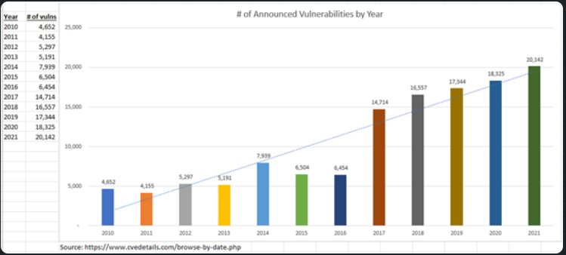
Software Vulnerabilities

Slide 25
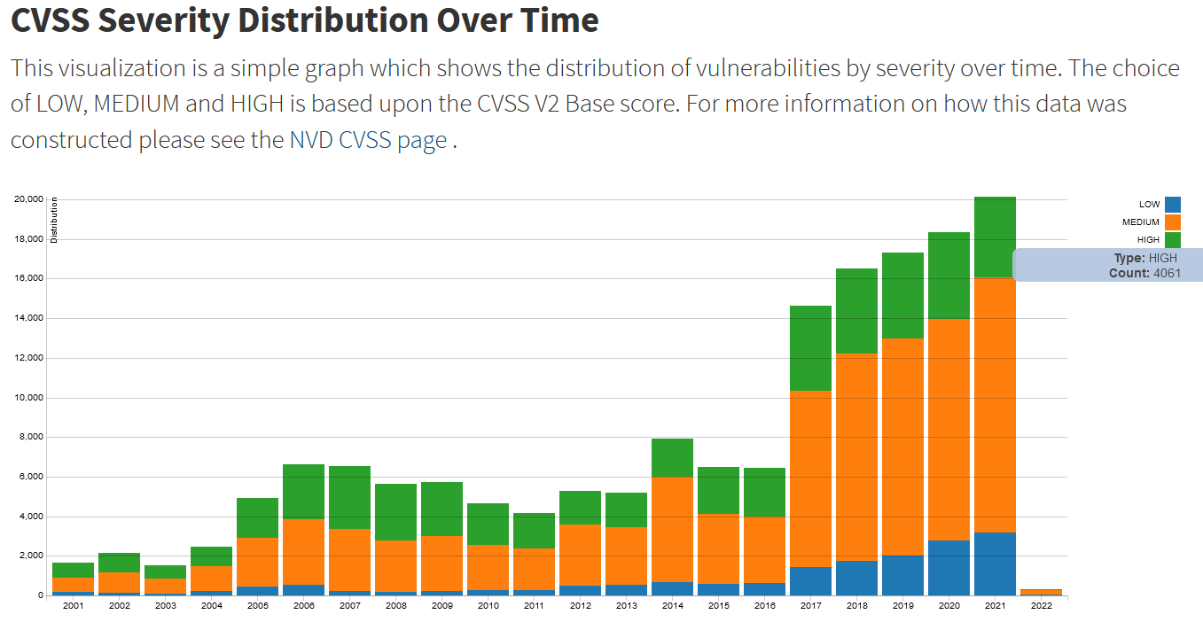
Software Vulnerabilities

Slide 26
Software Vulnerabilities
Ponemon Institute: 57% of security breaches were due to vulnerabilities in unpatched software
34% of cybercrime victims were aware of holes but didn’t patch them in time
37% of breach victims don’t perform regular scans to find vulnerabilities in their own systems
Synopsys “Open Source Security and Risk Analysis” (OSSRA) audited a total of 1,703 codebases in 2022, 96% contained open source
Notes:
https://www.synopsys.com/blogs/software-security/open-source-trends-ossra-report/

Slide 27
Software Vulnerabilities
Of the 1,703 total audited codebases:
89% contained open source that was more than four years out-of-date
54% of audited codebases contained codebases with license conflicts
Of 1,481 of audited codebases that included security and operational risk assessments:
84% contained at least one vulnerability
48% contained at least one high-risk vulnerability
Notes:
https://www.synopsys.com/blogs/software-security/open-source-trends-ossra-report/
There are justifiable reasons for not keeping software up-to-date, but it’s likely that a large percentage of the 91% is due to DevSecOps teams not being aware that a newer version of an open source component is available.

Slide 28
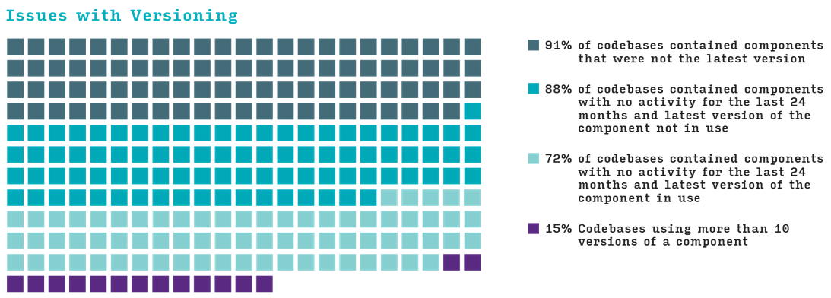
Notes:
https://www.synopsys.com/blogs/software-security/open-source-trends-ossra-report/

Slide 29
OWASP TOP 10
Common issues across the years:
Injection, Misconfiguration, Authentication, Access Control
SBOM specific issues:
Using Components with Known Vulnerabilities / Vulnerable and Outdated Components
Notes:
Open Web Application Security Project - OWASP Foundation

Slide 30
3rd-Party Risk
“Whether an incident is material is not based on where the relevant electronic systems reside or who holds them. In other words, we do not believe a reasonable investor would view a significant breach of a registrant’s data as immaterial merely because the data were housed on a third-party system, especially as companies increasingly rely on third-party cloud services that may place their data out of their immediate control.”

Slide 31
3rd-Party Risk
Some of the world’s worst hacks due to 3rd-parties
New SEC cybersecurity incident disclosure requirements call 3rd-party cyber risk a material business risk
SEC final rule says 98% of organizations use at least one 3rd-party vendor breached in the last two years
SEC final rule mentions “third-party” 39 times

Slide 32
3rd-Party Risk
Two basic forms:
Breach through a vendor or partner
FOSS: 2022 Open Source Security and Risk Analysis Report: FOSS accounts for 75% of codebases on average

Slide 33
EO 14028
Notes:
Executive Order 14028
11 matches
Solar Winds, Log4j

Slide 34
EO 14028
"...providing a purchaser a Software Bill of Materials (SBOM) for each product directly or by publishing it on a public website"
All US government software vendors were required to submit documentation, including SBOMs, by September 14, 2023, or June 11 if the software is deemed critical.
Notes:
Both the UK and the EU have followed suit in issuing their own cyber security acts with similar demands.

Slide 35
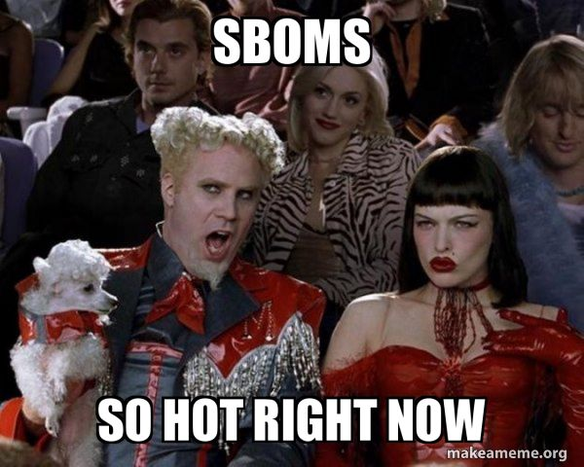
Notes:
From a security perspective, SBOMs are valuable because they ensure that the software is up-to-date and patched against known security vulnerabilities. -

Slide 37
Bill of Materials (BOM)
A comprehensive list of components, materials, parts, and sub-assemblies required to manufacture a product
A crucial document in various industries, including manufacturing, engineering, construction, and product development
A detailed breakdown of the items needed to create a particular product, along with relevant information such as quantities, part numbers, descriptions, and sometimes even costs
Notes:
ChatGPT

Slide 38
Notes:
https://www.optiproerp.com/blog/10-types-boms-explained/

Slide 39
Software Bill of Materials (SBOM)
Analogous to a traditional BOM, but for software
Structured list defining the composition of software
Provides a detailed inventory of all the third-party and open-source components, libraries, frameworks, and dependencies that are used to build a software application.
Notes:
ChatGPT
It documents all the code components that are used in building your product; particularly the open-source elements.
A nested description of software artifact components and metadata.

Slide 40
Software Bill of Materials (SBOM)
Formal record containing the details and supply chain relationships of various components used in building software
Enumerates components in a product
Provides a detailed inventory of all 3rd-party and open-source components, libraries, frameworks, and dependencies in a software application
Allows developer to:
Ensure components are up to date
Respond quickly to new vulnerabilities
Notes:
EO 14028

Slide 41
Software Bill of Materials (SBOM)
A nested inventory, a list of ingredients that make up software components. - CISA
Buyers can use an SBOM to perform vulnerability or license analysis
Those who operate software can use SBOMs to quickly and easily determine whether they are at potential risk of a newly discovered vulnerability
Notes:
EO 14028
You can’t protect it if you don’t know you have it

Slide 42
Software Bill of Materials (SBOM)
A formal, machine-readable inventory of software components and dependencies (which result from combining various OSS components, third-party code, and code developed in-house), technical information about those components, and the code’s hierarchical relationships - McKinsey
Notes:
https://www.mckinsey.com/capabilities/risk-and-resilience/our-insights/cybersecurity/software-bill-of-materials-managing-software-cybersecurity-risks

Slide 43
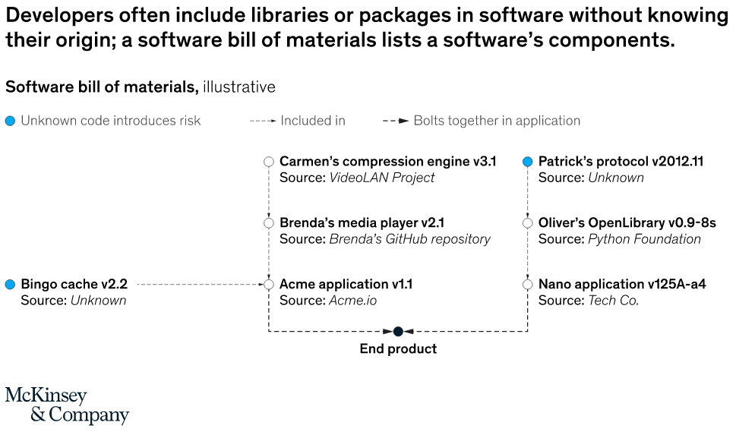
Notes:
https://www.mckinsey.com/capabilities/risk-and-resilience/our-insights/cybersecurity/software-bill-of-materials-managing-software-cybersecurity-risks

Slide 44
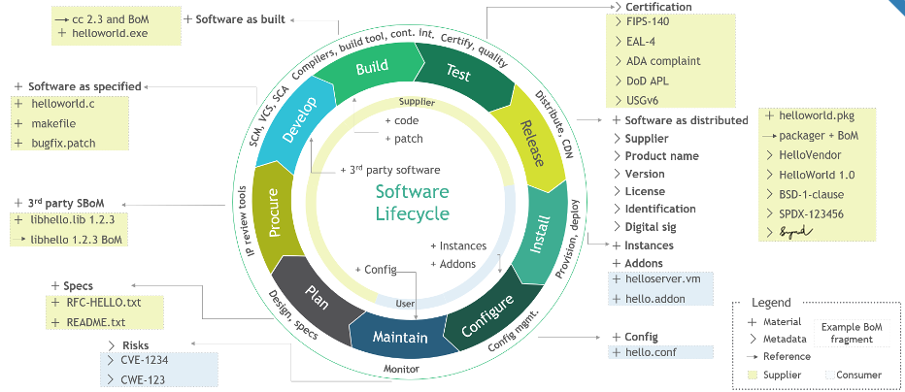
Notes:
How an SBOM may be assembled across the SDLC.
https://www.nist.gov/itl/executive-order-14028-improving-nations-cybersecurity/software-security-supply-chains-software-1

Slide 45
Why Use an SBOM?
Identify & correct vulnerabilities
Create transparency
Qualify vendors
Manage software supply chain risk
Verify license compliance
Foundation for Zero-Trust
Indicative of a developer’s or supplier’s application of secure development practices
Compliance: NIST SP 800-161 Rev1 / EO 14028

Slide 46
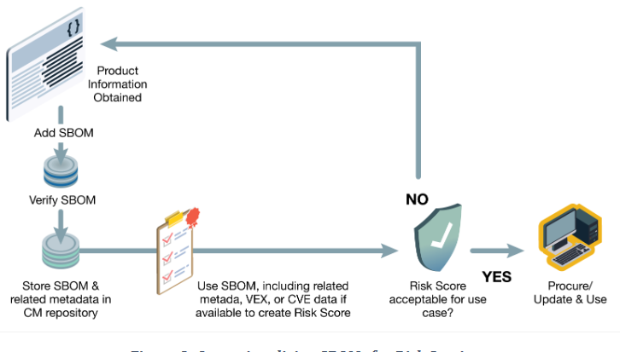
Notes:
CISA

Slide 47
Why Use an SBOM?
The Linux Foundation Research Team reported:
51% of organizations say SBOMs make it easier for developers to understand dependencies across components in an application
49% say SBOMs make it easier to monitor components for vulnerabilities
44% say SBOMs make it easier to manage license compliance

Slide 48
Who Uses an SBOM?
Traditionally used by compliance teams
Increasingly used by:
Security teams
Development teams

Slide 49
What’s in an SBOM?
The National Telecommunications and Information Administration (NTIA) released “The Minimum Elements For a Software Bill of Materials” RE: EO 14028
Supplier Name
Component name
Version of the component
Other unique identifiers
Dependency relationship
Author of SBOM data
Timestamp
Notes:
https://www.ntia.doc.gov/files/ntia/publications/sbom_minimum_elements_report.pdf

Slide 50
SBOM Minimum Requirements
One of three machine readable formats:
SPDX
CycloneDX
Software Identification Tagging (SWID)
Generate a new SBOM for each new version
Explain dependencies that may exist but are unknown to the developer
Notes:
https://www.ntia.doc.gov/files/ntia/publications/sbom_minimum_elements_report.pdf

Slide 51
SBOM Formats
Software Product Data Exchange (SPDX):
An international open standard (ISO/IEC 5962:2021) format for communicating the components, licenses, and copyrights associated with software. Open source project from Linux Foundation
Software Identification Tagging (SWID):
Contain descriptive information about a specific release of a software product that provides a transparent way for organizations to track software installed on their devices
CyloneDX:
Lightweight standard useful for application security contexts and supply chain component analysis. Open source project from the OWASP community
Notes:
https://www.ntia.doc.gov/files/ntia/publications/sbom_minimum_elements_report.pdf
SPDX/SWID: 2009~2010
CycloneDX: 2017
SWID least popular

Slide 52
Foundational Capabilities
Conform to industry standard formats to enable the automated ingestion and monitoring of versions
Meet the NTIA’s Recommended Minimum Elements
Available for all classes of software – including purchased software, open source software, and in-house software
Requiring sub-tier software suppliers to produce, maintain, and provide SBOMs whenever practical
Maintain readily accessible and digitally signed SBOM repositories
Share SBOMs with software purchasers directly or publish them on a public website
Notes:
https://www.nist.gov/itl/executive-order-14028-improving-nations-cybersecurity/software-security-supply-chains-software-1

Slide 53
Sustaining Capabilities
Contextualize SBOM data with additional data elements that inform the risk posture of the acquiring entity
Includes plug-ins, hardware components, organizational controls, and other community-provided components
Integrate vulnerability detection with SBOM repositories for automated alerting RE security risks throughout the supply chain
Ensure that current SBOMs detail the supplier’s integration of commercial software components
Maintain vendor vulnerability disclosure reports at the component level
Notes:
https://www.nist.gov/itl/executive-order-14028-improving-nations-cybersecurity/software-security-supply-chains-software-1

Slide 54
Enhancing Capabilities
Develop risk management and measurement capabilities to dynamically monitor the impact of SBOMs’ vulnerability disclosures on the acquiring organization.
Align with asset inventories for further risk exposure and criticality calculations
Perform binary decomposition of software installation packages to generate SBOMs when no vendor-supplied SBOM is available (e.g., legacy software), when technically and legally feasible
Notes:
https://www.nist.gov/itl/executive-order-14028-improving-nations-cybersecurity/software-security-supply-chains-software-1

Slide 55
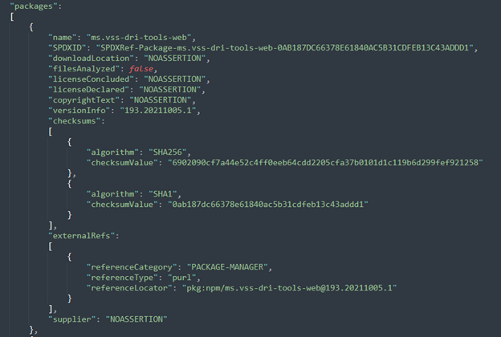
Notes:
JSON

Slide 56
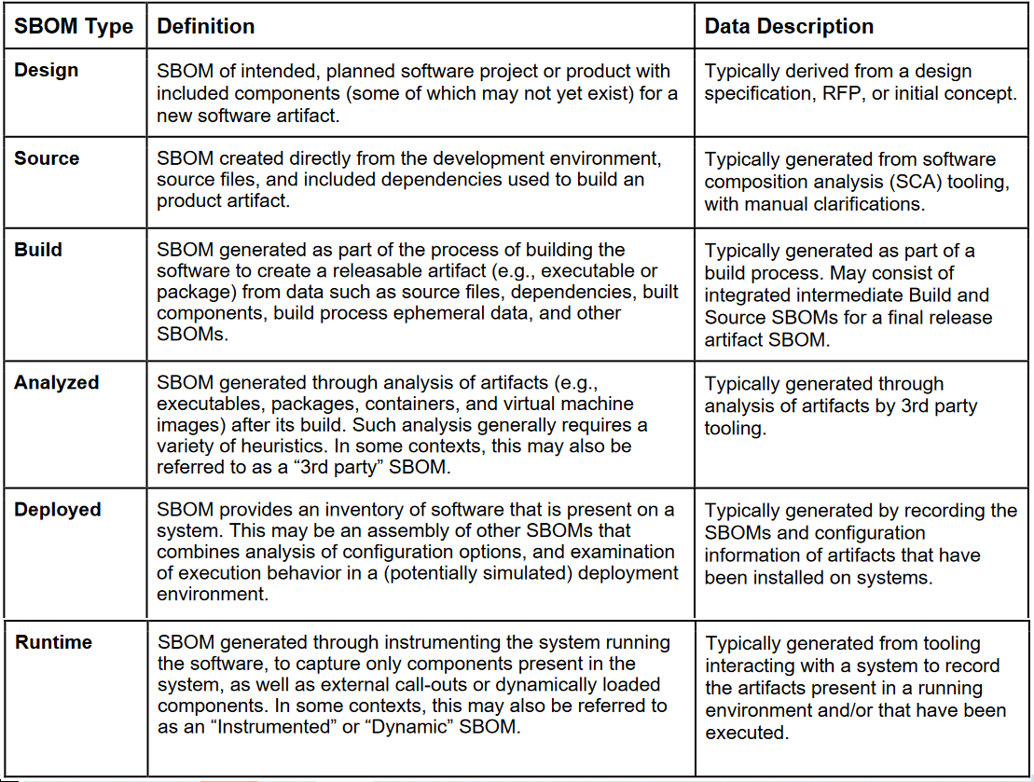
Notes:
Summarize the different types of SBOMs and the benefits and limitations of each type. This list of SBOM types is not intended to be tightly tied to the software lifecycle. Some SBOM types may be available and useful across multiple lifecycle phases, while others may be available only in one lifecycle phase. Also, the data presented within an SBOM type may vary, depending on the software’s lifecycle phase and industry
CISA
https://www.cisa.gov/sites/default/files/2023-04/sbom-types-document-508c.pdf

Slide 57
SBOM Creation
Manually
Software Composition Analysis (SCA) Tools
Software Build Process
Notes:
https://www.ntia.doc.gov/files/ntia/publications/sbom_minimum_elements_report.pdf
https://devblogs.microsoft.com/engineering-at-microsoft/microsoft-open-sources-software-bill-of-materials-sbom-generation-tool/
The SBOM generator is now referred to simply as sbom-tool.

Slide 58
SCA
Systematic process and set of tools aimed at identifying and assessing the FOSS software components used within an application
Thorough examination of the software's codebase to create an inventory of all components, libraries, frameworks, and dependencies that contribute to its functionality
Primary goal is to manage and mitigate security, licensing, and compliance risks associated with using third-party code
Notes:
ChatGPT

Slide 59
SCA Tools
Synk
Veracode
BlackDuck
Anchore
FOSSA
Mend
Rezillion
SPDX SBOM Generator
Notes:
ChatGPT

Slide 60
VEX
Vulnerability Exploitability eXchange
VEX is not technically part of SBOM, it can exist independently
Machine-readable security advisory that indicates if a product is affected by known vulnerabilities
Vulnerabilities identified in the SBOM may overstate the actual risks of a product
VEX helps to prioritize vulnerability risk
Using both maximizes the efficiency and security of using an SBOM
Notes:
Vulnerability Exploitability eXchange
CISA
Not all vulnerabilities in the dependencies of a software product actually affect the security of that product.

Slide 61
Secure By Design/By Default
Secure by Design:
Products where the security of the customers is a core business requirement, not just a technical feature
Secure by Default:
Products secure to use out of the box, with little to no configuration changes and are available at no additional cost, such as multi-factor authentication (MFA), gather and log evidence of potential intrusions, and control access to sensitive information
Notes:
https://www.cisa.gov/securebydesign

Slide 62
Secure By Design/By Default
"[Consumer] safety must be front and center in all phases of the technology product lifecycle — with security designed in from the beginning and strong safety features, like seatbelts and airbags, enabled right out of the box, without added costs. Security by Design includes actions like transitioning to memory-safe languages, having a transparent vulnerability disclosure policy, and secure coding practices.“ —Jen Easterly
Notes:
https://www.cisa.gov/securebydesign
CISA, the NSA, the FBI and other cybersecurity agencies worldwide have strongly encouraged every technology manufacturer to build their products in a way that prevents customers from having to constantly perform monitoring, routine updates, and damage control on their systems to mitigate cyber intrusions
US Cyber Trust Mark

Slide 63
Conclusion
Gone from nice to have to need to have
Identify and correct vulnerabilities
Ensure licensing compliance
Demonstrates commitment to quality and security
Protect the ever-growing software supply chain

Slide 64
Conclusion
Gartner says 60% of organizations building or procuring critical infrastructure software will mandate and standardize SBOMs by 2025
Linux Foundation Research said 78% of organizations expected to produce or consume SBOMs in 2022
Protect society!

Slide 65
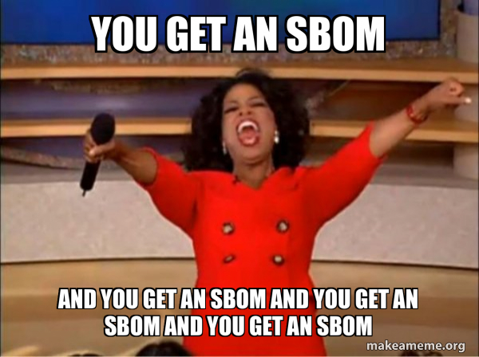

Slide 66
Notes:
Mikko

Slide 67
For more information:
Bruce Schneier:@schneierblog
US-CERT: @USCERT_gov
SecurityWeek: @SecurityWeek
Center for Internet Security: @CISecurity
MSRC: @msftsecresponse
NIST Cyber: @NISTcyber
Intrust IT: @IntrustIT
ODNI: @ODNIgov
CISA: CISAgov
MSRC: @msftsecresponse
Microsoft Secure: @msftsecurity
RSA: @RSAsecurity
Mikko Hypponen: @mikko
CSOnline: @CSOonline
Me: @DaveHatter

Slide 68
Additional Resources
https://www.ntia.gov/files/ntia/publications/ntia_sbom_formats_and_standards_whitepaper_-_version_20191025.pdf
https://www.cisa.gov/sbom
https://www.nist.gov/itl/executive-order-14028-improving-nations-cybersecurity/software-security-supply-chains-software-1
https://www.cisa.gov/sites/default/files/2023-04/sbom-types-document-508c.pdf
https://csrc.nist.gov/projects/Software-Identification-SWID
https://www.nist.gov/itl/executive-order-14028-improving-nations-cybersecurity/software-security-supply-chains-software-1
https://csrc.nist.gov/pubs/sp/800/218/final
https://csrc.nist.gov/pubs/sp/800/161/r1/final
https://www.cisa.gov/news-events/events/sbom-rama
https://www.cisa.gov/securebydesign
https://www.nsa.gov/About/Cybersecurity-Collaboration-Center/Enduring-Security-Framework/
https://media.defense.gov/2023/Nov/09/2003338086/-1/-1/0/SECURING%20THE%20SOFTWARE%20SUPPLY%20CHAIN%20RECOMMENDED%20PRACTICES%20FOR%20SOFTWARE%20BILL%20OF%20MATERIALS%20CONSUMPTION.PDF

Slide 69
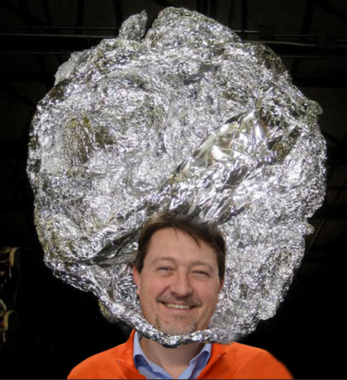
Q & A
“Cybersecurity is national security”
- NSA Director General Paul Nakasone

Slide 70
Thank You!
Dave Hatter, CISSP, CISA, CISM, CCSP, CSSLP, PMP, ITIL
Intrust IT
linkedin.com/in/davehatter
twitter.com/davehatter
Get our checklist: https://www.intrust-it.com/cyber-security/cyber-essentials-checklist/
Ask about our no-cost, no-obligation vulnerability assessment
Catch Tech Friday live on 55KRC at 6:30 AM every Friday on 550 AM or http://55krc.iheart.com
Catch Cyber Monday live on WTVG at 6:30 AM and Tech Support at 9:00AM every Monday on 13 ABC or https://www.13abc.com/

