Slide 1
Differential Privacy for Privacy Protection in Federated Learning
Speaker: Ahmed El Ouadrhiri
Samah Saeed Baraheem, Zhongmei Yao, Phu Phung
March 09, 2023

Slide 2
Biosketch
Ph.D. in computer science in 2017.
Assistant researcher at Alfaisal University (remotely).
Technical Project Manager at Carta Worldwide (Payment System).
Postdoctoral fellow at the University of Houston.
Postdoctoral fellow and Adjunct Faculty at the University of Dayton.

Slide 3
Agenda
Introduction
Federated Learning
Problem Description
Proposed Solution
Summary

Slide 4
Introduction
What is the difference between machine learning and deep learning?

Slide 5
Machine Learning (ML)
A model that includes one or at max two layers for learning.
Top 8 machine learning algorithms:
Linear regression
Logistic regression
Decision tree
SVM algorithm
Naive Bayes algorithm
KNN algorithm
K-means
Random forest algorithm

Slide 6
Deep Learning (DL)
A DL model includes more than three layers of learning. Usually, layers comprise Neurons.
Most deep learning methods use neural network architectures.
DL steps:
Collect data from users
Implement the DL model
Training
Trained model

Slide 7
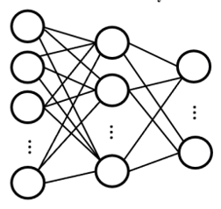
Introduction
Traditional deep learning (DL) models
The server trains the deep learning model.
Server
Training
Trained DL model
Dataset
DL

Slide 8
Introduction
Dataset
Width | Height | Weight | Label
0.2 | 0.4 | 0.6 | Apple
0.12 | 0.5 | 0.4 | Orange
……
+
weight*Input +b
Activation function
Width
Probability
0.9
height
weight
0.1

Slide 9
Introduction
Time
Computational power
Dataset

Slide 10
Federated Learning
No dataset
Central server
Training step 4
Update global gradient
Pre-training step
Training step 3
Training step 1
The server sends
Learning model architecture
Initial global gradient
Local gradients
Global gradient
dataset
dataset
dataset
Training step 2
Each client trains the model on the local dataset
Client 1
Client 2
…
Client n

Slide 11
Federated Learning vs Traditional Learning
Mitigating the central server computational load
Training on large-scale datasets
Protecting the users’ privacy

Slide 12
Examples of federated learning applications
Diagnosis model using different hospitals.
News recommendation model.
Visual target detection using data from different organizations.

Slide 13
Agenda
Federated Learning
Problem Description
Proposed Solution
My other works
Summary
Research plan
What I will contribute to Rockford University.

Slide 14
Motivation and problem description
Attackers could retrieve a client’s training dataset using the shared gradient.
Central server
Gradient
Intercepts
Training step 4
Update global gradient
Reverse engineering
Training step 3
Training step 1
Dataset
Local gradients
Global gradient
Training step 2
Each client trains the model on the local dataset
Client 1
Client 2
…
Client n

Slide 15
Motivation and problem description
Solution: Add noise to local gradients.
Central server
Training step 4
Update global gradient
Training step 3
Training step 1
Noisy Local gradients
Global gradient
Training step 2
Each client trains the model on the local dataset
Client 1
Client 2
…
Client n

Slide 16
Differential Privacy
Analyzing a dataset without revealing a single individual private information.
Example:
Dataset D
Smoking probability
ML Model
0.6
$$log\left(\frac{0.62}{0.6}\right)=0.014$$
Privacy loss evaluation
Dataset D’
ML Model
0.62
$$log\left(\frac{P(M\left(D^{′}\right)∈S)}{P(M\left(D\right)∈S)}\right)$$
Less privacy loss
$log\left(\frac{0.87}{0.6}\right)=0.1$61
Dataset D’
ML Model
0.87
More privacy loss

Slide 17
Differential Privacy
$$log\left(\frac{P(M\left(D\right)∈S)}{P(M\left(D′\right)∈S)}\right)≤ε$$
Privacy budget
The model M is $ε$- differentially private
$$P\left(M\left(D\right)∈S\right)≤e^{ε}P(M(D^{′}∈S)$$
Formal definition

Slide 18
Motivation & Problem Description
In 2022, researchers were able to recover the training dataset even if the gradient was protected using DP.
Training step 4
Update global gradient
Training step 3
Training step 1
Noisy Local gradients
Global gradient
Training step 2
Each client trains the model on the local dataset
Client 1
Client 2
…
Client n
Privacy leaks over iterations. It goes from ε to n x ε after n iteration.

Slide 19
Agenda
Introduction
Federated Learning
Problem Description
Proposed Solution
Summary

Slide 20
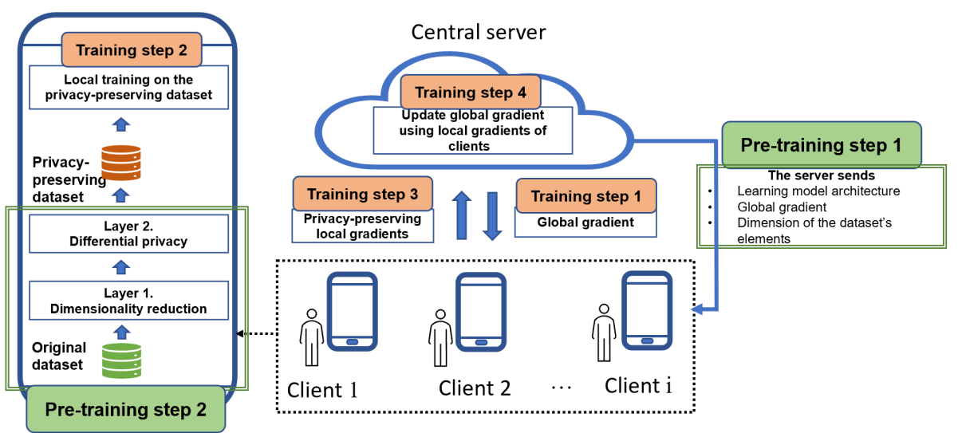
Proposed Solution

Slide 21
Layer 1. Hensel’s Compression-Based Dimensionality Reduction
We proposed a new dimensionality reduction method based on Hensel’s compression.
Reduce a dataset’s dimension without losing information.
Hensel’s Lemma

Slide 22
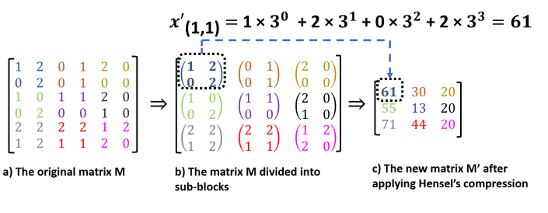
Layer 1. Hensel’s Compression-Based Dimensionality Reduction
Example of reducing the dimension of a matrix using Hensel’s compression.

Slide 23
Layer 2. Differential Privacy
Apply DP once on the compressed dataset resulting from the first layer.

Slide 24
Experiments
Developed deep learning model

Slide 25
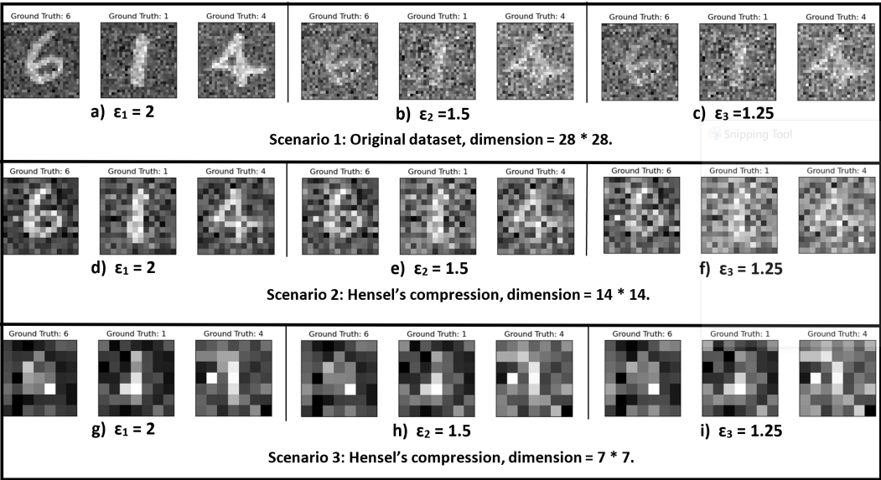
Experiments
Experiments scenarios

Slide 26
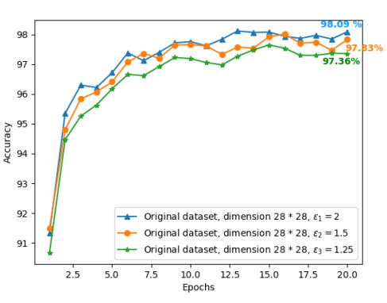
Experimental results
Scenario 1: Evaluating the impact of DP on accuracy.

Slide 27
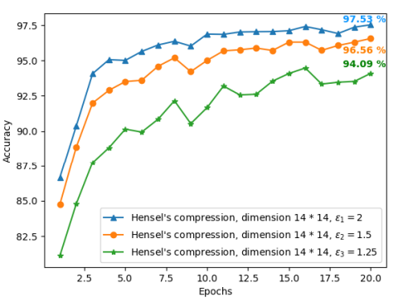
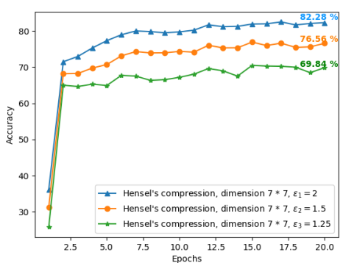
Experimental results
Scenario 2: Impact of DP and dimensionality reduction to 14∗14.
Scenario 3: Impact of DP and dimensionality reduction to 7∗7.

Slide 28
Future work
How does Hensel’s compression impact accuracy?
Could we increase the accuracy by implementing complex learning models?
What is the trade-off between privacy protection and accuracy?

Slide 29
Agenda
Introduction
Federated Learning
Problem Description
Proposed Solution
Summary

Slide 30
Summary
Machine Learning and Deep Learning
Federated Learning
Privacy protection in federated learning using differential privacy.
A new dimensionality reduction method based on Hensel’s compression.

Slide 31
Questions?

