Slide 1
A Gentle Introduction to Bitcoin
Jason

Slide 2
Agenda
What is Bitcoin?
Why is Bitcoin Needed?
Bitcoin History in 5 bullets or Less
“Inventing Bitcoin”
Additional Technical Details
Interesting Take Aways

Slide 3
What Is Bitcoin?
What is Bitcoin?
What is Money?
What is Value?
Notes:
We now have a peer-to-peer consensus network and no longer require a middle-man
Will need to solve the Byzantine Generals Problem, solving for consensus between parties where some are dishonest or unreliable, needed to be solved.

Slide 4
What Is Value?
Value is a measure of the benefit or importance that an item or service has in the context of fulfilling needs or wants.
Value is a function of Time. The ultimate scarce resource and universal equalizer.
Simplest way to exchange value is to exchange valuable goods.
Known as Direct Exchange, ie Bartering.
Bartering, alone, does not survive the problem of Coincidence of Wants.
What you want to obtain is offered by someone who doesn’t want what you have to offer.
I have apples and you have bananas. I want bananas but you don’t want apples. So now what?
Notes:
We now have a peer-to-peer consensus network and no longer require a middle-man
Will need to solve the Byzantine Generals Problem, solving for consensus between parties where some are dishonest or unreliable, needed to be solved.

Slide 5
Coincidence of Wants
Lack of Coincidence in:
Scales: I make shoes for a living, and you make houses. I don’t want portion of a house and you don’t want 10000 shoes.
Locations: My valuable good is the land I own in a location you don’t live or want to live.
Time Frames: I sell apples and you again sell houses. I will fight shelf life trying to accumulate enough apples.
Solution is to these problems is Indirect Exchange.
We go find Sally who sells pears.
The pears are a Medium of Exchange.
Notes:
Indirect Exchange is great as it allows people to specialize in how they create value.
Indirect Exchange obviously has a scaling problem.

Slide 6
What is Money?
Money is a good that assumes the role of a widely accepted Medium of Exchange.
The potential good will be adopted as Money is (in theory) how well it addresses the Coincidence of Wants.
The three Properties Money needs to serve:
Unit of Account … addresses Coincidence in Scales
Medium of Exchange … addresses Coincidence in Location
Store of Value … address Coincidence in Time Frames
Notes:
Salability is the potential a good will be adopted as Money.
Notice that Money is naturally adopted and emerges, not forced.

Slide 7
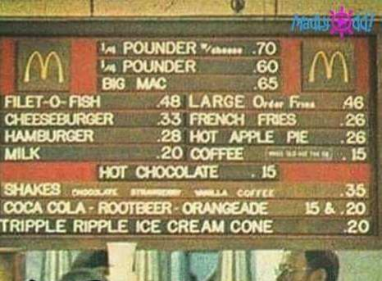
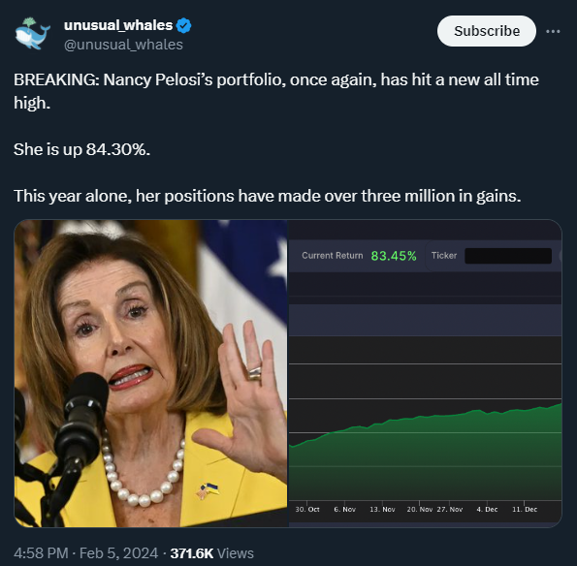
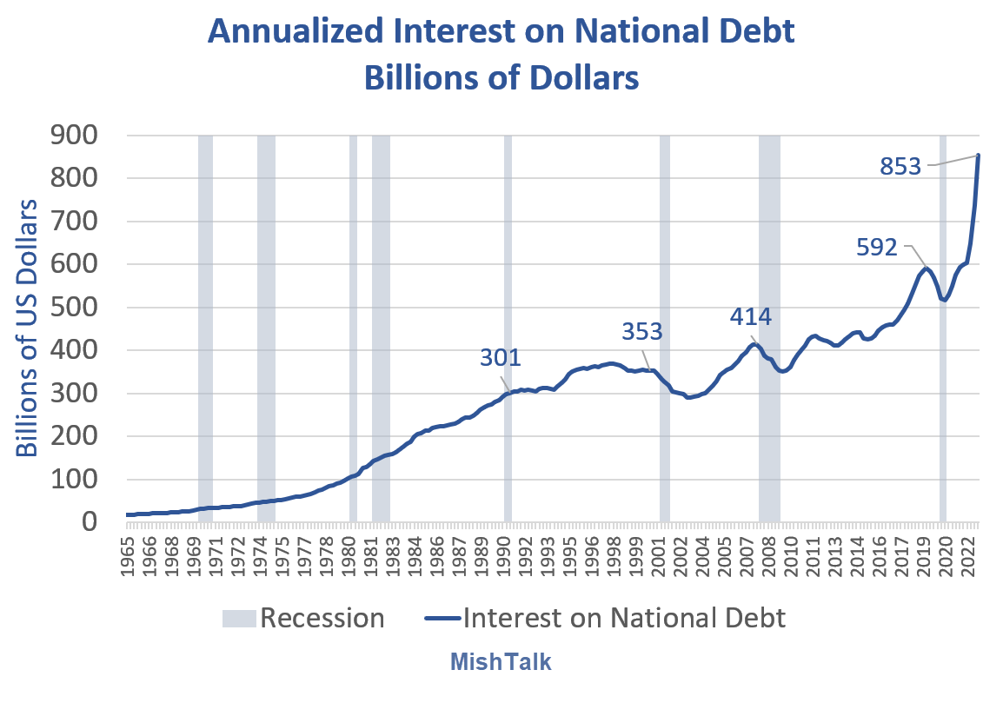
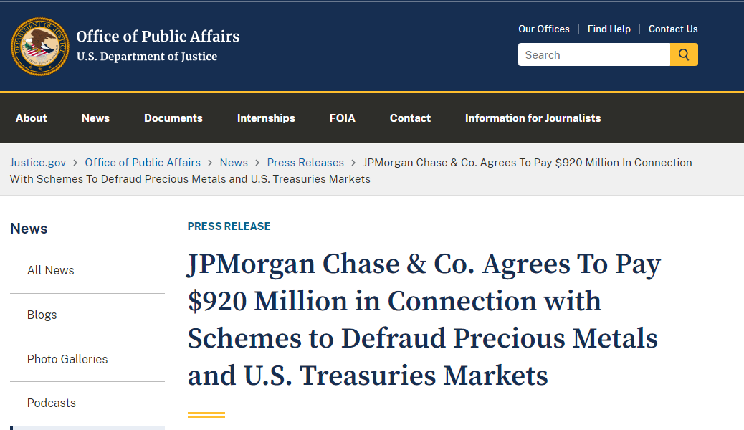
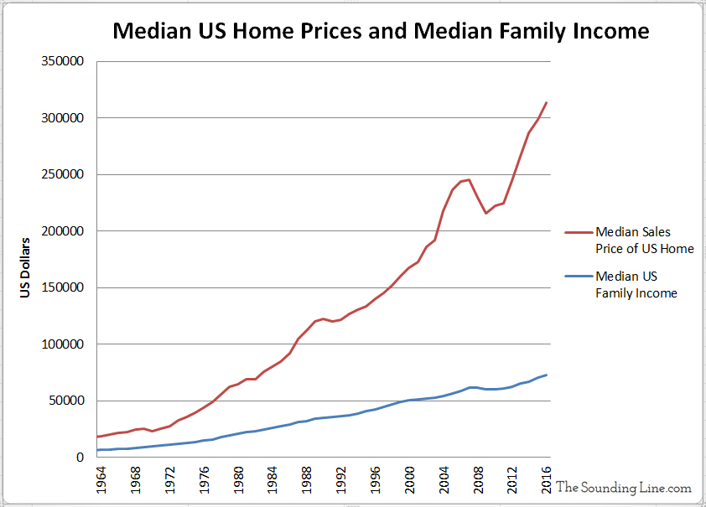
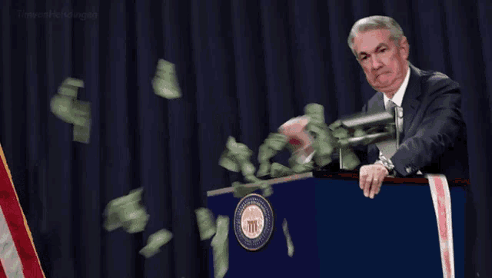
Why is Bitcoin Needed?
Notes:
So why are we talking about Bitcoin?
[Insert long commentary on the history of money Salt, Seashells, Rai Stones, Gold…]
US dollar (all Fiat currencies) fail the Store of Value requirement of money ever since leaving the gold standard in 1971.
Wealth inequality has sky rocketed
National debt interest payments have officially (last week) surpassed Defense spending

Slide 8
History of Bitcoin in 5 Bullets or Less
Early 1990s: The Cypherpunk movement, embodied in Eric Hughes' "A Cypherpunk's Manifesto" (1993), champions the use of cryptography to protect privacy and freedom, setting the stage for the development of digital currencies.
Late 1990s to Early 2000s: Pre-Bitcoin digital cash experiments like DigiCash, Hashcash, and b-money address key concepts in cryptocurrency, despite not achieving lasting success. These efforts, alongside contributions from figures like Wei Dai and Nick Szabo, contribute foundational ideas for the later development of Bitcoin.
2008: Satoshi Nakamoto releases the Bitcoin whitepaper, "Bitcoin: A Peer-to-Peer Electronic Cash System," introducing Bitcoin as the first decentralized digital currency and successfully overcoming the limitations of prior digital cash models.
2009 onwards: Bitcoin emerges as the first successful application of blockchain technology, firmly establishing itself as a pioneering cryptocurrency and realizing the Cypherpunk vision for a decentralized, privacy-focused digital currency.
2024: The SEC approves 11 Bitcoin ETFs, marking a significant milestone in Bitcoin's integration into mainstream financial systems and recognizing its legitimacy and potential as an investment asset.
Notes:
BLUF: Bitcoin has stood the test of time. Was started at the core of protecting freedom and privacy. 15 years after starting, the Security and Exchanges Commission legally approved acknowledged 11 ETFs.

Slide 9
Questions So Far?

Slide 10
Let’s “Invent Bitcoin”

Slide 11
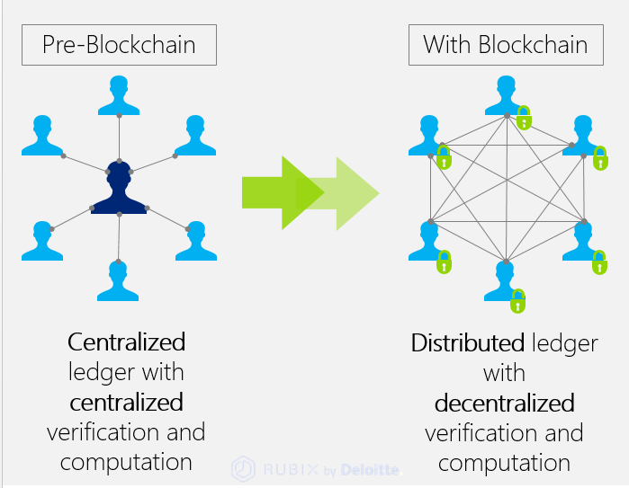
High Level - What’s the End Goal?
Remove the Middle Man.
Create Decentralized and Distributed network where everyone holds and maintains a copy of their own ledger.
Does not scale well:
Requires permission to join
Need to trust participants
Susceptible to consensus failures (like the double-spend attack) when network participants can’t discern malintent/misinformed actors.
We want to make a permissionless system, meaning anyone can join, so malintent/misinformed actors are unavoidable.
Notes:
First picture obviously isn’t entirely accurate as there are many middle men and organizations. But mostly just to represent that for me to send you money (as discussed earlier which means give you some of my value or time) I have to ask permission of my bank to ask your bank to give to you.
We now have a peer-to-peer consensus network and no longer require a middle-man.
Will need to solve the Byzantine Generals Problem, solving for consensus between parties where some are dishonest or unreliable, needed to be solved.

Slide 12
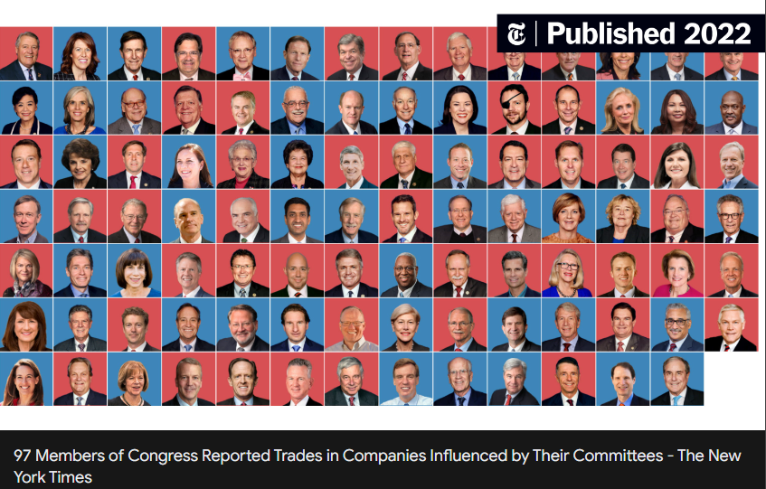
Starter Naïve Solutions
Attempt 1: Appoint some honest ledger keepers.
Open to coercion and quickly becomes centralized.
Attempt 2: Democratic voting process that periodically elects ledger keepers
Also open to coercion just with some extra steps
Both attempts failed for the same reason. Real-world Identities were used
We want a system that:
Does not use/require identity
Permissionless
Where the ledger keepers are not known in advanced.
Notes:
We now have a peer-to-peer consensus network and no longer require a middle-man
Will need to solve the Byzantine Generals Problem, solving for consensus between parties where some are dishonest or unreliable, needed to be solved.

Slide 13
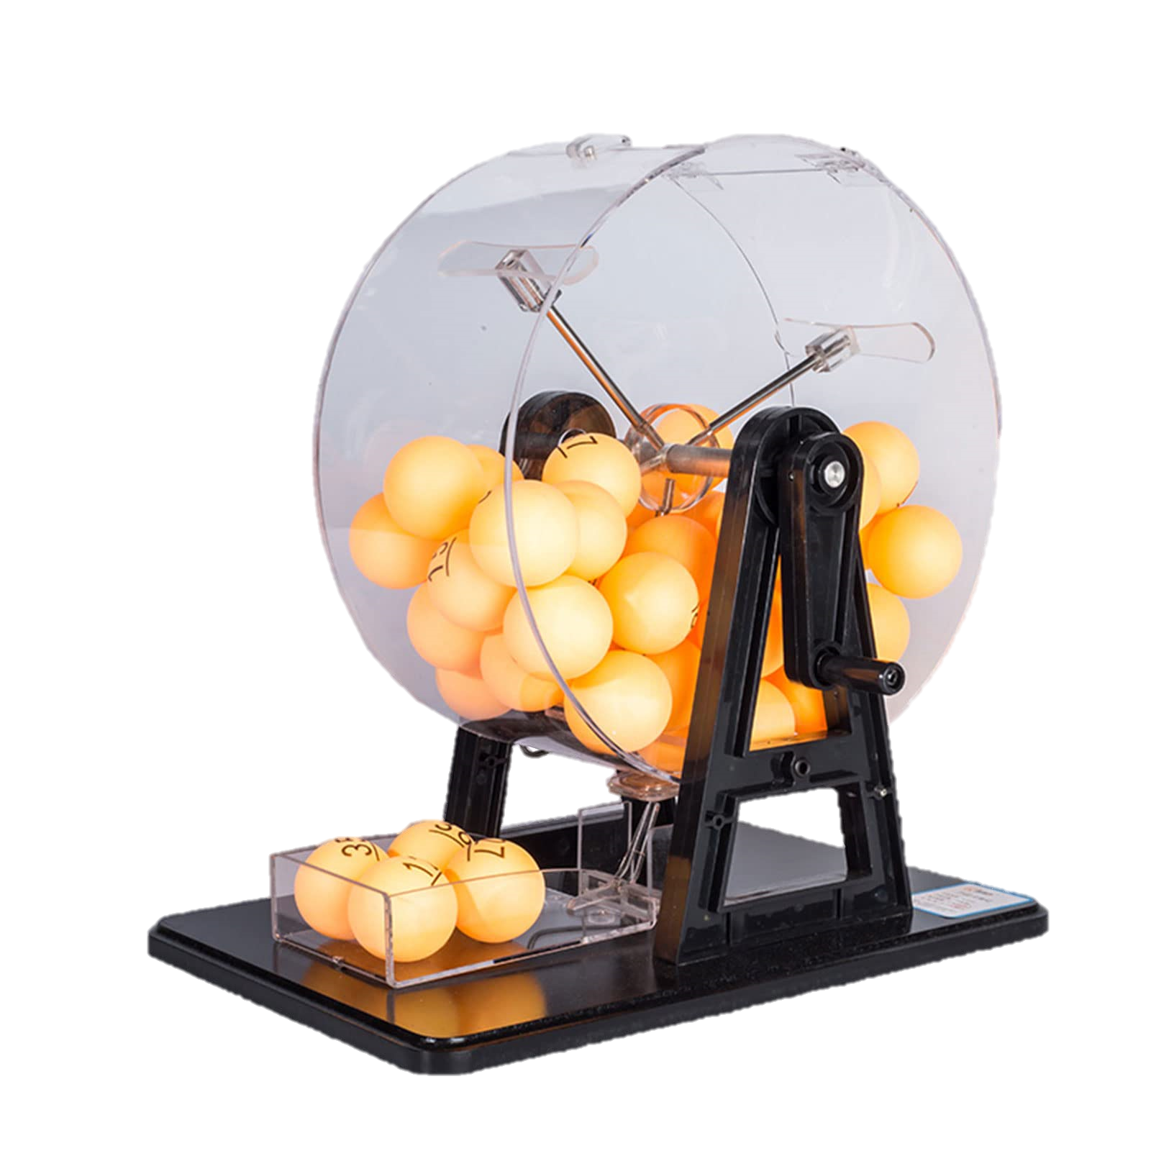
Introduce the Lottery System
Anyone is allowed to participate in this lottery.
Like before people announce their transactions and everyone listens / writes them down.
Randomly select a winner who gets to record the transactions into the ledger.
If the selected winner is honest (people can verify this) and follows all the rules, then they are paid a fee.
Everyone still maintains a copy of their own ledger and adds the transactions the lottery winner announced.
Wait a little bit so everyone can update their ledgers and repeat.
Concerns:
Who will run this lottery (sell the tickets, pick the winner)?
Why should we trust the lottery winner would act honestly?
Notes:
We have solved for Coercion.
Hard to compromise the participants because don’t know who will win the lottery.

Slide 14
Let’s Improve the Lottery System
We need to improve the lottery system to make it a Trustless, Permissionless, system:
Anybody needs to be able to generate their own lottery ticket (no central authority to sell them).
Must have cost associated with getting a lottery ticket otherwise participants would just make infinite amount.
Needs to be easy for other participants to verify/validate the winner holds the winning ticket since there is no central authority to verify.
Introducing: Proof of Work (PoW)
Notes:
Take the Middleman back out of the equation.

Slide 15
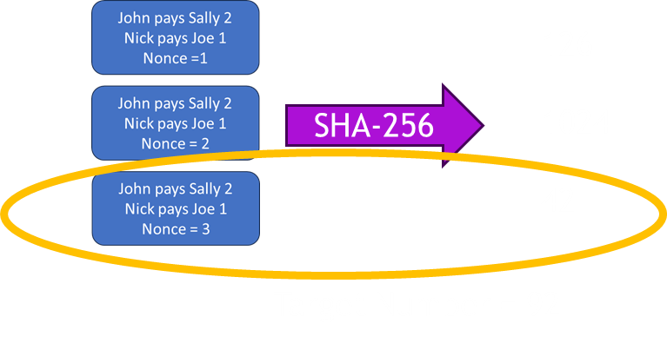
PoW Replaces the Lottery System
We will use real world Energy to introduce cost.
Users can plug into the network (lottery system)
Users will listen to all transactions and record the ones they care about along with a nonce.
Users will hash (sha256) this set to generate a “random” number.
If this number is less than a Target Number, Then they win the “Lottery”.
Winning user records on the ledger, distributes to all others, and receives a payout for their contribution.
Notes:
The set of transactions along with the nonce is also known as a “Block”.
Retained the “Randomness” which prevents coercion.
Still decentralized.

Slide 16
PoW Key Notes
Observation | So…
Anybody can generate a hash on the network | Permissionless
Generating hashes cost electricity | Real world cost, incentivize honesty
Confirming a hash is instant vs discovering the hash which takes time | PoW is Asymmetric Energy System
You can put a gone to my head and steal my ASIC’s, but you’ll still have to pay my electricity bill. | Coercion resistant
Others can verify rule sets and hash | Trustless
This Pow Lottery Game is known as “Bitcoin Mining”

Slide 17
Questions So Far?

Slide 18
Additional Details / Concepts
John pays Sally 2
Nick Pays Joe 1
Jason gets paid 1.25
Nonce = 3
How are new Bitcoins Minted?
The “winning lottery ticket” includes transaction where the User get paid out (block reward).
Bitcoin Rules
Things like “Users can’t spend more than they have” or “Only 1MB of transactions can be recorded in a block”
Block Reward and Halving
The block reward started at 50 bitcoins per block and is halved approximately every four years (~210,000 blocks). This event is known as “Halving."
Halving reduces the rate at which new bitcoins are created, introduces scarcity and deflationary properties.
21 Million Bitcoin Ever
The amount of Bitcoin produces as reward at each block is a Bitcoin “Rule” that guarantees limit.
A single Bitcoin can be broken into 100,000,000 “Satoshi’s”.
Notes:
Next halving is in 2 months

Slide 19
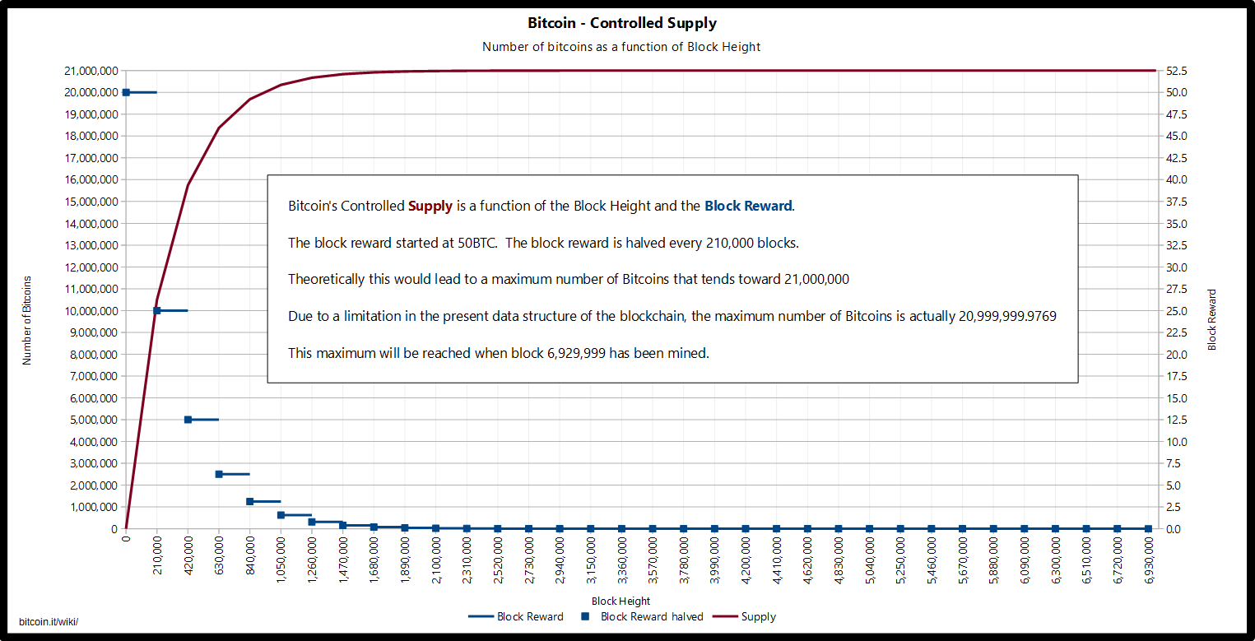
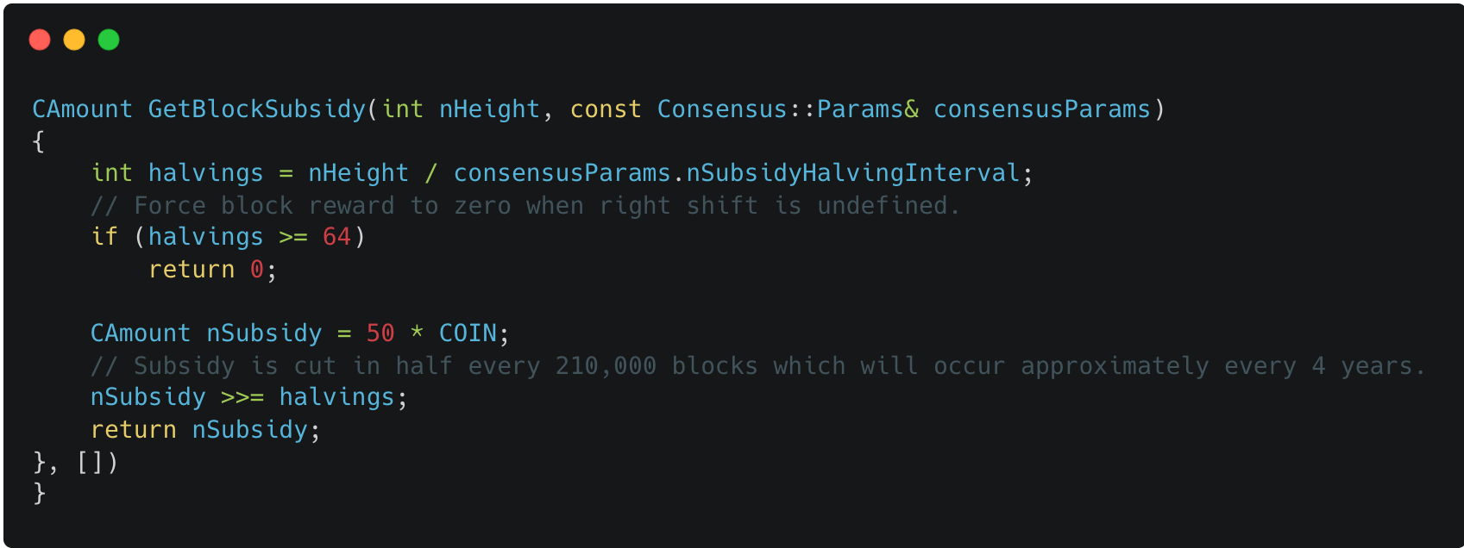
https://github.com/bitcoin/bitcoin/blob/v25.0/src/validation.cpp#L1542L1553
21 Million Guarantee

Slide 20
Additional Details / Concepts Continued
Fees and End of Block Rewards
Transaction fees are paid by users to miners to incentivize the inclusion of their transactions in the next block.
Eventually, when the block reward becomes zero after the last bitcoin is mined, transaction fees will be the only reward for mining activities.
Accounts/Wallets, Public/Private Keys, and Digital Signatures
There are no actual accounts for Bitcoin.
Users generate Private keys and their associated Public keys.
Bitcoin is nothing more than a ledger of transactions associated with Public Addresses (Generated from Public Key).
Bitcoin “Wallets” are just hardware devices for Digital Signatures associated with Private Keys.
Notes:
This adjustment ensures that the rate of block creation remains steady, regardless of the number of miners or the amount of computational power they contribute.
If more computational power joins the network, the difficulty increases; if computational power decreases, the difficulty decreases.
As the block reward decreases over time due to halving, transaction fees become an increasingly important economic incentive for miners.
The more confirmations a transaction has, the harder it becomes to reverse, because individuals would have to recreate the chain all the way back to the fake block and the future after that.

Slide 21
Recap
We now have a permissionless, trustless, decentralized, distributed, energy-consuming Network that creates Digital Scarcity.
Money is a good that assumes the role of a widely accepted Medium of Exchange.
The potential good will be adopted as Money is (in theory) how well it addresses the Coincidence of Wants.
The three Properties Money needs to serve:
Unit of Account … addresses Coincidence in Scales
Medium of Exchange … addresses Coincidence in Location
Store of Value … address Coincidence in Time Frames

Slide 22
Questions So Far?

Slide 23
Interesting Take Aways
Renewable Energy Production
Physically Secure Cyberspace (PoW specifically)
Solve the Internet Bots problem
Trapped Energy Consumers (Like Landfills)
Reuse of Heat to lower expenses on balance sheets
Water Desalination, Growing Facilities, HVAC for houses/commercial building
Instantaneous Payments
“Digital Property”
Currency of AI

Slide 24
Further Reading
The Bitcoin Standard - Saifedean Ammous
The Fiat Standard - Saifedean Ammous
The Price of Tomorrow – Jeff Booth
Inventing Bitcoin – Yan Pritzker
How to Think About the Economy – Per L. Bylund
Check Your Financial Privilege – Alex Gladstein
The Sovereign Individual – James Davidson

Slide 25
Bitcoin Mining Recap
Bitcoin mining
Anyone joins network with computer and listens for transactions.
Hear a transaction and pass it along to peers.
Starting hashing transactions heard, along with a nonce, and try to find nonce that gives output less than Target number.
Winning computer (once about every 10 minutes) announces they won and shares the details (transactions, nonce, and hash) with peers. (All this information together is called a block).
All the peers validate the supposed winning information, ensures that all the math lines up, and confirms none of the transactions break the agreed upon rules.
If everything checks out, users will append this block of information onto their existing ledgers forming what appears as a chain. Blockchain.

